Slide 2
2013 Commercial and Industrial Food Waste in the U.S.
Prepared for the Food Waste Reduction Alliance
August 2014

Slide 3
Contents
Survey objectives
Respondent profile
Survey results: Manufacturing sector
Survey results: Retail and wholesale sectors
Survey results: Restaurant sector
Conclusions

Slide 4

Survey Objectives
Survey objective was to collect primary data on:
  Food donations for human consumption
  Food waste reuse and recycling
  Food waste disposal
  Barriers to greater donation and reuse/recycling
Data was collected for the 2013 calendar year for U.S. company operations
Second time the survey was conducted; first in 2011
Cooperative effort of the Food Marketing Institute, Grocery Manufacturers Association, and National Restaurant Association, under the auspices of the Food Waste Reduction Alliance

Slide 5



Respondent Profile
Manufacturing Sector
16 survey respondents
$137B in annual sales
Represents 17.0% of total projected sales for the industry segments represented¹
Retail & Wholesale Sectors
13 survey respondents
$279B in annual sales
Represents 31.8% of total projected sales for the industry segments represented²
Restaurant Sector
27 survey respondents (13 over $20M revenue)
$74B in annual sales
Represents 15.2% of total projected sales for the industry segments represented³
¹ Based on 2011 U.S. food and beverage manufacturing revenue of US$805 billion (source: U.S. Census Bureau’s Annual Survey of Manufacturers, North American Industry Classification System Codes 311 and 3121).
² Based on 2013 U.S. grocery retail revenue of US$740 billion (source: Progressive Grocer) and 2013 U.S. grocery wholesale revenue of US$137 billion (source: IBIS World). Grocery retail excludes convenience stores.
³ Based on 2013 U.S. commercial restaurant and managed services revenue of US$486 billion (source: National Restaurant Association 2014 Restaurant Industry Forecast). This excludes bars and taverns, restaurants within hotels and retail outlets, and recreation and sports facilities, as there were no survey respondents from those segments.

Slide 6
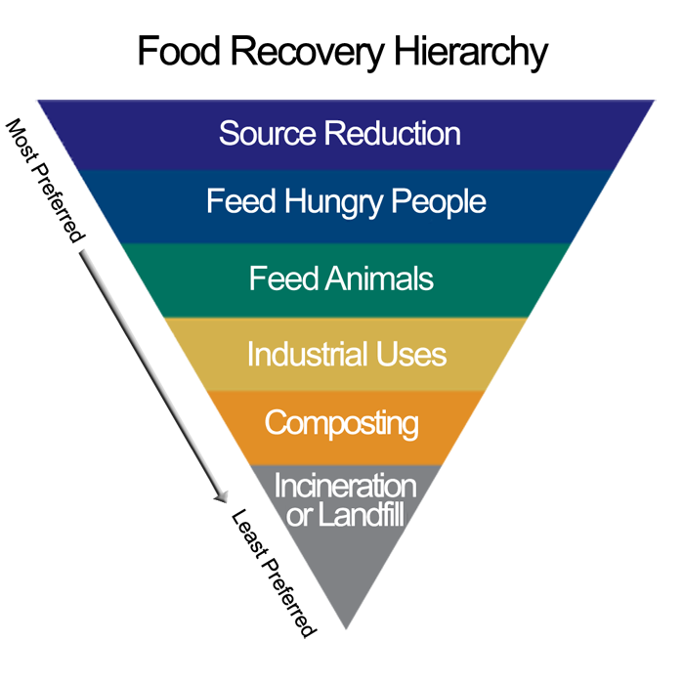
EPA Food Waste Recovery Hierarchy
The U.S. Environmental Protection Agency (EPA) has developed a hierarchy of recovery options for mitigating food waste to landfills
In the figure, reducing food waste is preferred, and the food recovery methods are listed in order of preference from top to bottom.
The hierarchy serves as an aspirational guide for efforts to minimize waste; not all waste diversion methods will be appropriate in every situation.

Slide 7
Manufacturing Sector

Slide 8
Manufacturing: Destination of Food Waste
2011 data:
Donated 1.6%
Recycled 93.0%
Disposed 5.4%

Slide 9
Manufacturing: Destination of Diverted Food Waste

Slide 10
Manufacturing: Barriers to Decreasing Food Waste
Are there barriers, either internal or external, that prevent your company from donating more unsaleable food?
  Yes: 60% No: 40%
Are there barriers, either internal or external, that prevent your company from reusing and recycling more food waste?
  Yes: 63% No: 37%
Types of barriers faced¹
Transportation constraints | 67%
Liability concerns | 67%
Regulatory constraints | 67%
Insufficient storage and refrigeration at food bank | 44%
Insufficient storage and refrigeration onsite | 33%
Types of barriers faced¹
Insufficient recycling options | 70%
Transportation constraints | 70%
Liability concerns | 50%
Food safety concerns for collection and storage | 50%
¹ among respondents who indicated that barriers are present

Slide 11
Retail & Wholesale Sectors

Slide 12
Retail/Wholesale: Destination of Food Waste

Slide 13
Retail/Wholesale: Comparison with 2011
To begin tracking year-to-year results, we identified the companies providing complete responses in both 2011 and 2013. The food waste diversion of these firms (which represent 7 percent of total projected sales for U.S. retailers and wholesalers) is shown below:
Destination of Food Waste | 2011 | 2013
Donated | 13% | 14%
Recycled | 30% | 36%
Disposed of | 57% | 50%

Slide 14
Retail/Wholesale: Destination of Diverted Food Waste

Slide 15
Retail/Wholesale: Barriers to Decreasing Food Waste
Are there barriers, either internal or external, that prevent your company from donating more unsaleable food?
  Yes: 100% No: 0%
Are there barriers, either internal or external, that prevent your company from reusing and recycling more food waste?
  Yes: 92% No: 8%
Types of barriers faced¹
Transportation constraints | 69%
Insufficient storage and refrigeration at food bank | 69%
Liability concerns | 54%
Insufficient storage and refrigeration onsite | 46%
Regulatory constraints | 15%
Types of barriers faced¹
Insufficient recycling options | 92%
Transportation constraints | 58%
Food safety concerns for collection and storage | 50%
Liability concerns | 41%
¹ among respondents who indicated that barriers are present

Slide 16
Restaurant Sector

Slide 17
Restaurants: Destination of Food Waste

Slide 18
Restaurants: Destination of Diverted Food Waste

Slide 19
Restaurants: Barriers to Decreasing Food Waste
Are there barriers, either internal or external, that prevent your company from donating more unsaleable food?
Small firms: Yes: 64% No: 36%
Large firms: Yes: 64% No: 36%
Are there barriers, either internal or external, that prevent your company from reusing and recycling more food waste?
Small firms: Yes: 54% No: 46%
Large firms: Yes: 92% No: 8%
 | Small firms¹ | Large firms¹
Transportation constraints | 78% | 78%
Insufficient storage and refrigeration onsite | 67% | 67%
Liability concerns | 67% | 56%
Regulatory constraints | 56% | 56%
Insufficient storage and refrigeration at food bank | 22% | 44%
 | Small firms¹ | Large firms¹
Insufficient recycling options | 83% | 100%
Management or building constraints | 50% | 83%
Transportation constraints | 100% | 67%
Food safety concerns for collection and storage | 33% | 50%
Liability concerns | 17% | 33%
Small companies: 1–10 locations
Large companies: more than 10 locations
¹ among respondents who indicated that barriers are present

Slide 20
Summary of Findings
Manufacturing respondents reported donating or recycling 94.9 percent of food waste; of this, more than 85 percent is repurposed for animal feed.
Retail and wholesale respondents reported donating or recycling 42.4 percent of food waste; composting and donation are the most common diversion methods.
Restaurant respondents reported donating or recycling 15.7 percent of food waste; of this, more than 70 percent is cooking oil recycling.
Retail and wholesale respondents generated the smallest volume of food waste (0.010 pounds per dollar of company revenue, compared to 0.033 pounds per dollar for restaurant respondents and 0.053 pounds per dollar for manufacturing respondents).

Slide 21
Opportunities Moving Forward
Based on the survey results, companies have opportunities to continue to reduce the amount of food waste they generate within the supply chain, as well as to identify options for directing it toward higher uses, as outlined in the EPA’s Food Recovery Hierarchy. In particular:
Food manufacturers have an opportunity to reduce the amount of food waste they generate and to move up the food waste hierarchy to increase the percentage of food that is donated.
Food retailers and wholesalers have an opportunity to divert more waste from landfills to higher uses.
Restaurants have an opportunity to divert more waste from landfills to higher uses and to reduce the amount of food waste they generate.

Slide 22
Thank you!
Elisa Niemtzow, Associate Director, eniemtzow@bsr.org
Corinna Kester, Manager, ckester@bsr.org

