Slide 1


Sustainability & Big Data
Audra Pavilcius Karalius
Sustainability Counsel at Boodell & Domanskis,
&
Katherine W. Schrank, J.D.
Founder and CEO of Sustainability Partners Inc. (SPI)
Presented at
The Global Sustainability Summit
August 15, 2014
Boston, MA

Slide 2
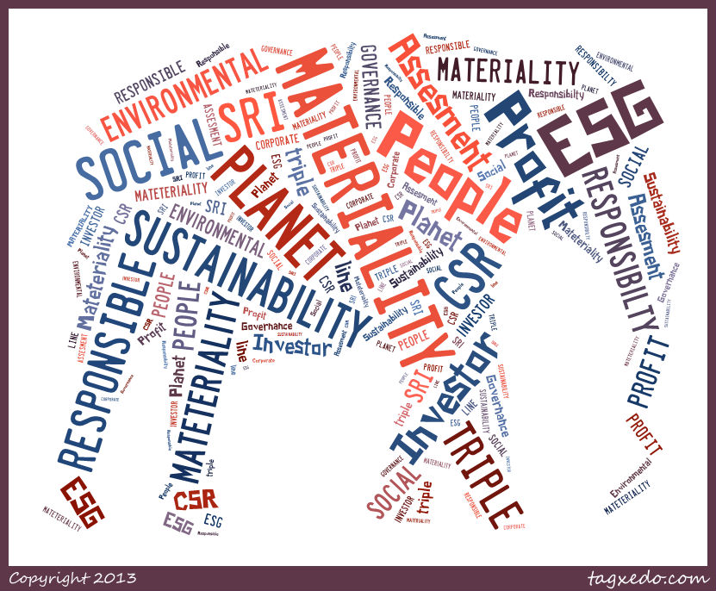
Sustainability
“...actions that meet the needs of the present without compromising the ability of the future generations to meet their own needs...”
World Commission on Environment and Development 1987 ( the Bruntland Report)

Slide 3

Big Data
Collection of huge amounts of information + sophisticated analytics = new insights, questions and opportunities
Information
  from many varied unrelated sources
  All data in varied formats
Analytics
  Differ between organizations
  Often proprietary
Learning
  How to make better predications

Slide 4

Big Data in Sustainability = Environmental, Social & Governance (ESG) Data
Companies generate ESG data to demonstrate corporate sustainability performance.
Public companies release ESG data through:
  Annual Form 10-K report
  Annual company sustainability or CSR report
Other data sources:
  CDP disclosures
  GRI reporting
  Emissions Trading Allowances
  Sustainalytics on Bloomberg
  Other data aggregators
  Disclosures to rating & ranking agencies

Slide 5
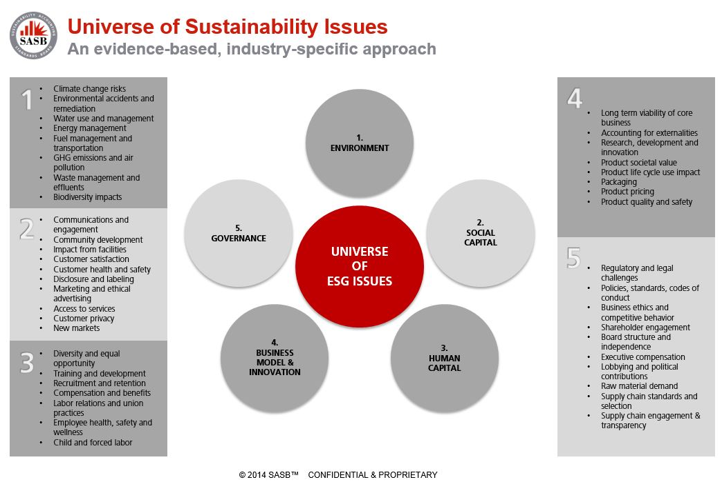
What Does ESG Data Measure?

Slide 6
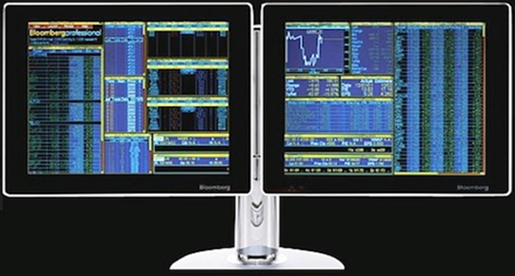
A major player in Sustainability and ESG Data is Bloomberg
Bloomberg is a Major News and Financial and ESG Data Aggregator.
320,000 subscription terminals in use around the world,
Bloomberg uploads financial and ESG data disclosed by public companies in Form 10-K and annual sustainability or corporate social responsibility (CSR) reports.
Bloomberg subscribers include investors, Fortune 500 companies, academic institutions, and public libraries around the world.
Bloomberg data is used to better predict
  Company's financial performance
  Long-term performance
  Industry performance & trends
  Company risks and opportunities along the value chain

Slide 7
800 ESG metrics tracked by Bloomberg
Environment Disclosures (up to 11 categories)
Air emissions
Water
Waste
Energy
Fines/Spills
Investments
external initiatives
Operational policy
Sector specific
Social (7 categories)
No. employees
Employee diversity
Accidents/incidents
Social cont’d
Community and customers
Operational policy
Supply chain
Training
Governance (up to 12 categories)
Board structure
Board independence
Board/executive diversity
Attendance
Auditors
Board activities
Board committee
Compensation
EXEC activities
Governance cont’d
Shareholder rights
Specific country reqs.
Executive compensation
Carbon Disclosure Project
(8 categories)
CDP score and responses
Reporting
Emissions
Emissions trading
Risks and opportunities
Emissions reduction
Governance and targets
Fuel use
Ratios/derived fields (up to 10 categories)
Bloomberg disclosure scores
Carbon/GHG intensity
Energy intensity
Resource: materials
Waste intensity
Water intensity
Community spending
Accidents/incidents
Training
Sector specific

Slide 8




Value of ESG Data
Sustainability Accounting Standards
Environmental
Social
Governance
Financial Accounting Standards
Business
Financial
Governance
Investment Value
Efficient due diligence and screening
Data for determining portfolio risk exposure
Peer-to-peer comparability of ESG risk & opportunity
Corporate Value
ESG legal and risk management tool
Cost-effective reporting
Peer benchmarks
Market-based sustainability perspective
Client Service Value
New service offerings
Powerful industry research
Thought leadership

Slide 9
ESG DISCLOSURE SCORE TREND
TOP 3 U.S. AGRIBUSINESS COMPANIES
TOP 3 U.S. AGRICULTURAL PRODUCTS COMPANIES | 2009 | 2010 | 2011 | 2012 | 2013
COMPANY A | 29 | 29 | 21 | 37 | N/A
COMPANY B | 16 | 19 | 25 | 21 | 21
COMPANY C | 18 | - | - | 19 | N/A
NOTE: ESG Disclosure Scores range between 0 (no disclosure) and 100 (full disclosure).
N/A means the data has not been released.
Do you see a momentum with any of these companies?

Slide 10
Current Environmental KPIs
Top 6 U.S. Meat, Dairy, Poultry & Fishing Companies
TOP 6 U.S. MEAT, POULTRY, DAIRY & FISHING COMPANIES | ESG Disc Score | GHG Emissions | Energy Consumption | Total Water Use | Total Waste | Investment in Operational Sustainability
COMPANY A | 44 | 767 | 1.96 | 18,171 | 0.14 | $3,400,000.00
COMPANY B | 37 | 408 | 1.10 | 6,963 | 0.21 | NA
COMPANY C | 31 | 5,200 | NA | 92,293 | NA | $1,900,000.00
COMPANY D | 13 | NA | NA | NA | NA | NA
COMPANY E | 9 | NA | NA | NA | NA | NA
What questions does this ESG benchmark raise for you?

Slide 11
Current Environmental KPIs
Top 4 Global Restaurant Companies
Top 4 Global Restaurant Companies | GHG Intensity/Sales | Water Intensity/Sales | Total Waste | Investment in Operational Sustainability
Company A | 66 | N/A | N/A | N/A
Company B | N/A | N/A | N/A | N/A
Company C | 20 | N/A | N/A | N/A
Company D | N/A | N/A | N/A | N/A
What questions do the disclosure gaps raise for you?

Slide 12
Current Social & Governance KPIs
Top 4 Global Restaurant Companies
4 Top Global Restaurant Companies | % Women Employed | % Women Mgt | % Women on Board | % Minority Employed | % Minority Mgt | Community Spend | % Indep Directors
Company A | N/A | 28 | 23 | N/A | N/A | $ 21,700,000.00 | 92
Company B | N/A | N/A | 17 | N/A | N/A | $ 12,747,000.00 | 92
Company C | N/A | N/A | 13 | N/A | N/A | N/A | 88
Company D | N/A | N/A | 17 | N/A | N/A | $ 60,000,000.00 | 75
What questions do the disclosure gaps raise for you?

Slide 13
Current Environmental KPIs
Top 7 U.S. Processed Food Companies
PROCESSED FOODS (7) | ESG Disc Score | GHG Emissions | GHG Intensity/Sales | Total Water Use | Water Intensity/Sales | Investment in Operational Sustainability
COMPANY A | 48 | 769 | 96 | 24,820 | 3,083 | $16,000,000.00
COMPANY B | 48 | 1,924 | 125 | 49,697 | 3,222 | NA
COMPANY C | 42 | 1,011 | 57 | 16,200 | 911 | NA
COMPANY D | 36 | 326 | 46 | 6,473 | 974 | NA
COMPANY E | 26 | NA | NA | NA | NA | NA
COMPANY F | 26 | NA | NA | NA | NA | NA
COMPANY G | 19 | NA | NA | NA | NA | NA
What questions does this ESG benchmark raise for you?

Slide 14
Current Environmental KPIs
Top 4 U.S. Household Products Food Companies
Household Products (13 securities) | ESG Disc Score | Total GHG Emissions | GHG Scope 3 | Tot Water Use | Water Intensity/Sales
COMPANY A | 71 | 671 | 511 | 8,775 | 504
COMPANY B | 57 | 5,101 | NA | 93,000 | 4,397
COMPANY C | 48 | 1,953 | NA | 43,490 | 659
COMPANY D | 45 | 5,700 | NA | 74,300 | 883
What questions does this ESG benchmark raise for you?

Slide 15
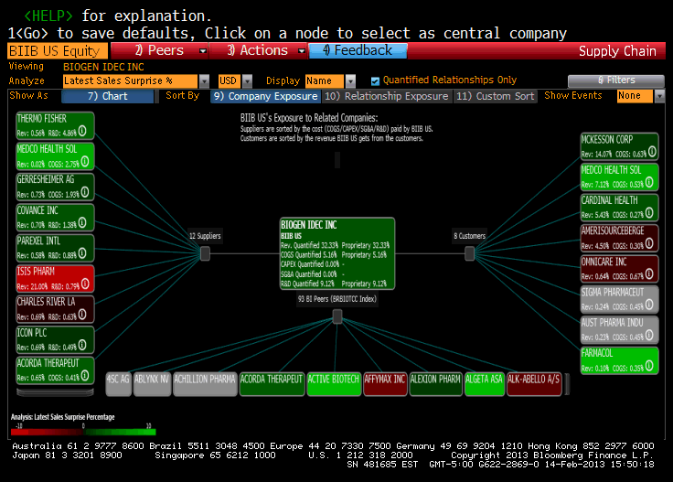
ESG Data for Your Value Chain Data from your point of view

Slide 16
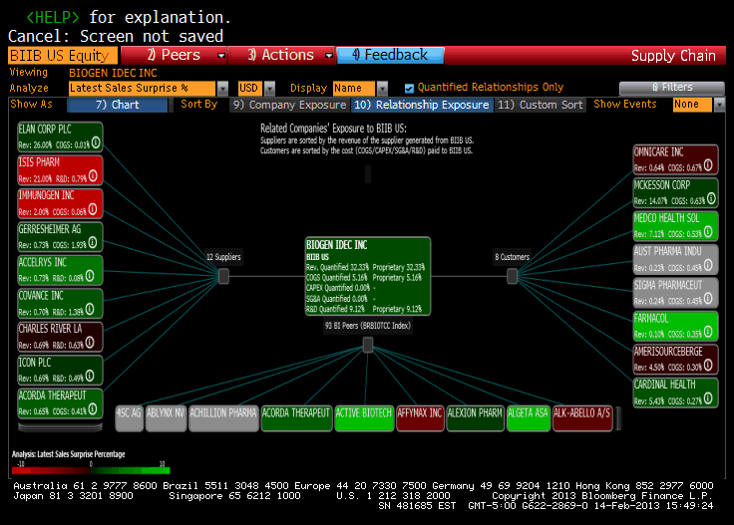
ESG Data For Your Value Chain from your stakeholders’ perspective

Slide 17

Looking at these charts of data
We see there is a lot of data, but it’s a basket of fruit
Consider what the data means
  Are you actually making progress in becoming more sustainable?
  How can this data help you tie your sustainability efforts to your corporate strategic marketing and customer preferences?
  How does this data affect your financial performance?

Slide 18
So what does the company sustainability/CSR leader do with this information?
Validate that the data is correct
Correct any incorrect data
Consider filling in the data gaps if needed

Slide 19
What action should you take as a result of the insights gained from ESG data?
Consider how your supply or value chain affects the data
Consider how you affect your customers’ value chains
Consider how this data makes you look to your stakeholders
Consider what information you want or need to become more sustainable?

Slide 20
Numbers may speak for themselves
But ……..
Data is subject to “biased” interpretation
Data can lead to incomplete or partially correct conclusions
Data, especially big data, can blur the distinction between correlation and causation
Data does not unambiguously tell us if a company’s sustainability efforts are succeeding
How do we get data to take reflect the complex reality in which we operate?

Slide 21
Conversations & stories hold the key
A good sustainability story grounded in data, can
Inspire your stakeholders with your compelling sustainable future vision.
Communicate what’s really behind the numbers
Present the “uncountable” such as ethics, values, culture, fairness, trust, community
Explain the “why” which may not be obvious from the numbers
As sustainability/ CSR leaders it is our job to use the big data to craft a more compelling sustainability conversation

Slide 22
“Everything that can be counted does not necessarily count:
everything that counts cannot necessarily be counted.”
Albert Einstein

Slide 23
Thank you & let’s continue the conversation!
Katherine W. Schrank, J.D
IEMA Certified Sustainability Practitioner
Sustainability Partners, Inc.
630-363-1133
kate@sustainabilitypartnersinc.com
Twitter: @SustainPartners
Audra Pavilcius Karalius
Boodell & Domanskis, LLC
353 North Clark Street
Suite 1800
Chicago, Illinois 60654
Direct: 312-219-8540
akaralius@boodlaw.com

