Slide 1

Making the Business Case for Sustainability

Slide 2
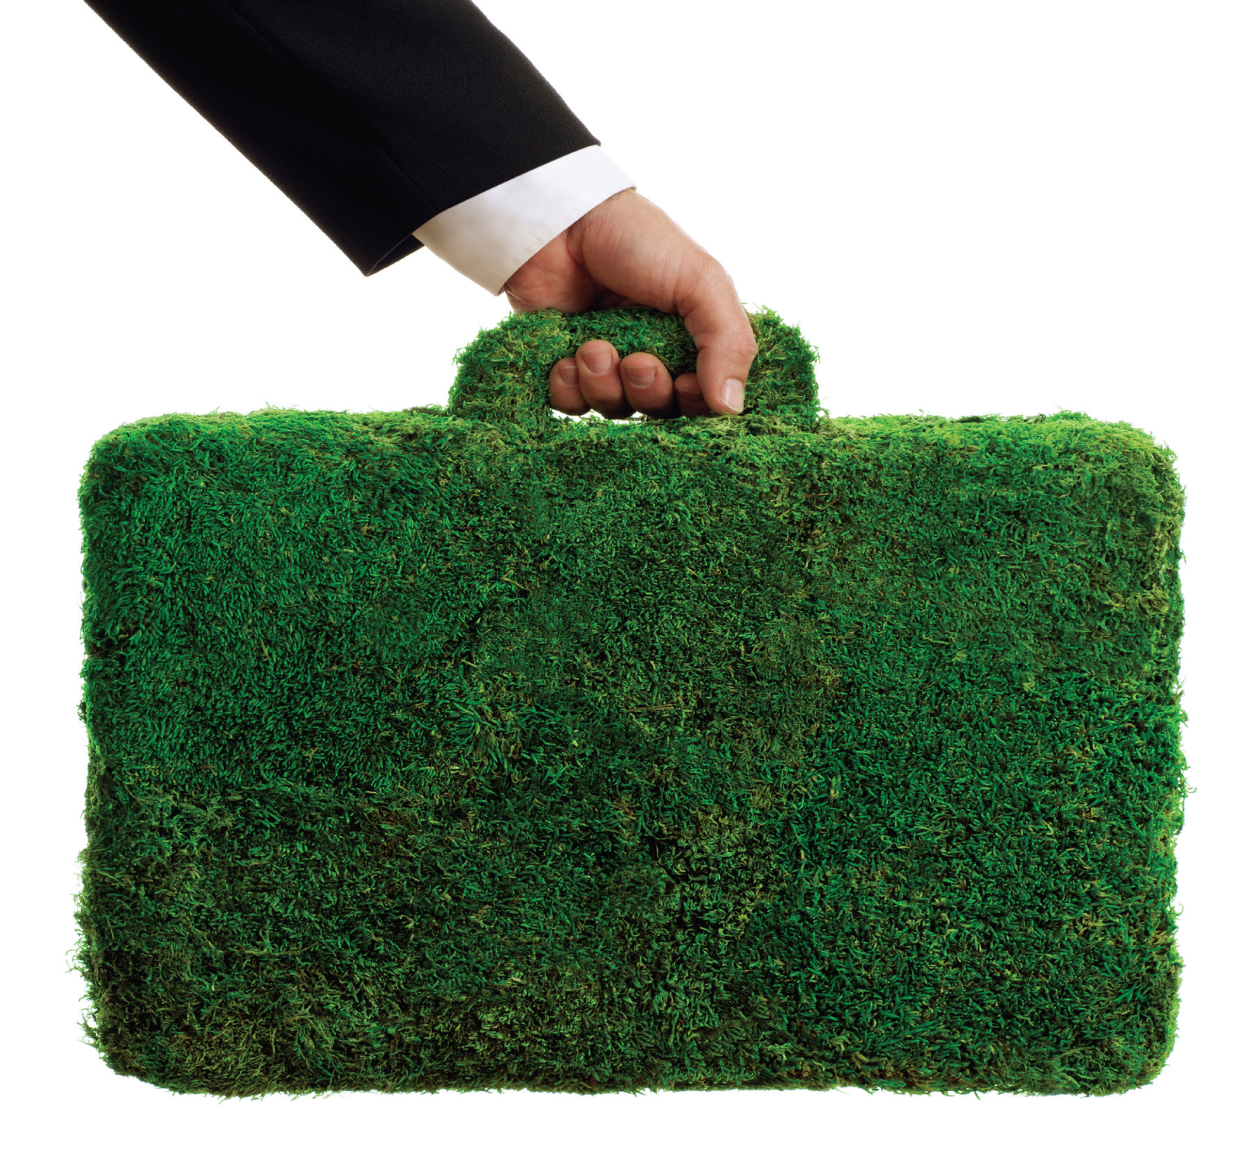
MAKING THE
BUSINESS CASE
FOR SUSTAINABILITY
A GUIDE FOR
PRACTITIONERS

Slide 3

Your Presenters
Sonya Fiorini – Senior Director, Loblaw Companies Limited
Nate Shepley Streed – Sustainability Manager, Corporate Brands, The Kroger Company
Mike A. Smith – Assistant Vice President, Real Estate and Sustainability, Hy-Vee, Inc.
Patti Olenick – Sustainability Manager, Weis Markets, Inc.

Slide 4
You’ve Seen The Headlines
Wegmans installs solar at
organic farm
IKEA to install record number of Solar Arrays
Walmart Plans Huge Global LED Lighting Program
Coke Builds Green Beverage Plant in China
Ocean Spray, Tropicana Team Up to Reduce Shipping Emissions

Slide 5
Why
A business case in traditional terms is well known: what is the financial impact of a given
strategy or initiative?
the business case is not just about increasing profit but increasing profit while conserving the planet and enhancing communities.
it can also provide greater
benefits, not just on direct financial returns but brand
enhancement, employee recruitment and retention,
and a more secure supply chain

Slide 6
The BC Guide is organized by these three key steps: Its as easy as 1.2.3!
Step 1. Lay the Groundwork
Step 2. Develop the Content
Step 3. Build Support & Buy-In

Slide 7

STEP 1:
LAY THE GROUNDWORK
Conduct an assessment
Close the Gaps
Outline a plan for Success

Slide 8
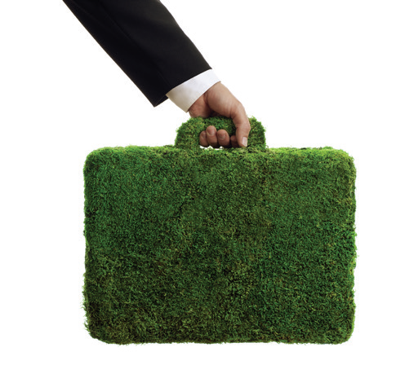
STEP 2:
DEVELOP THE CONTENT
Establish a clear vision
Conduct a Business Analysis
Define Urgency
Identify simple requests

Slide 9

STEP 3:
BUILD SUPPORT AND BUY-IN
Understand the Audience perspective
Deliver effectively
Refine and Persist – Make it Better!

Slide 10

Food Power
Goal: Divert food waste by creating on-site renewable energy
Kroger employs more than 375,000 associates who serve customers in 2,640 stores in 34 states and the District of Columbia under two dozen local banner names including: Fred Meyer, Dillons, Fry’s, Harris Teeter, Ralphs, King Soopers, and QFC. Food waste is highly material to our business and our key objective was to repurpose this value stream to reduce our operating expenses by creating on-site renewable energy.
Lay the groundwork | Assess current situation: Food that could not be sold or donated was backhauled to DC, aggregated, and sent to a composter 6X/day = 1,200 miles of diesel truck traffic Waste management expense
Develop the content | Could we find a higher order of value for our food waste and reduce other operating expenses along the way? Partnered with 3rd Party Food Waste Expert: FEED Resource Recovery Inc. worked closely with associates at store, DC, and plant level to ensure consistent communication and streamline new process Baseline our energy, natural gas, and waste water expenses for on-site facilities Could new process reduce these expenses? What’s the ROI?
Build support and buy-in | New process promoted by each affected business unit Engagement at all levels: Company and Division-level leadership support as well as store, DC, and plant associates Tracked progress and shared success: provided periodic updates about the system and the collective environmental and financial benefits it was having in our Ralphs/Food4Less Division
Environmental benefits: kept organics out of landfills; eliminated 500,000 miles of transportation emissions associated with sending organics to composter; eliminated greenhouse gas emissions associated with composting; produced nutrient-rich organic fertilizer
Financial benefits: reduced natural gas consumption by 95%, produced more than 20% of the energy demand for our 650,000 sq. ft. DC, eliminated the costs of sending the effluent from our Compton Creamery to the sanitary sewer
For more information please contact Suzanne Lindsay-Walker at suzanne.lindsay-walker@kroger.com

Slide 11
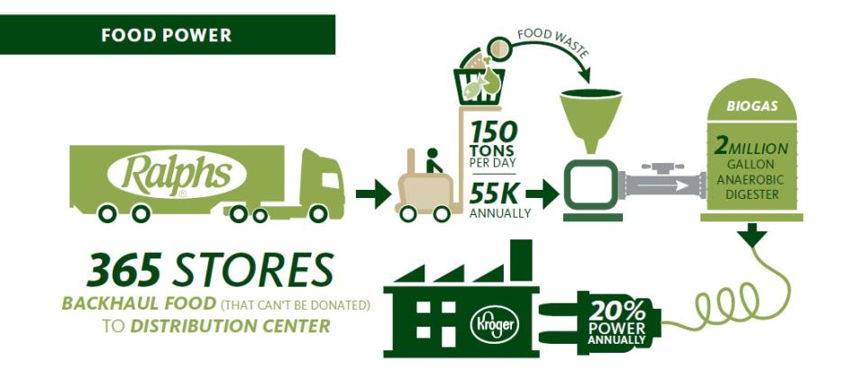

Slide 12

Waste Diversion
Goal: Reduce Plastic Shopping Bag Use
Loblaw Companies Limited is Canada’s largest food and pharmacy retailer Diverting waste from landfill is one of our key CSR priorities. Although much of our focus is on putting waste to productive use, our efforts actually begin with source reduction – looking for ways to reduce waste from happening at all.
Lay the groundwork | In April 2007, Loblaw committed to the goal of diverting one billion plastic bags from landfill as a means of helping minimize the waste we produce and inspiring Canadians to take action for the environment. To bring about real change and promote reusable bag practices, we then took the big step of charging for plastic bags. As of April 22, 2009, Loblaw corporate and participating franchise stores stopped providing complimentary plastic shopping bags at checkout. Instead, customers were asked to bring their own PC G.R.E.E.N or other reusable shopping bags or bins to the store or to buy plastic bags at five cents apiece. In 2009 alone, these actions led to a 55% reduction in the use of plastic bags coming from our stores. As of Dec 2013, more than 6 billion fewer plastic bags in existence since 2008
Develop the content | Before making this change, we tested various approaches to identify best practices in reducing plastic shopping bag use. Our data revealed that stores that had been charging a nominal fee for plastic bags distributed almost 55% fewer bags than those stores providing plastic shopping bags for free.
Build support and buy-in | To further encourage Canadians to demonstrate their support for the environment, Loblaw committed to providing 1 Million dollars a year from the partial proceeds from the sale of plastic bags to WWF-Canada. Over the past six years, we have donated 6 million to WWF. The money supports their national programs to help Canadians reduce their daily environmental footprint through simple, planet-friendly actions
As our plastic bag reduction initiative demonstrates, these actions on environmental issues can alter behaviour by our customers and throughout our industry.
Notes:
008

Slide 13
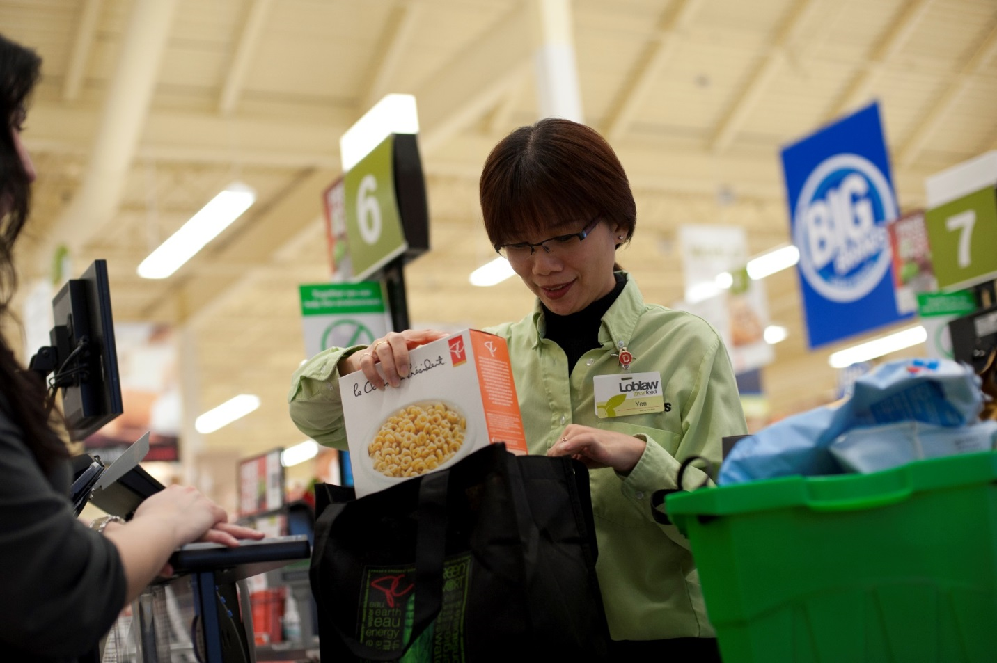
Loblaws:
6 Billion Bags and Counting…

Slide 14
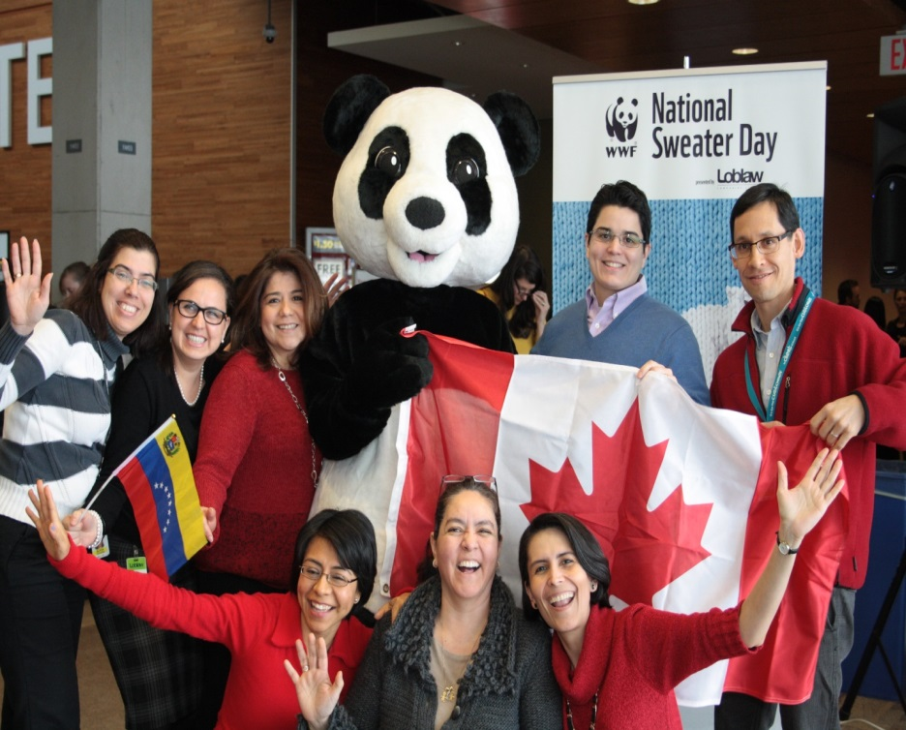
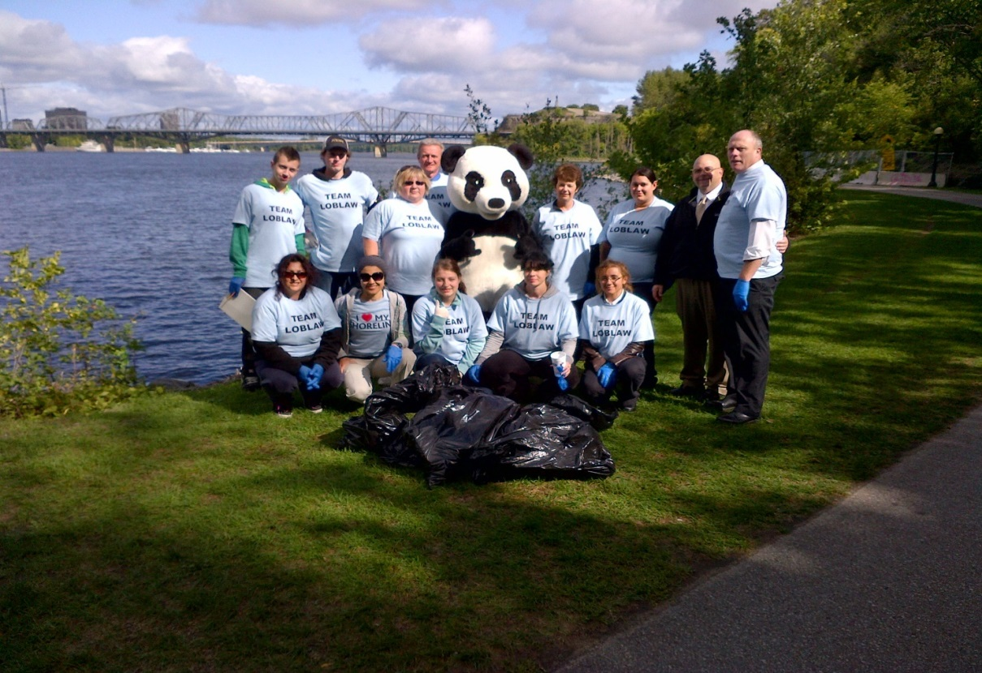

Loblaws: Great Canadian Shoreline Cleanup and
National Sweater Day

Slide 15

Community Gardens
Goal: Support development of local community gardens.
Employee-owned Hy-Vee ranks among the top 25 supermarket chains and 50 private companies in the United States, with 237 retail stores across eight Midwestern states. Community gardens promote healthy living and encourage local food production, which are key organizational objectives. Efforts in sustainability and helping others lead healthy lives are integrally linked, like branches of the same tree. For information on our healthy living and sustainability efforts, visit www.hy-vee360.com.
Lay the groundwork | Dietitians saw community gardens as a way for stores to support local families and educate youth and adults on gardening and the advantages of fresh produce Identified land adjacent to stores and dietitians/store employees to provide support and education Identified local non-profits and businesses interested in partnering in effort Program helps build brand awareness and loyalty within community
Develop the content | Determined the types of gardens needed and the resources required Developed resources and programming for multiple formats (Sprouts, community/Hy-Vee staff supported) Worked with local non-profits to connect students, families and immigrant communities with community gardens Structured effort as a part of Hy-Vee’s healthy living and sustainability efforts
Build support and buy-in | Worked with local businesses to donate gardening supplies Provide information to public on efforts both at store level and as a part of Hy-Vee360 (www.hy-vee360.com) Developed One-Step Community Garden Grant as a part of One-Step product line (One-Step Potatoes) Program continues to grow and evolve with input from local community Hy-Vee recognized for promoting health and local growing in its communities
Community gardens help people lead more healthy lives, promote local food production, provide a sustainable alternative for consumers, and provide a healthy alternative to those in need.

Slide 16
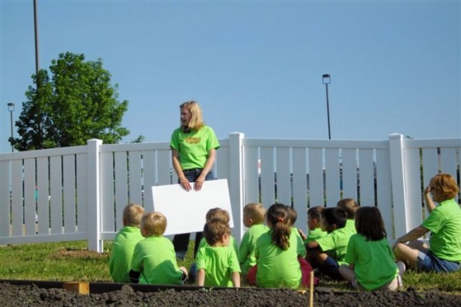


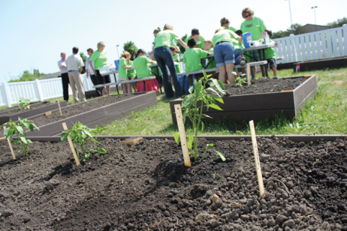
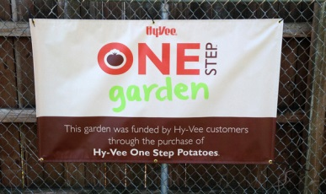
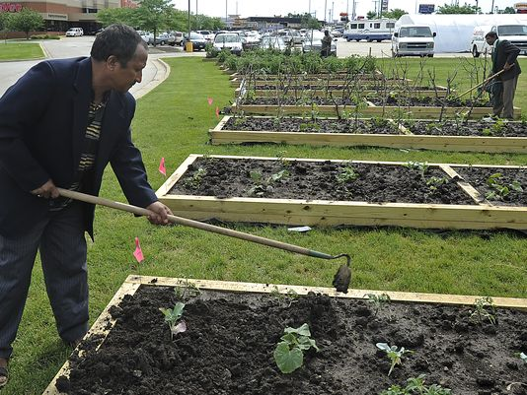
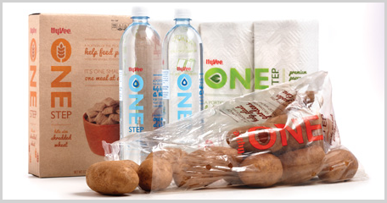
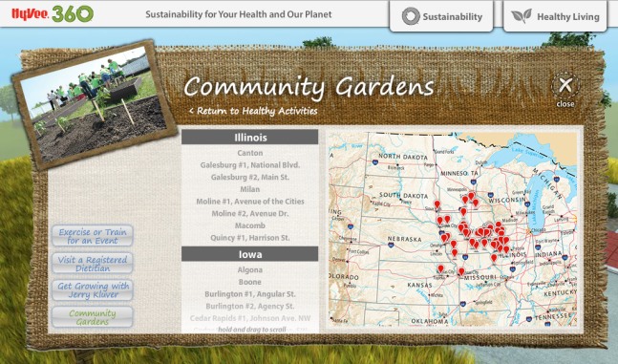
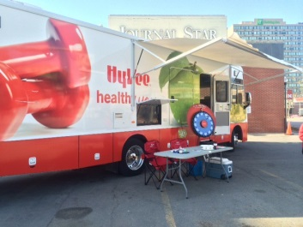
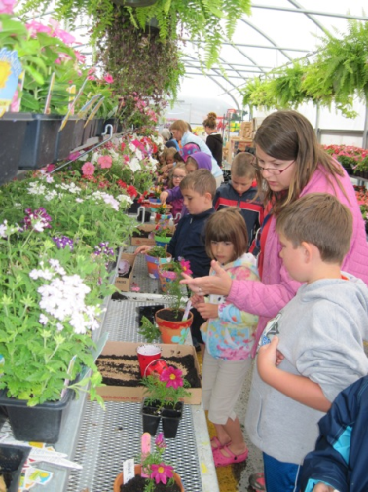
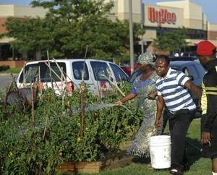
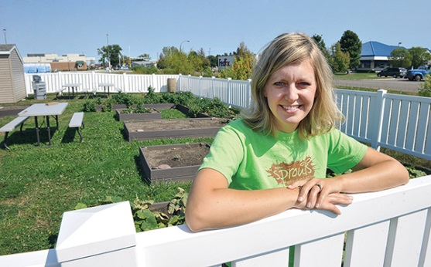
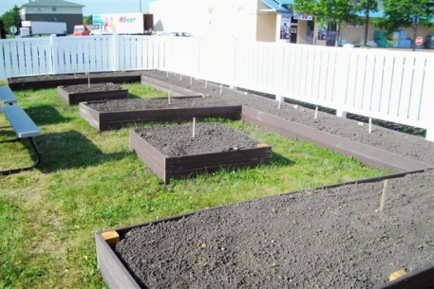
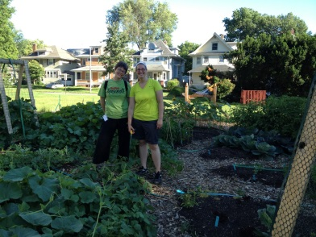
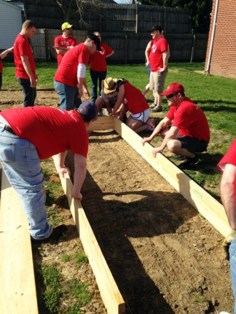
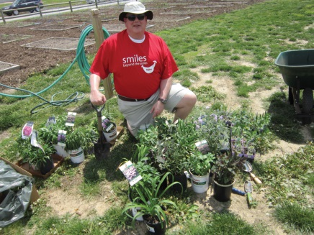

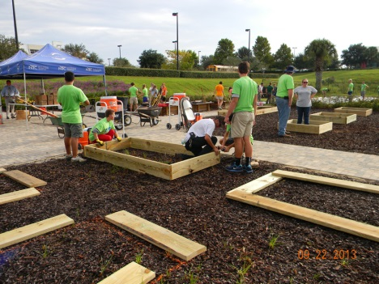
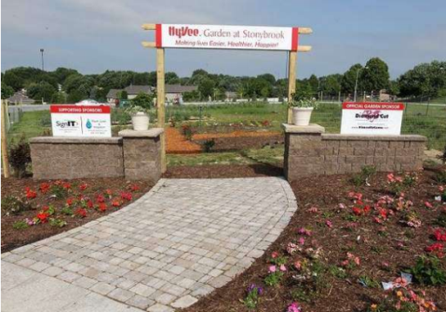
One-Step Community Gardens

Slide 17
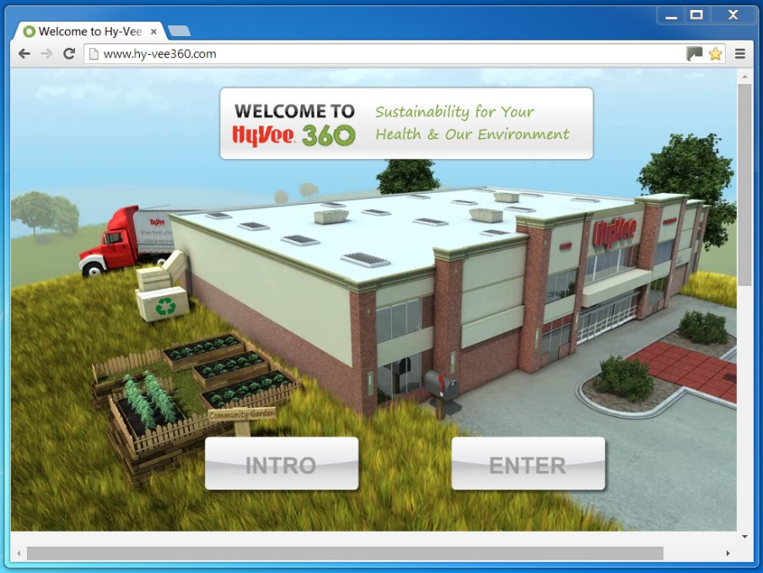
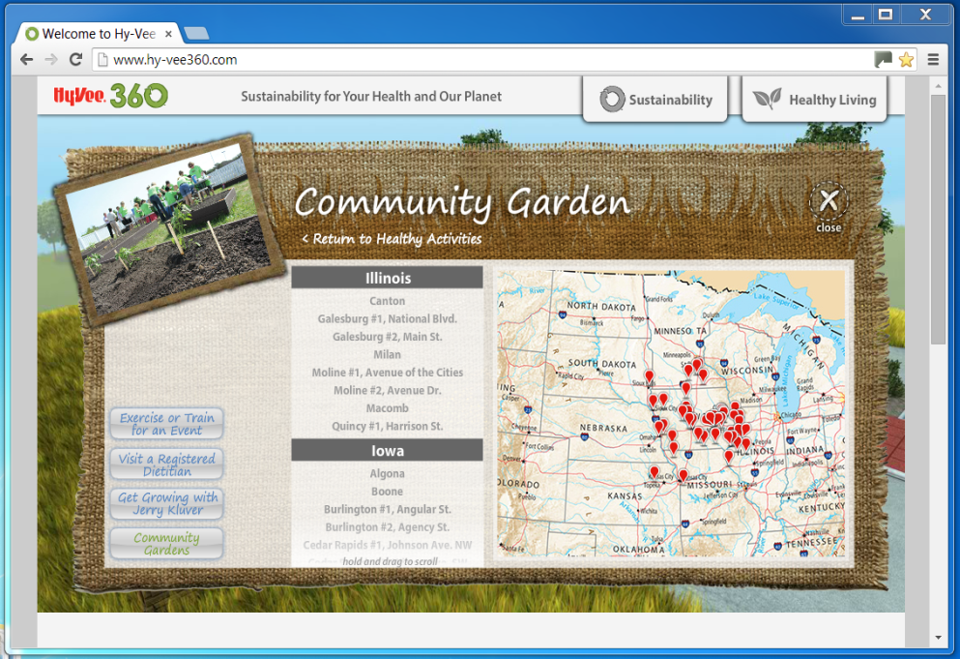
To Keep Up With Our Efforts
Go To: www.hy-vee360.com

Slide 18
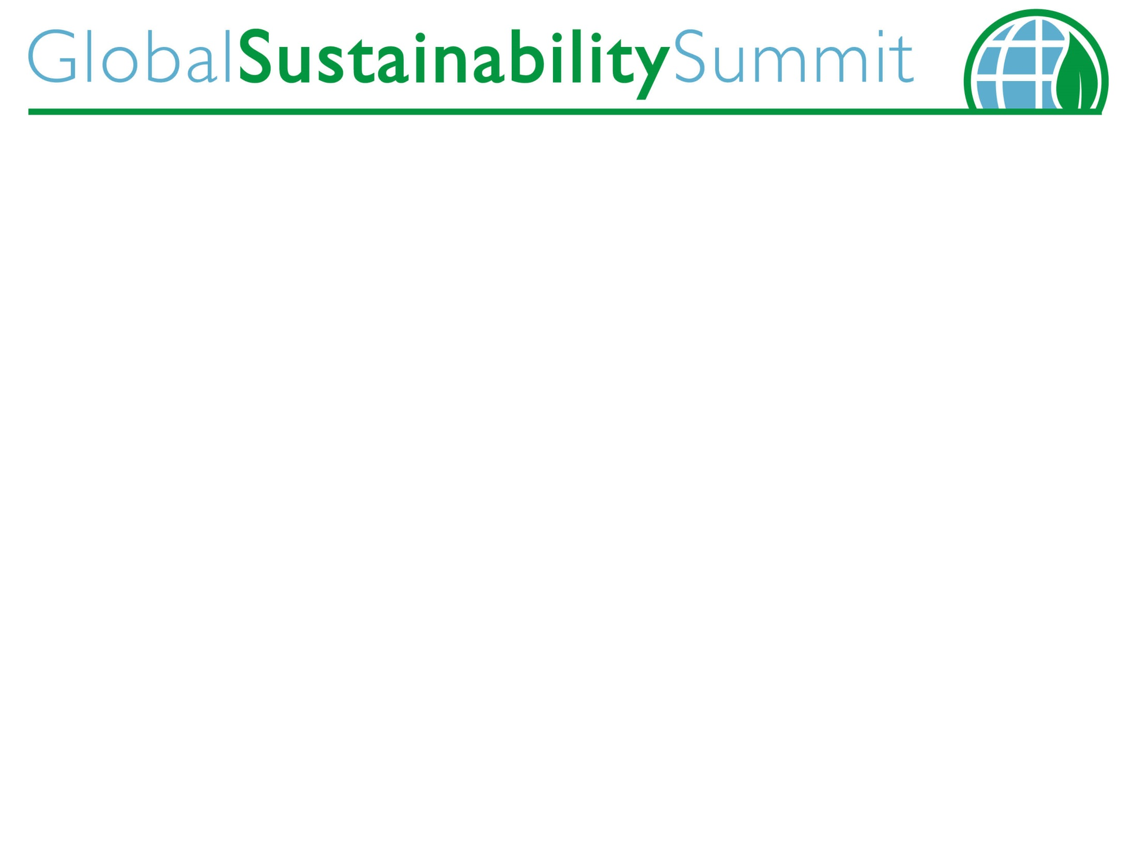
What’s Your Story?
What’s Your Story?
Follow the FMI Sustainability Toolkit for Practitioners

