Slide 1

Food Hubs: Solving Local
John Fisk, Wallace Center at
Winrock International

Slide 2

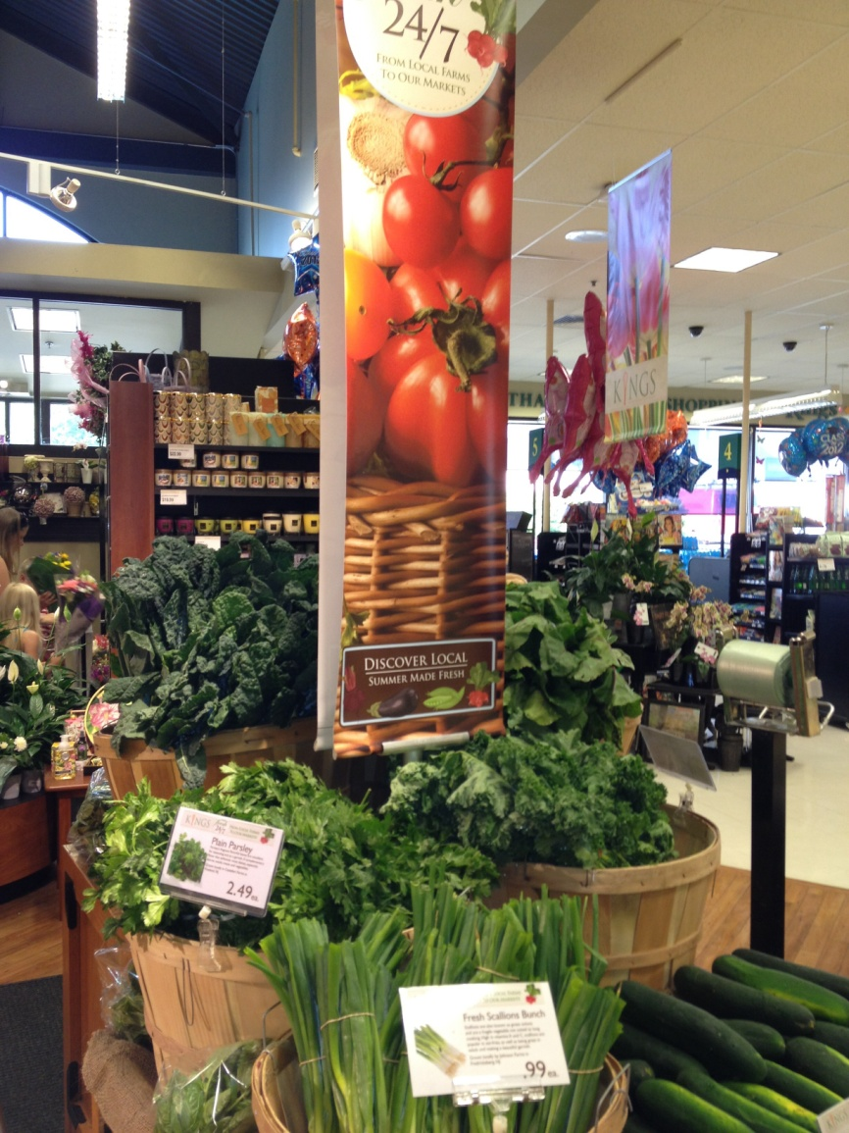
24/7 Program
Same-day local produce
Kings Food Markets (NJ, CT)
Red Tomato
Righteous Produce
Develops marketing, packaging, and branded programs.
Manages all supply chain logistics.
Sources from a network of growers it has built since 1996 in the Northeast.
Notes:
Attention getting story
Use Case study to explain ... Here for reference
24/7 PROGRAM INSPIRES REGIONAL CHAIN
Same-day local produce was an untested concept. But Paul Kneeland decided to give it a try. Kneeland is vice president of produce, floral, seafood and meat for Parsippany, N.J.-based Kings Food Markets. In 2012, he piloted the 24/7 program with its developer — the regional food hub Red Tomato.
Soon his phone started ringing: “I’d never before gotten unsolicited compliments from produce managers.”
Within weeks Kings expanded the four-store pilot to all 25 of its northern New Jersey stores. By Labor Day, 2012, the 24/7 program accounted for 10 percent of Kings’ produce sales over 12 weeks.
Thirty New Jersey growers delivered more than 50 products to their farmer-owned Landisville Cooperative for cooling, packing, and labeling. Red Tomato’s third-party logistics firm hauled pallets to Kings’ distribution center for store delivery.
In 2013 Red Tomato replicated this system for the Kings’-owned Balducci’s Food Lovers Market stores in four Connecticut locations. Between 2012 and 2013, total 24/7 sales increased from $165,882 to $292.609.
The program has been a public relations homerun and an employee motivator.
Last summer, a busload of Kings employees visited the New Jersey farm that supplies the majority of leafy greens. “A lot of produce managers had never seen a vegetable farm,” grower Ryan Ploch says. “They seemed excited about going back and telling customers ‘I know where this stuff came from.’ ”
Red Tomato’s 24/7 program is one example of its sourcing and marketing initiatives, which all begin with on-farm research.
”I’ve never seen a company like Red Tomato,” says Felix Danato, manager of the century-old Landisville Cooperative. “They first came here years ago to learn about peak growing seasons and get a handle on our items. They created grower profiles and visible labels so consumers can recognize where the product comes from. Now we’re all looking for ways to grow the volume.”
BUSINESS BASICS
Non Profit
2013
$3.8 million in sales
7 employees
Supply Base
Coordinates the sale and marketing of fresh fruits and vegetables (308 SKUs in 2013).
Offers produce from early to late in the season through an 80-farm network that stretches from New England to New Jersey.
Customer Base
Supplies 22 retail chains and distributor customers in 14 states.
In 2013, 80% of product went to retailers and 20% to distributors serving a mix of retail and food service accounts.
Supply Chain Approach
Develops marketing, packaging, and branded programs to build farm identity and differentiated products.
Manages all supply chain logistics to move produce through relationships with more than a dozen distributors and a network of third-party carriers.

Slide 3
Food hubs are building go-to-market strategies with retailers and food service companies that are willing to innovate in order to build local food supply and credibility.
These new intermediaries are delivering:
Consistency and safety the market demands.
Local food with the attributes consumers want.
Notes:
TRANSITION
Red Tomato and 24/7 is one of several case studies re. retailers and food service companies teaming up with regional food hubs to differentiate themselves with local food programs and satisfy strong consumer demand
MAIN IDEA
Food hubs are building go-to-market strategies with retailers and food service companies that are willing to innovate.
These new intermediaries are delivering:
Consistency and safety the market demands
Local food with the attributes consumers want.
Don’t forget to hit Credibility, which belongs up here (after main idea, before preview)
CREDIBILITY - Introduce Wallace and NGFN work in this arena
Our mission is to facilitate market-based approaches to a more sustainable food and farm sector. In 2008 we launched the National Good Food Network, a learning network of regional food entrepreneurs and initiatives. With network partners, we’ve been digging into the new business models shaping this sector.
PREVIEW your presentation
Food Hub Background
Wholesale value
Next scaling up innovations (re. frontier of hub to hub networks)

Slide 4
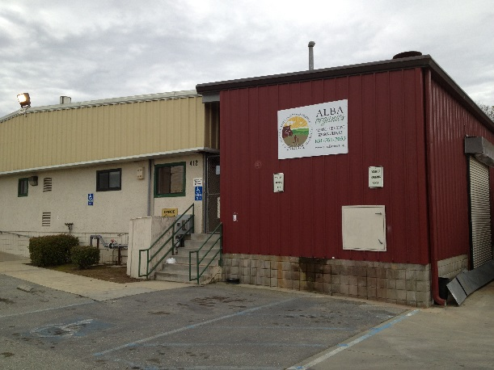
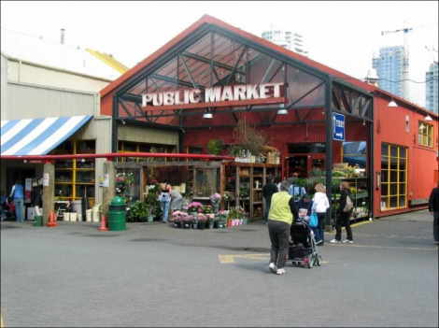
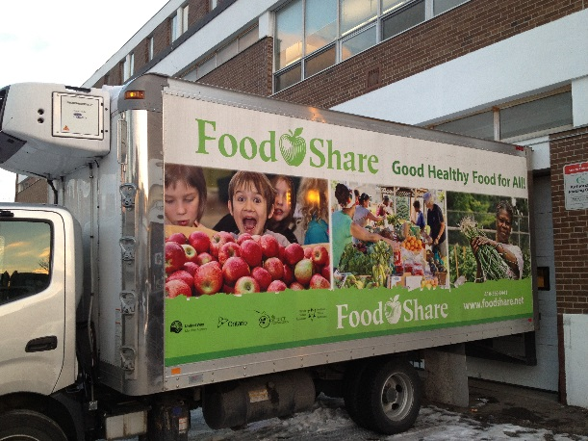
Regional Food Hub: Definition
A regional food hub is a business or organization that actively manages the aggregation, distribution, and marketing of source-identified food products primarily from local and regional producers to strengthen their ability to satisfy wholesale, retail, and institutional demand.
Fills a market function not adequately addressed by the current system:
  Aggregation and distribution from small to mid-sized producers into local/regional wholesale market channels.
Notes:
Definition: Enter food hubs, as the proposed solution.

Slide 5
Regional Food Hubs
Producer Services | Operational Services | Community Services
Actively linking producers to markets On-farm pick up Production and post-harvest handling training Business management services and guidance Value-added product development Food safety and GAP training Liability insurance | Aggregation Distribution Brokering Branding and market development Packaging and repacking Light processing (trimming, cutting, freezing) Product Storage | “Buy Local” campaigns Distributing to “food deserts” Food bank donations Health screenings, cooking demonstrations SNAP redemptions Educational programs Youth and community employment opportunities
Notes:
Definition: Visual representation of how a food hub connects farmers to schools.

Slide 6
  Defining Characteristics
Carrying out or coordinating the aggregation, distribution, and marketing of locally/regionally produced product from multiple producers to multiple markets.
Committed to buying from small to mid-sized local producers whenever possible and considers these producers as core to their business model.
Utilizing one or more product differentiation strategies (e.g. identity preservation, local, group branding, sustainable production practices, etc.).
Working closely with producers to ensure they can meet buyer requirements by either providing direct technical assistance or finding partners that can provide this technical assistance.
Aiming to be both financially viable and have positive economic, social, and/or environmental impacts within their respective communities
Over 60% of all food hubs have operational commitments to equity, increasing food access, and/or community development.
Notes:
Definition: What is a food hub? How is it different than a traditional distribution company? Value-driven.

Slide 7


Over 300 in 2014
At least 120 food hubs have started in the past five years (2008-2012), as well as at least 64 in the past three years (2010-2012)
*Based on a working list of 237 food hubs identified by the NGFN Food Hub Collaboration (June 2013)
Notes:
***************Alternative statistic: Between 2000 and 2006 the number of food hubs in the United States grew from 50 to 94 (an annual growth rate of 14.7 %)
Between 2006 and 2012 the number of food hubs in the United States grew from 94 to 232 (an annual growth rate of 24.5 %)

Slide 8
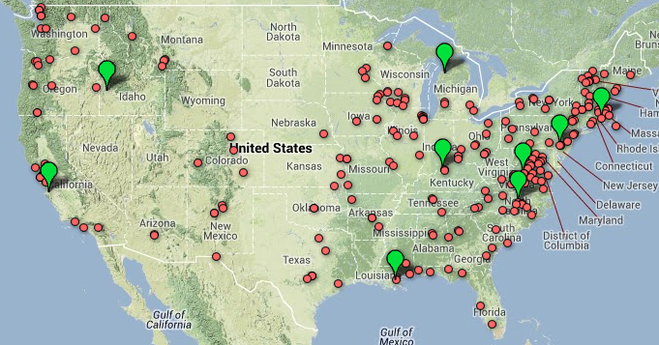
Food Hubs 2013
Based on a working list of 239 active regional food hubs identified by the NGFN Food Hub Collaboration

Slide 9
Research Summary
Over 300 and growing
33% B-B
28% B-C and to B-B
48% for-profits, 20% coops, & 27% not for profits
62% less than 6 years old, 23% 6-15 years old
Diverse product lines; most revenue from produce & proteins
Typically 40 farmer suppliers
60% of a gross sales from small and mid-sized farms
National Food Hub Survey 2013, MSU Center for Regional Food Systems & The Wallace Center at Winrock Int.

Slide 10
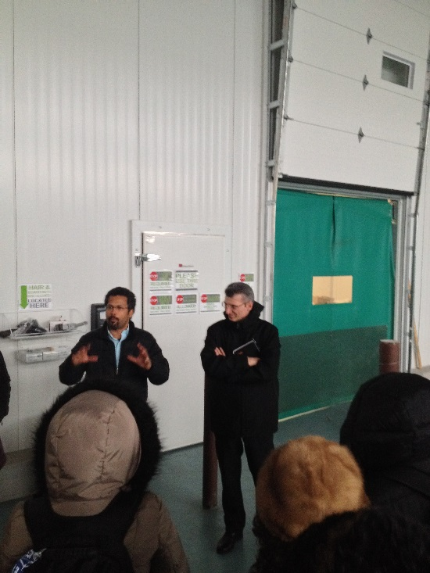
Research Summary
Revenue ranged from $1,500 to $75 million
  Average of $3,284,632/median of $450,000
  Range due to diversity of hub models and age
  Average revenue increases with age of the hub
60% found to be financially viable
Revenue continues to grow for many
2014 Financial Benchmarking Study w/FCC
Challenges
  Managing growth
  Balance supply and demand
  Access to capital
National Food Hub Survey 2013, MSU Center for Regional Food Systems & The Wallace Center at Winrock Int.

Slide 11
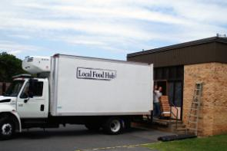
Local Food Hub – Charlottesville, VA
75 small and mid-sized family farms within 100 miles from Charlottesville
Annual growth of 25%, $1.1 million in 2013
Farm of origin labeling, web profiles, point of sale materials, media exposure for farmers
Produce, meat, eggs, and value-added products to more than 150 customers:
  Schools, College dining halls, Senior Centers, Hospitals
  Restaurants and Grocery stores
  Several distributors, processors, and caterers
Farm services include bulk-purchasing, pre-season production planning, sustainable production training
Notes:
Use an a brief example to illustrate FH. Also a plus that it is within the DC Metro region. Keep it short because LFH will speak later on the agenda

Slide 12
FarmLogix LLC – Chicago, IL
On-line B-B platform that connects schools, restaurants, institutions to over 300 local farms
Farmers drop product at 1 of 3 aggregation centers
Partnership with Testa Produce that delivers and invoices
Report itemizing orders by farm, state, product and miles saved
Service free to farms, buyers pay percentage by volume
Over $3 million in farm to school sales
“Business is crazy, We did not expect this kind of demand. In the six months since we launched we have signed on 200 restaurants and more than 1,000 schools.”
Linda Mallers, Founder
Notes:
FarmLogix is here to represent the web based hubs model that is growing. There are other models like this such as Relay Foods, OR FoodEx, Azoti, Farmigo, Good Eggs. Chose this one because it focuses on wholesale markets while many of the others are direct to consumer.

Slide 13
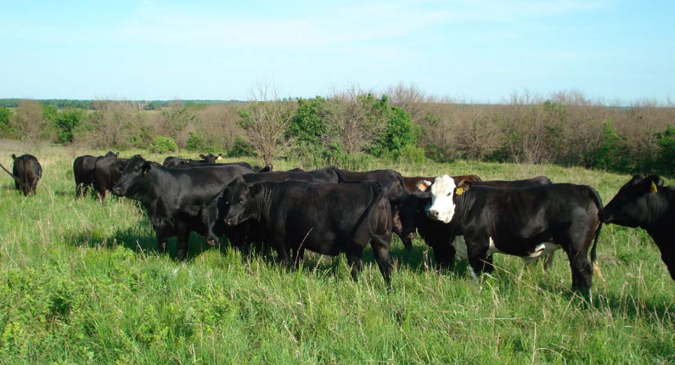
Impacts on farms and local food supply
Helping to grow size and number of farms
Farmers are diversifying the products they grow
Farms are extending their growing season
Using more sustainable production methods
Building farm business acumen
Creating jobs on farm and off
Actively involved in their community, offering a wide range of services to both producers and consumers

Slide 14
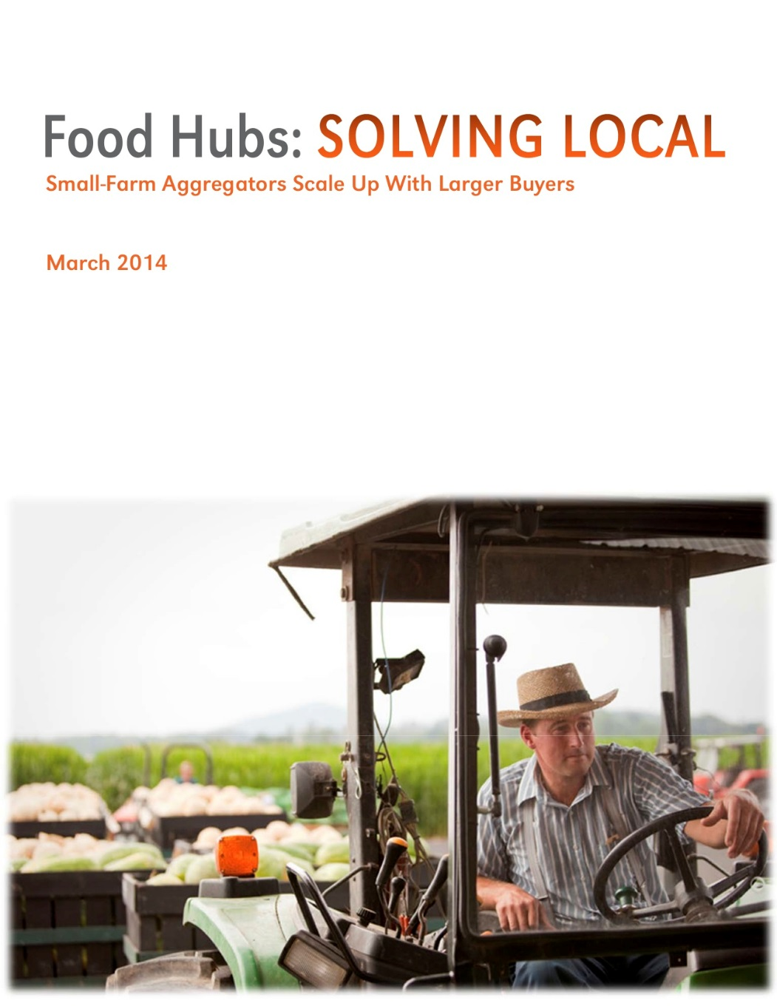
Supply Chain Solutions
Packaging & Quality Control
Food Safety
Seasonality
Consistency
Transportation
Notes:
Transition to this slide, which starts Section B (Wholesale value)
Transition: We’ve seen (first section) how hubs are growing. Here’s how they’re delivering value on the wholesale buyer side.
Next slides cover these topics and examples:

Slide 15
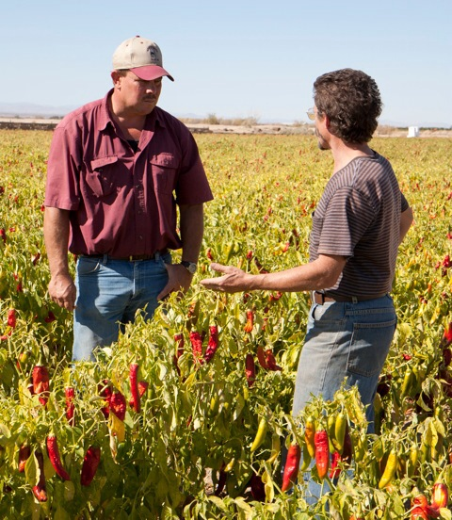
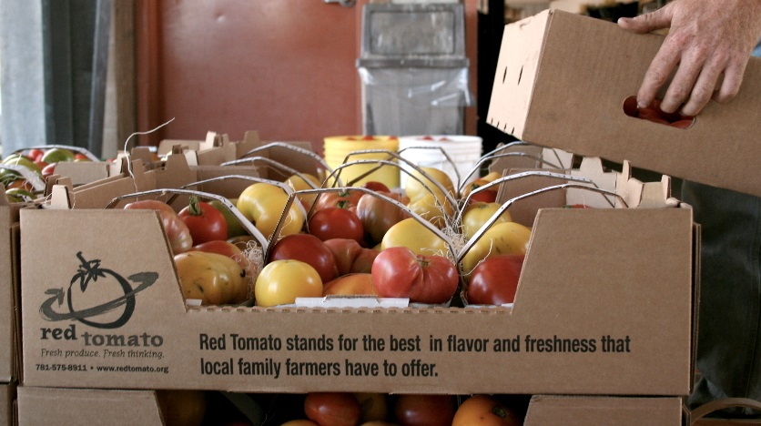
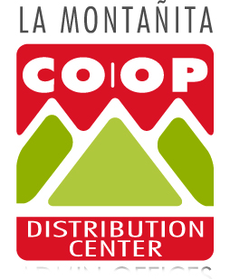

Packaging and Quality Control
Red Tomato’s branded programs include packaging designed to both feature local farms’ growing practices and protect perishable products.(Northeast)
La Montanita Distribution works with producers to gear up for larger-scale sales, from cold chain to freight lines.(NM)
Notes:
Transition to this slide, which starts Section B (Wholesale value)
Transition: We’ve seen (first section) how hubs are growing. Here’s how they’re delivering value on the wholesale buyer side.
Next slides cover these topics and examples:
Packaging and Quality Control
Red Tomato’s branded programs include packaging designed to both
feature local farms’ growing practices and protect perishable
products.
Like many food hubs, La Montanita Distribution works on the front
end with producers to gear up for larger-scale sales, from cold chain
to freight lines.
Food Safety
Good Natured Family Farms expands its producer network by
working directly with farms to achieve GAP certification and ship to
buyers’ specifications.
Cherry Capital Foods assures food safety with its Good Handling
Practices certification, traceability systems, and supplier inspections.
Seasonality
Cherry Capital Foods and Red Tomato tap regional producer
networks from south to north to extend seasonal availability.
Common Market is expanding year-round supply with frozen local
products, either from their own ventures or partner processors.
Consistency
Consistency
Good Natured Family Farms and its Kansas City retail partner secure
steady supplies by guaranteeing prices to farms and moving
surpluses to non-competing markets.
La Montanita Distribution Center uses sales outside its five retail
stores to build markets for producers.
Transportation
Red Tomato contracts with third-party carriers and distributors to
move product from its regional network of farms.
Common Market and other food hubs set up multiple aggregation
points for shorter hauls and fewer trips to farms.

Slide 16
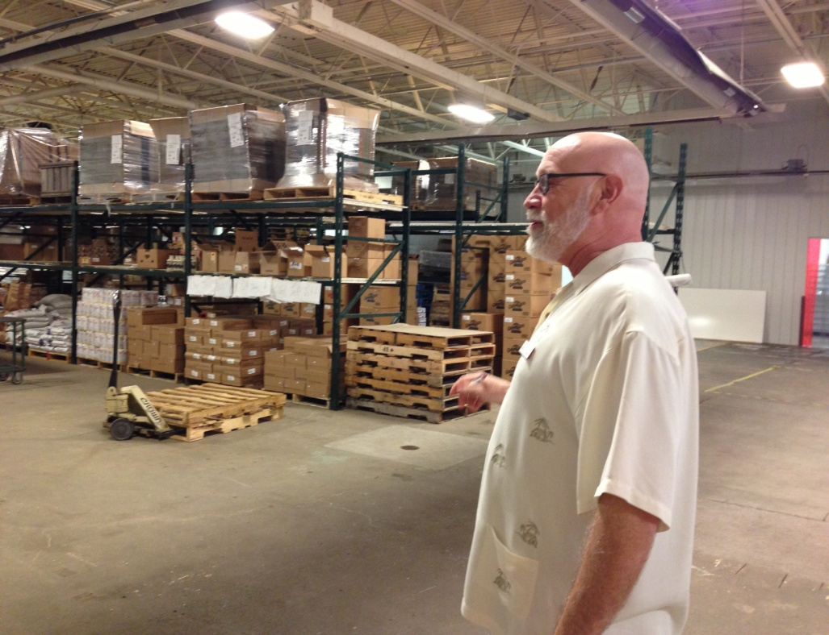

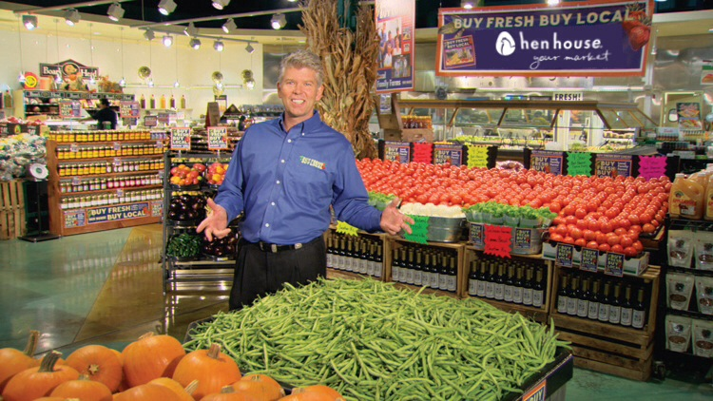
Food Safety
Good Natured Family Farms works directly with farms to achieve GAP certification and ship to buyers’ specifications (MO-KS).
Cherry Capital Foods assures food safety with its Good Handling Practices certification, traceability systems, and supplier inspections (MI).
Notes:
Food Safety
Good Natured Family Farms expands its producer network by
working directly with farms to achieve GAP certification and ship to
buyers’ specifications. NOTE: That’s David Ball of Balls Foods – also on board of Associated Wholesale Grocers – big midwest distributor
Cherry Capital Foods assures food safety with its Good Handling
Practices certification, traceability systems, and supplier inspections.
Seasonality
Cherry Capital Foods and Red Tomato tap regional producer
networks from south to north to extend seasonal availability.
Common Market is expanding year-round supply with frozen local
products, either from their own ventures or partner processors.
Consistency
Consistency
Good Natured Family Farms and its Kansas City retail partner secure
steady supplies by guaranteeing prices to farms and moving
surpluses to non-competing markets.
La Montanita Distribution Center uses sales outside its five retail
stores to build markets for producers.
Transportation
Red Tomato contracts with third-party carriers and distributors to
move product from its regional network of farms.
Common Market and other food hubs set up multiple aggregation
points for shorter hauls and fewer trips to farms.

Slide 17
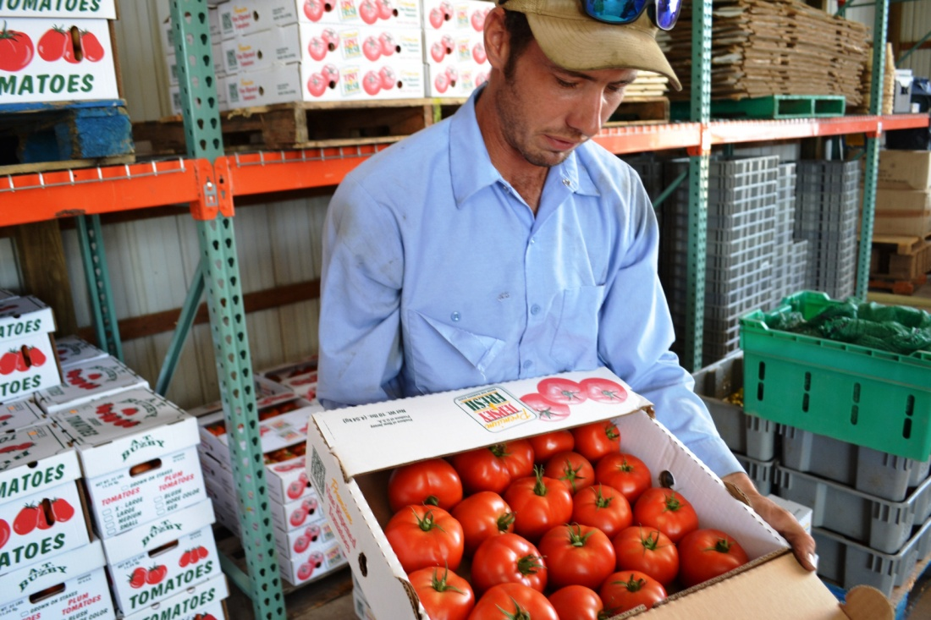
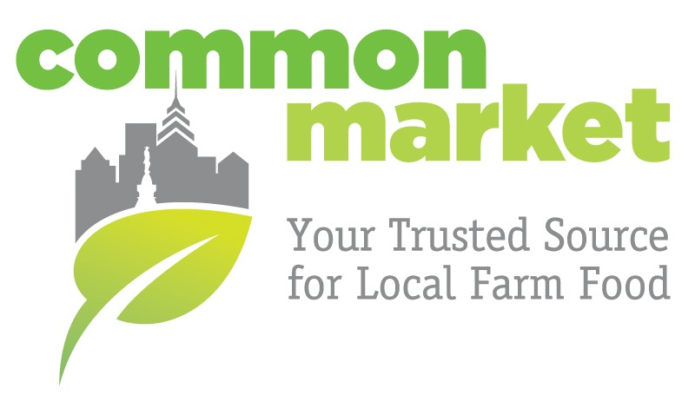
Seasonality
Many food hubs tap regional producer networks from south to north to extend seasonal availability.
Another Common Market is expanding year-round supply with frozen local products.
Notes:
Seasonality
Cherry Capital Foods and Red Tomato tap regional producer
networks from south to north to extend seasonal availability.
Common Market is expanding year-round supply with frozen local
products, either from their own ventures or partner processors.
Consistency

Slide 18

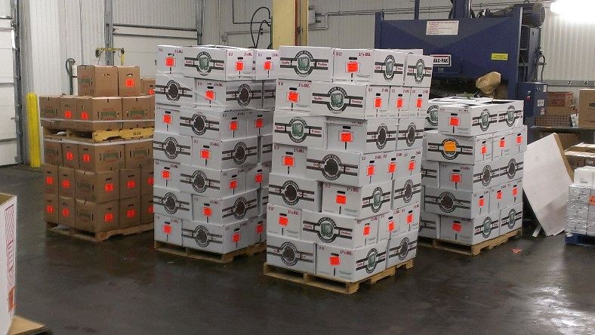
Consistency
Food hub Good Natured Family Farms and its Kansas City retail partner secure steady supplies by guaranteeing prices to farms and moving surpluses to non-competing markets.
The La Montanita Distribution Center uses sales outside its five retail stores to build markets for producers.
Notes:
Consistency
Consistency
Good Natured Family Farms and its Kansas City retail partner secure
steady supplies by guaranteeing prices to farms and moving
surpluses to non-competing markets.
La Montanita Distribution Center uses sales outside its five retail
stores to build markets for producers.
The Co-op Foodshed Initiative
To strengthen Co-op retail stores, enhance opportunities for
local and regional food producers, and support the local
economy, the Co-op offers distribution and marketing
services to medium sized farms that have identified a need
for these services. Routing trucks through New Mexico and
Southern Colorado, the Co-op picks up product and
delivers to Co-op stores and to other co-ops and
independent groceries and food service customers.

Slide 19
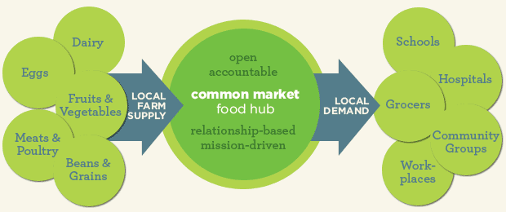
Transportation
Red Tomato contracts with third-party carriers and distributors to move product from its regional network of farms.
Common Market and other food hubs set up multiple aggregation points for shorter hauls and fewer trips to farms.
Notes:
Transportation
Red Tomato contracts with third-party carriers and distributors to
move product from its regional network of farms.
Common Market and other food hubs set up multiple aggregation
points for shorter hauls and fewer trips to farms.

Slide 20
Food Hubs 2013
Food Hubs 2013
Based on a working list of 239 active regional food hubs identified by the NGFN Food Hub Collaboration
Notes:
TRANSITION to C: Next Scaling up Strategy – Hub to Hub Networks
This photo shows regional concentrations that could move that way … like we’re seeing in MI, and NC (example of multi hub partnership with grocery chain next)

Slide 21

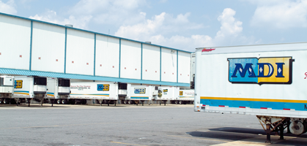
Notes:
Transition to final/third section of content re. Next Scaling up Strategies – Hub to Hub networks
Transition: Key to remember that difference between food hub and regular distributor etc. is the small farm relationships and reach they bring.
E.G. NC Lowes Foods already works with about 100 NC farms to supply stores … but now working with hubs gain access to, builds access for 100 more smaller farms that are not in the normal wholesale supply chain without food hubs as mission-driven, market-minded intermediary
Key points, info
North Carolina’s Lowe’s Foods (96 stores in NC) partnering with several food hubs in the state through a university facilitated effort (North Carolina Growing Together).
Greater access to broader range of farms, particularly smaller farms with real local community cred not already in larger supply chains.
"Across North Carolina, we partner with over 100 farms, says Produce Director Dick McKellogg. “However, through hubs alone, like Tractor, Operation Spring Plant and Pilot Mountain Pride, we are able to source from another 100 small farms.”
Lowe's is "willing to innovate" (quote from SL intro, key point)
3 big steps to date re. willing to innovate
farm DSD (letting local farms get into local stores directly through DSD avenues available to e.g. beer and flowers)
Hub DSD (more volume from hubs, letting them serve area stores directly)
Hubs cross-docking with MDI distribution trucks at central warehouse.
NC Growing Together is a project of NC State’s Center for Environmental Farming Systems. CEFS is a partnership between the two federal land grant universities—North Carolina State and North Carolina A&T State.
NC Growing Together is funded through a $3.9 million U.S. Department of Agriculture grant to utilize the products of North Carolina’s small farmers to build a regional-scale food distribution network.
Participants include Lowes, Fort Bragg and Merchants Distributors-- as well as NC State’s School of Management.

Slide 22


Lowes Foods now sourcing through 5 hubs:
Pilot Mountain Pride (DSD, MDI)
Tractor (MDI)
Feast Down East (DSD)
Firsthand Foods (DSD)
Eastern Carolina Organics (DSD)
Notes:
PICTURED are the two hubs that move product thru MDI (per NC Growing Together interview past spring)
The other 3 of 5 are DSD
NOTE: NC hubs were planning get together in June for collaborative networking a la Michigan
NOTE the MAIN IDEA HERE AGAIN
Hubs that have worked with Lowes via MDI:
Tractor in Yancey County
http://tractorfoodandfarms.com/tfaf/Coming_soon..html
https://www.facebook.com/tractorfoodandfarms
Pilot Mountain Pride in Surry County http://pilotmountainpride.com/index.php/new-home
Hubs delivering direct-store-delivery DSD
Pilot Mountain Pride
Feast Down East http://www.feastdowneast.org/index.html
Firsthand Foods http://firsthandfoods.com/
Eastern Carolina Organics (ECO) -- just signed up to deliver direct to store. http://www.easterncarolinaorganics.com/

Slide 23
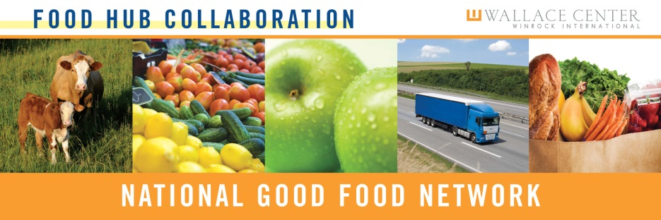
“Food hubs around the country are well situated to help retailers and distributors build programs that will bring local to the next level, foster long-term relationships with growers and ensure quality control and food safety. Together these kinds of partnerships could go a long way towards creating a sustainable future for farmers and increasing access to fresh, local food for everyday shoppers.” Michael Rozyne, Red Tomato
Community of Practice
Networking
Conferences
Webinars
Peer to Peer
Research
New Info
New Audiences
Technical Assistance Strengthen Food Hubs
Study Hubs
Deeper Learning
Notes:
Benchmarking Study
National Survey
Webinars
Website
Learning Tours
Conf calls
List serve
Etc.

Slide 24


“The retail industry recognizes the broad consumer shift towards fresher foods. We also know that meeting this demand means addressing the challenge of how to pull consistent volumes of safe, locally sourced products through the supply chain. FMI looks forward to exploring how regional food hubs can help our members implement economically viable solutions.” Mark Baum, Senior VP, FMI
John Fisk, Director
Wallace Center at Winrock International
Jfisk@Winrock.org
www.Wallacecenter.org
http://foodhub.info
  Solving Local
  http://ngfn.org/solvinglocal
Notes:
PICTURED are the two hubs that move product thru MDI (per NC Growing Together interview past spring)
The other 3 of 5 are DSD
NOTE: NC hubs were planning get together in June for collaborative networking a la Michigan
NOTE the MAIN IDEA HERE AGAIN
Hubs that have worked with Lowes via MDI:
Tractor in Yancey County
http://tractorfoodandfarms.com/tfaf/Coming_soon..html
https://www.facebook.com/tractorfoodandfarms
Pilot Mountain Pride in Surry County http://pilotmountainpride.com/index.php/new-home
Hubs delivering direct-store-delivery DSD
Pilot Mountain Pride
Feast Down East http://www.feastdowneast.org/index.html
Firsthand Foods http://firsthandfoods.com/
Eastern Carolina Organics (ECO) -- just signed up to deliver direct to store. http://www.easterncarolinaorganics.com/

Slide 25
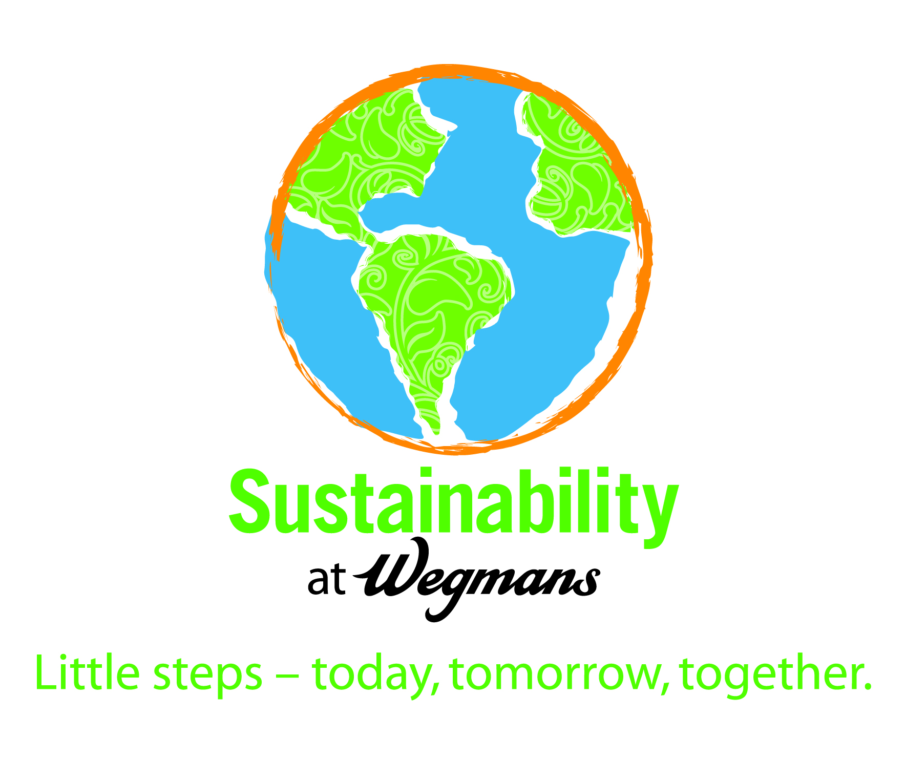
Jason Wadsworth
Sustainability Manager

Slide 26
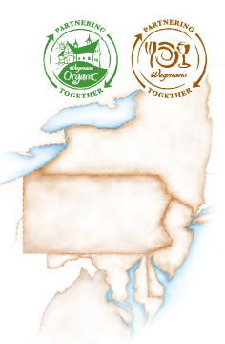
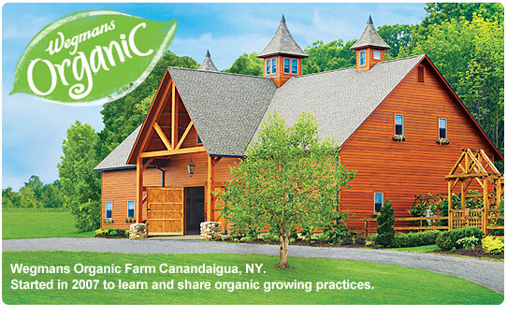



Slide 27
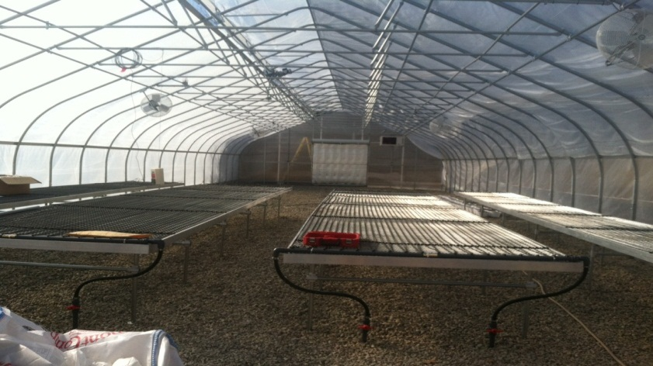
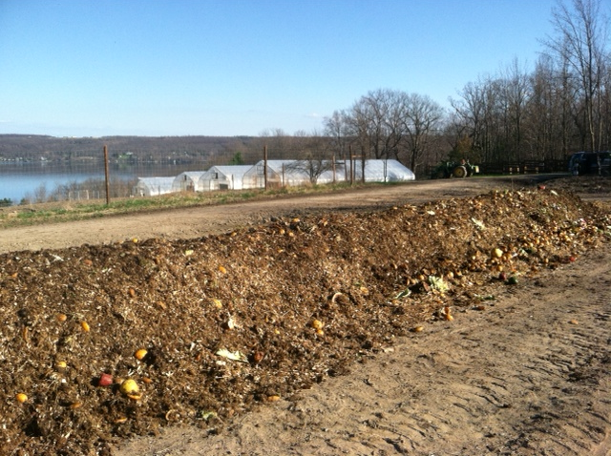
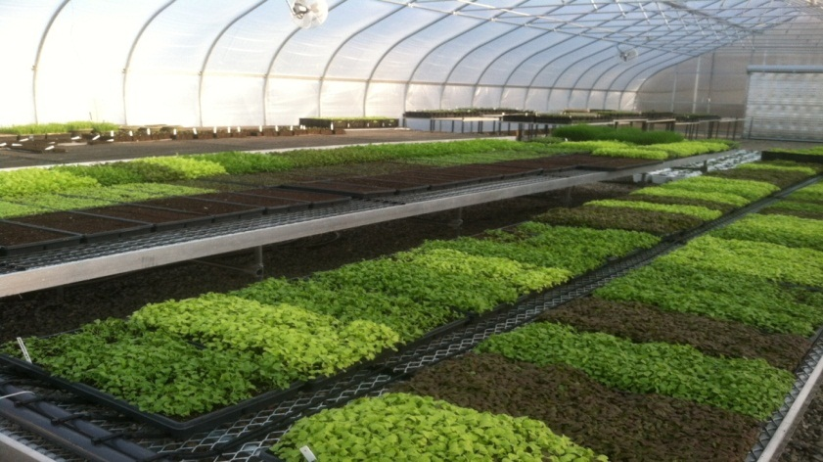
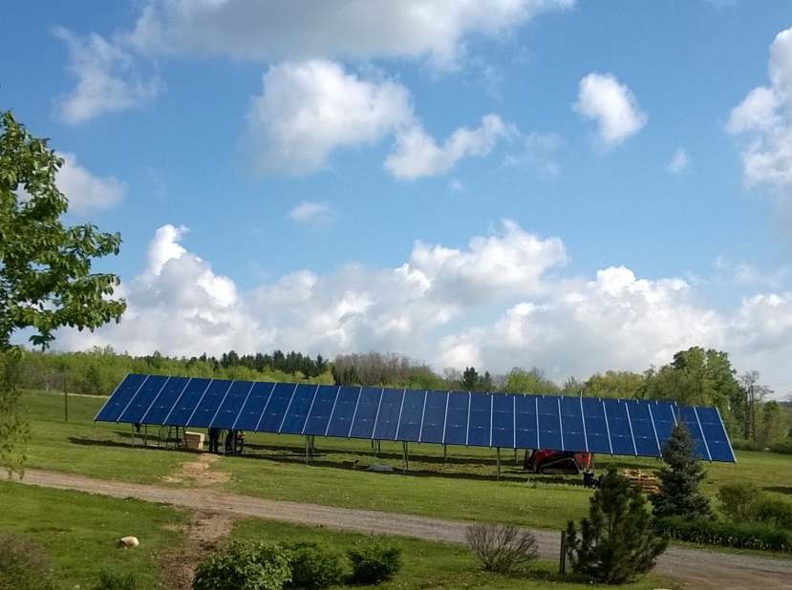
Growing Local/Regional Organic
Growing Earlier & Later Each Year
Producing Better Compost
Warming Soil for Germination
Solar Power

Slide 28
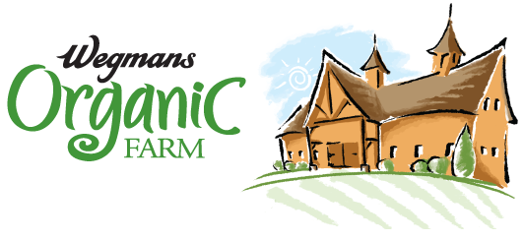
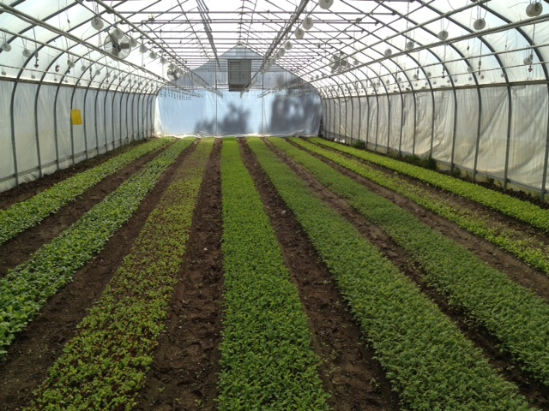
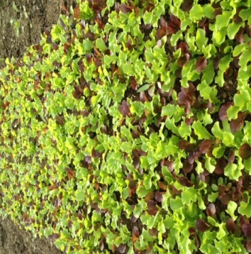
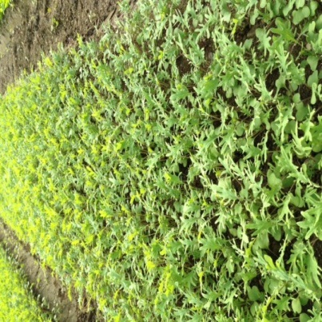
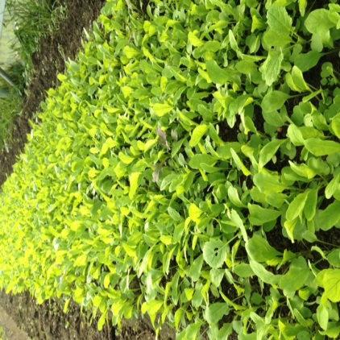
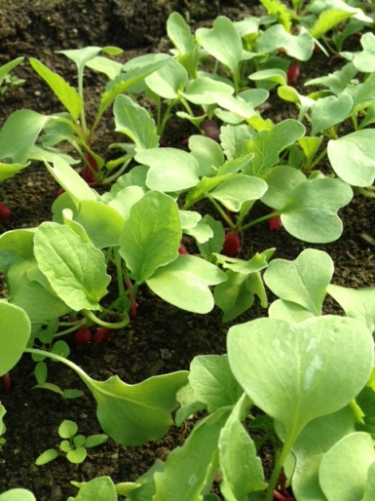
Baby Greens
Baby Kale
Baby Arugula
Radishes
2013 Fall Baby Leaf Production
Half acre in fall production

Slide 29
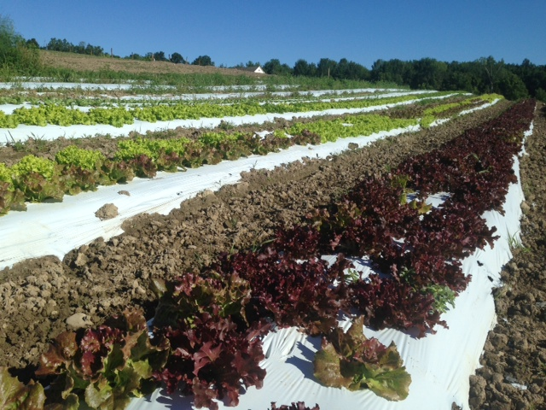
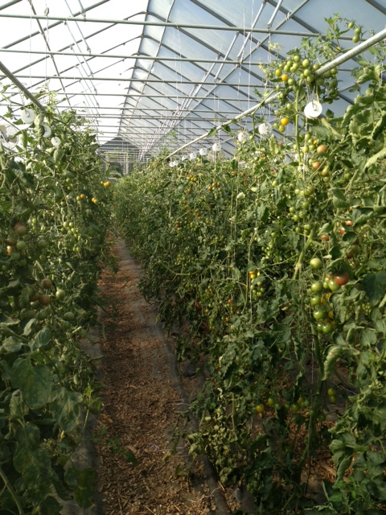
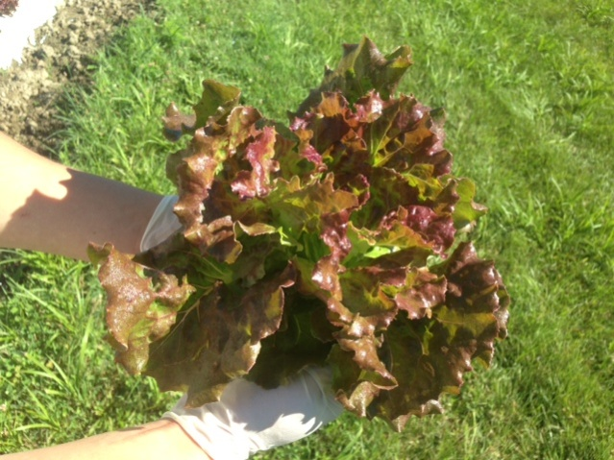
Plant Height
White Plastic (temp control)
Heat Tolerant lettuces
Weed Control

Slide 30
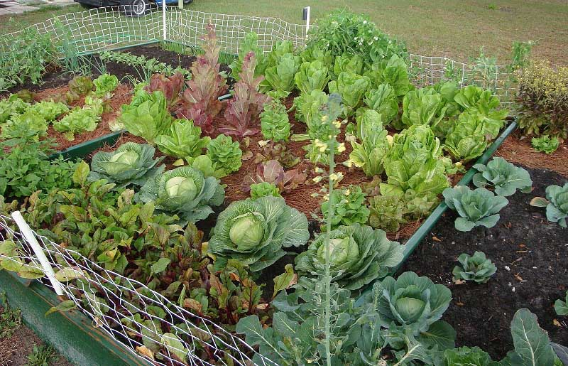

Slide 31
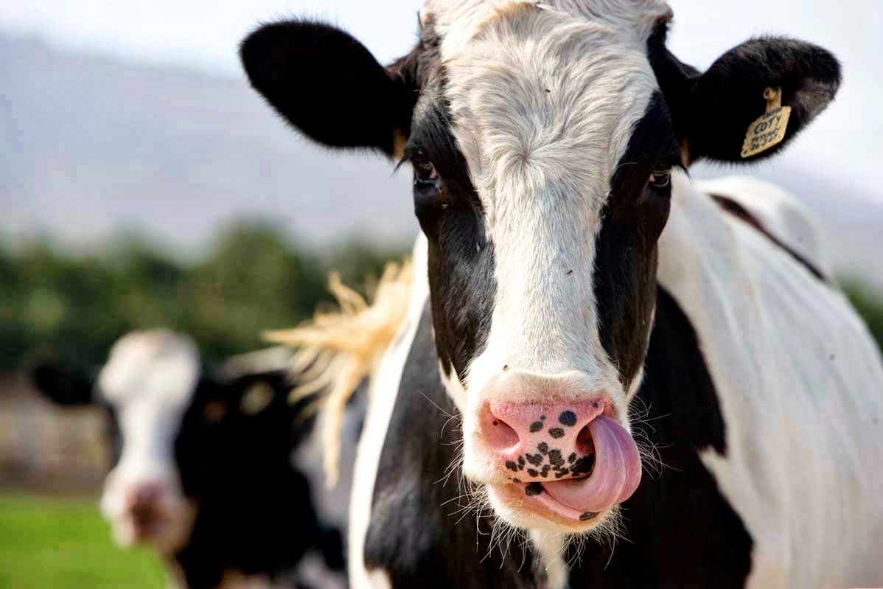

Slide 32
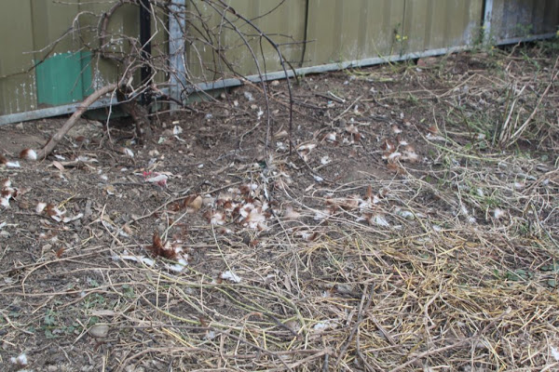

Slide 33
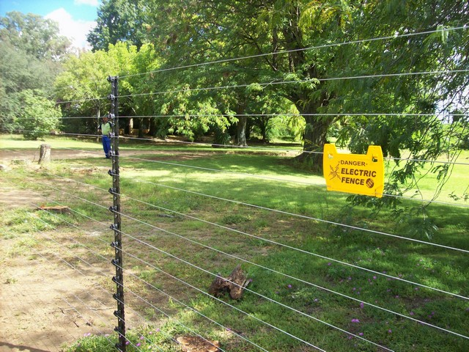

Slide 34
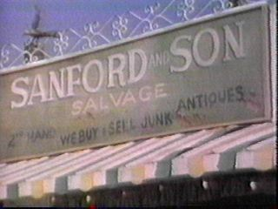

Slide 35
  “So I say again; Local farming is awesome. But Pete, get this “local” s*** in the grocery stores. It’s a hell of a lot easier that way!”
  - Josh Pearson

Slide 36
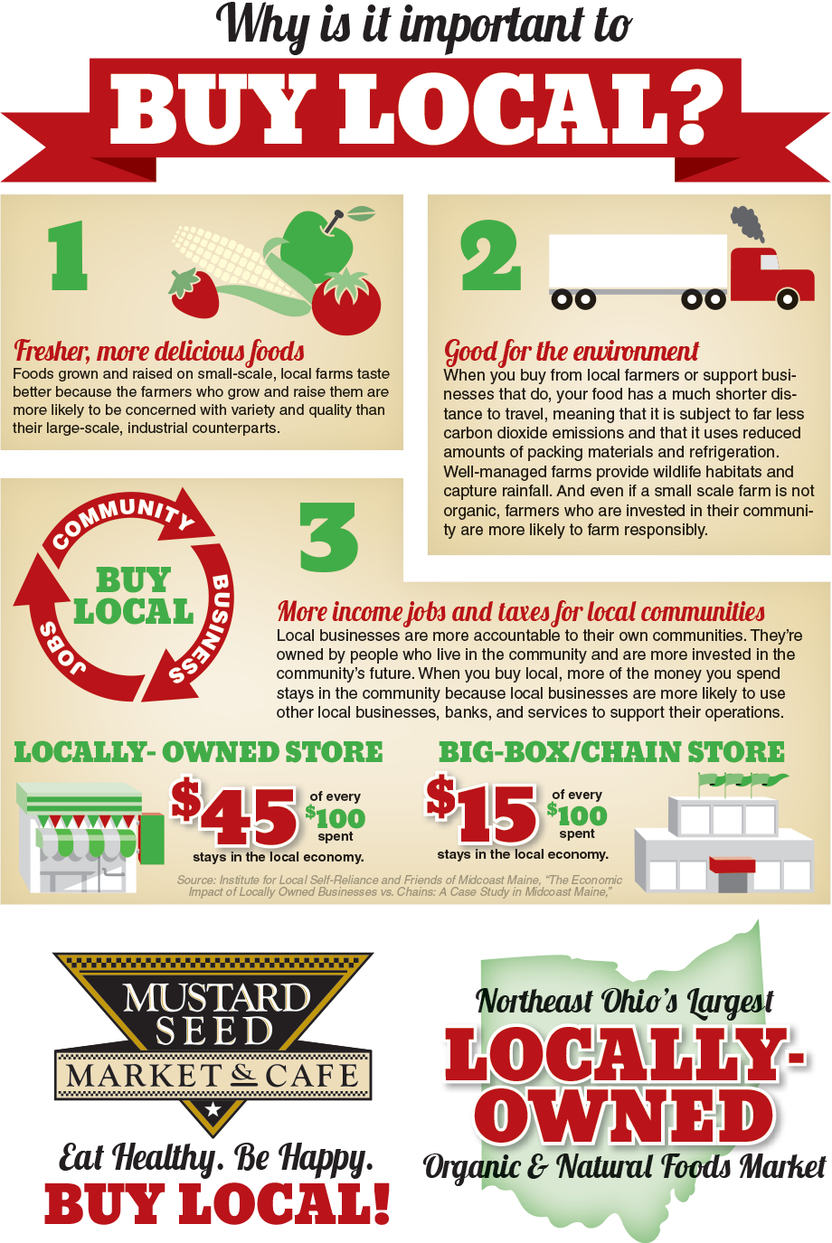
WHY?
Notes:
We could address many reasons to buy local. Taste, freshness, environmental concern, but I’m going to focus on two main reasons. Economic vitality and Risk factors.

Slide 37
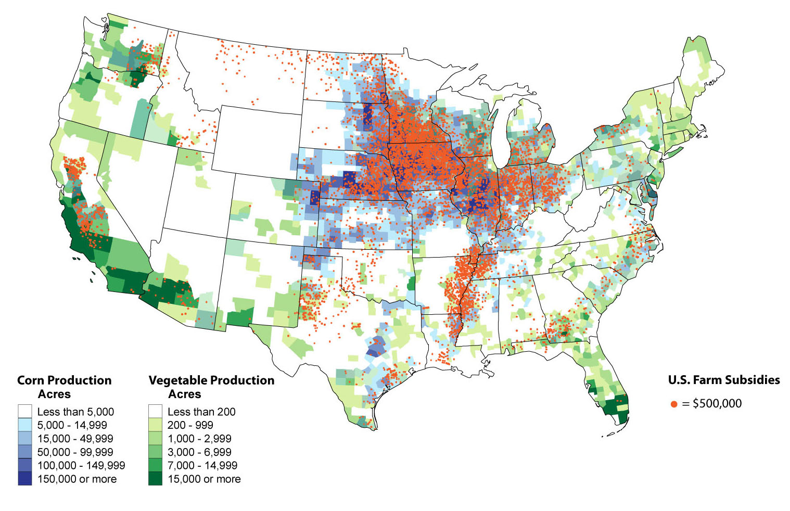
National Food Shed
*USDA spent $13.7 billion in commodity, crop insurance and supplemental disaster assistance payments to support large industrial farms. The agency spent less than $100 million that year to support local and regional food system farmers.

Slide 38
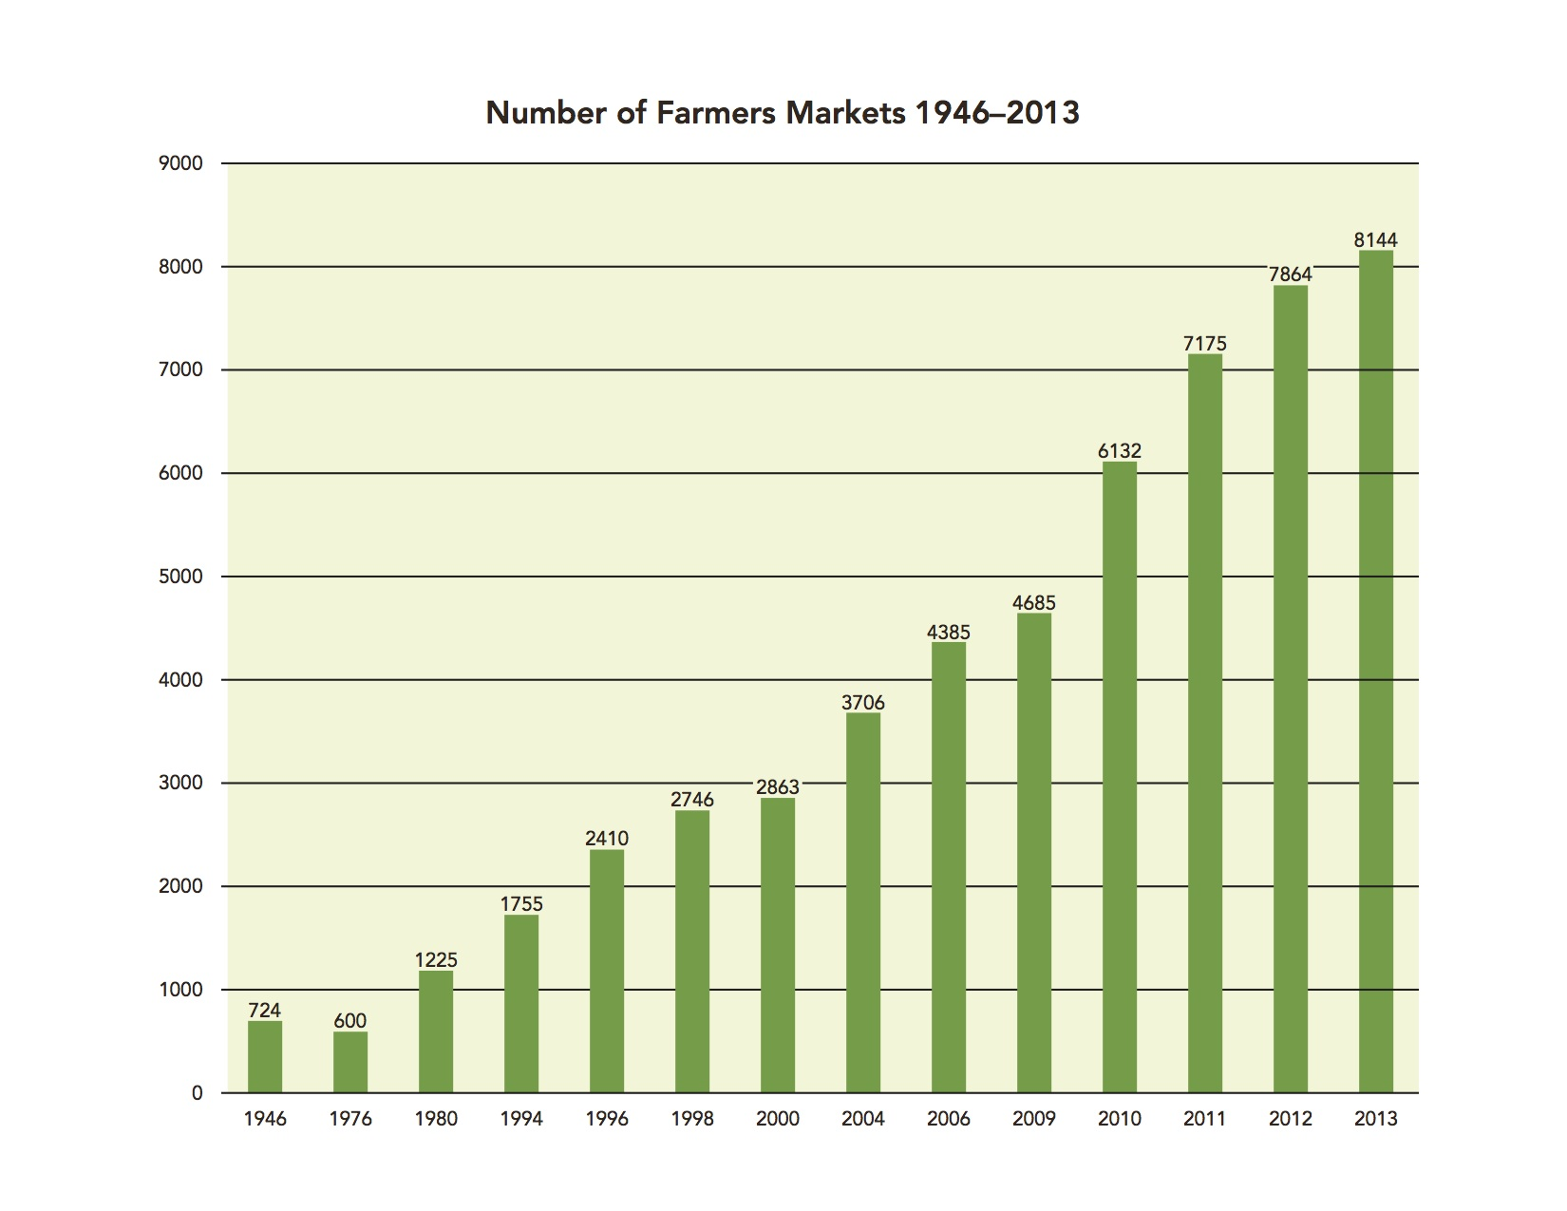
Job Growth

Slide 39
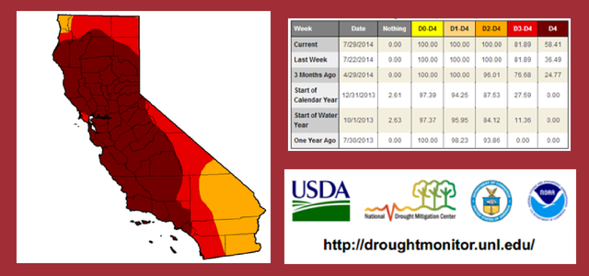
Risk Management
Increasing weather volatility or other long-term changes in global weather patterns, including any changes associated with global climate change, could have a significant impact on the price or availability of some of our ingredients.
                – Chipotle Restaurants

Slide 40
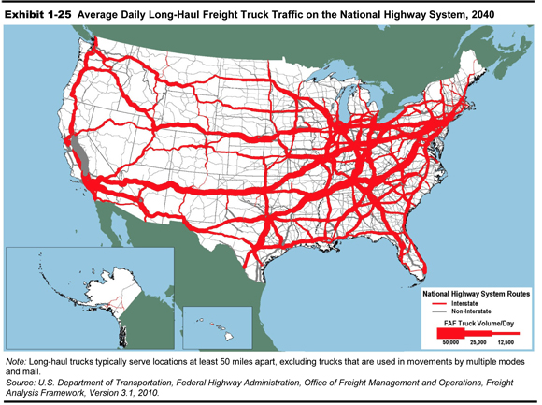
Risk Management
$1 of final demand for agricultural products requires 14.2 cents in transportation services
A week-long disruption through the Ports of Los Angeles and Long Beach could cost the national economy $150 million per day

Slide 41
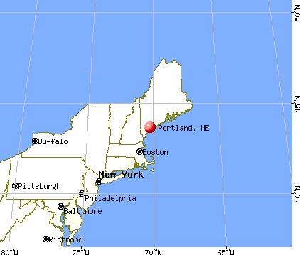
Economic Growth
Every $100 spent at locally owned businesses contributes an additional $58 to the local economy.
By comparison, $100 spent at a chain store yields just $33 in local economic impact.
Independent BC: Small Business and the British Columbia Economy — by Civic Economics, February 2013

Slide 42
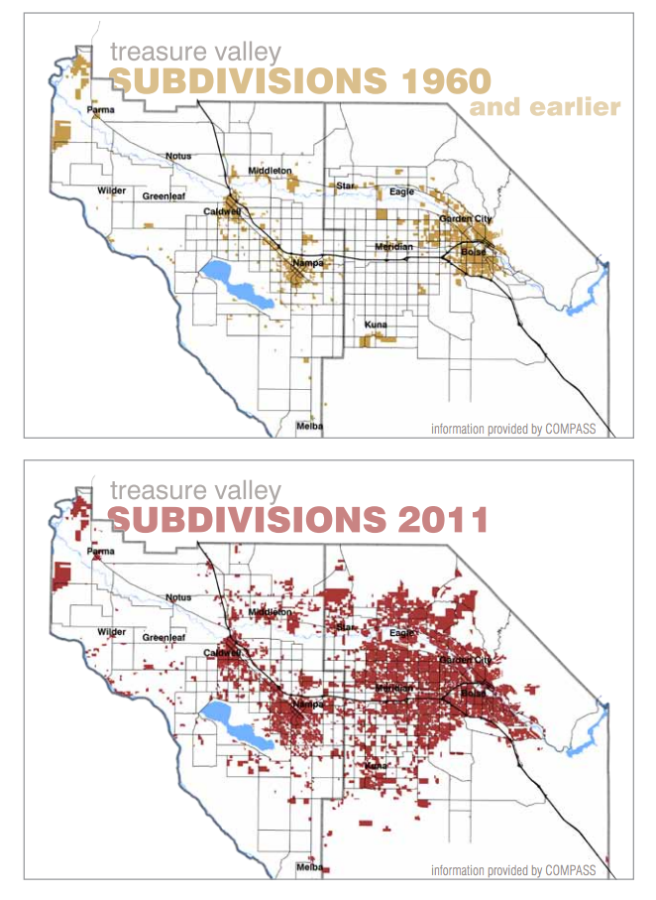
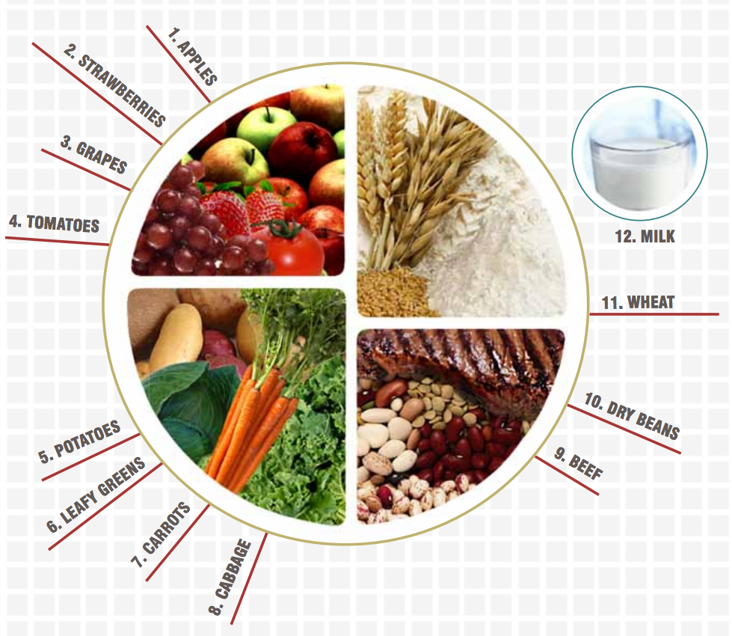
Growth and Food Demand

Slide 43
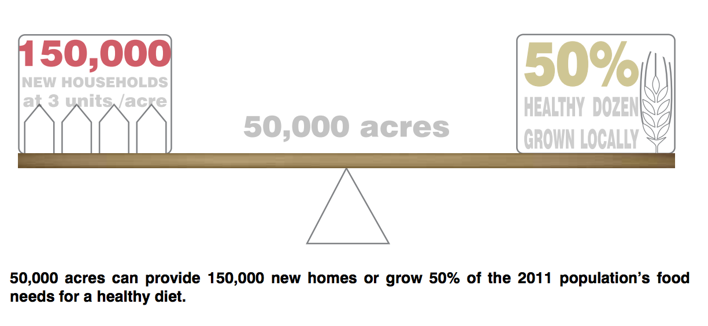
Local Food Reality

Slide 44
‘Local’ Shopping Trends
Primary drivers are perceived quality and local economic benefits
90% of consumers say they purchase locally grown products at least occasionally
86% of shoppers say “local” gives them better quality and better nutrition factors
61% said taste of local products is better
56% stated knowing the source of the product is as a key buying driver
Cited: 2013 FMI US Grocery Shopper Trends; http://www.foodnavigator-usa.com/Markets/FMI-Hartman-Group-grocery-shopping-trends

Slide 45


Farmer Demographics
Current Farmer
Future Farmer
Age: 57-60
Part of Baby Boomer Generation:
Goal oriented
Value real “face time”
Hard working
Highly completive, strive to win
Looking to retirement
Age: 25-35
Part of Millennial Generation:
Healthy lifestyle
Very active in social media
Embrace cause marketing, brands must have purpose
It’s about being happy
They want to solve problems

Slide 46

So why isn’t it happening?
The Merchandising Team:
More with less - We can’t manage a higher volume of relationships when we’re always being asked to do more with less.
Food Safety – we can’t sell half the stuff you see at a farmer market. Priorities are appearance, shelf life and price. Proper post-harvest handling is essential!
Volume - Small local farmers can’t keep up with our demand. Must be on-time and consistent.

Slide 47

So why isn’t it happening?
The Farmer:
I can’t get the grocery store to talk with me.
The vendor setup process takes too long.
Too many rules and restrictions, too much emphasis on appearance causing too much waste.
Selling to a grocery store constantly squeezes margin, can’t make a profit.

