Slide 2
Food waste: Challenges & Opportunities
Dr Richard Swannell
Director, WRAP

Slide 3


Slide 4




Trends

Slide 5

A ‘Perfect Storm’
Increased demand
50% by 2030 (IEA)
Energy
Climate Change
Food
Increased demand
50% by 2030
(FAO)
Water
Increased demand
30% by 2030
(IFPRI)
One third of food is wasted- 1.3 billion tonnes/year

Slide 6
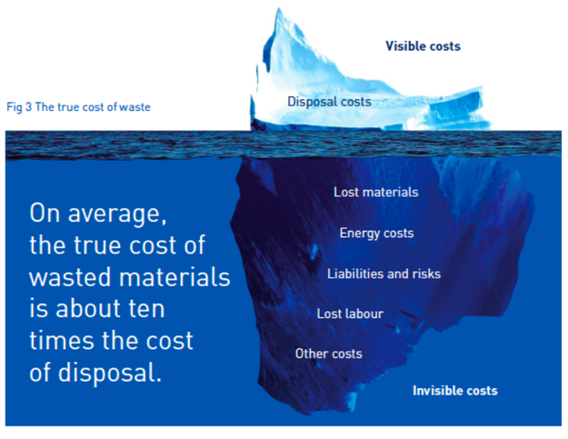
The true cost of waste
Notes:
Cooked Uncooked
True cost per wasted portion of chips £0.33 £0.08
True cost per wasted piece of Cod £0.82 £0.58
disposal of cooked chips is 400% more expensive than wasted potato and that cooked fish is 140% more expensive than uncooked fish.
need to highlight that measuring is key - most companies woudl not knowingly waste food, so we have found different ways to convey this and support action
Financially, WRAP’s current research shows the financial cost of food waste to be around £1,800 a tonne – purely food purchase and waste management. Research underway to get a more holistic figure for this - will come on this later
Environmentally – 4.2 tonnes of carbon for every tonnes of food wasted, household figures.
Research underway to identify a figure more apt for HaFS
Looking at HaFS research and evidence specifically: What do we have

Slide 7
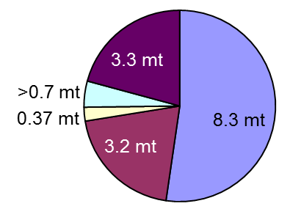
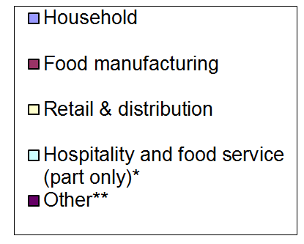
UK food waste in 2007 - 16 Mt
21%
7%
52%
20%
Notes:
Background on American food waste
In the US, Buzby et al (2014) estimated that 60 million tonnes (133 billion pounds [lbs]) of food was wasted at retail and consumer stages, with a retail value of US$162 billion ($2,700 a tonne)
In the US the costs of landfilling the 32 million tonnes of municipal food waste are likely to be around US$1.5 billion a year (EPA, 2014).
Buzby, J., Wells, H.F., Hyman, J. (2014). The Estimated Amount, Value, and Calories of Postharvest Food Losses at the Retail and Consumer Levels in the United States. Economic Information Bulletin No. (EIB-121); http://www.ers.usda.gov/publications/eib-economic-information-bulletin/eib121.aspx
US consumers 41 MT by comparison. Value 110 billion

Slide 8

Approach:
Research
Insight
Innovating
Convening
Supporting change
Notes:
We bring these same principles to our consumer engagement. Recycle Now, and Love Food Waste
Starting off with the research. That gives insights. That lead to some innovative engagement ideas. We brought people together around those ideas. It helps people make change.
The Whitehall Government has paid us to use that in relation to Recycling and Waste Prevention.
Interestingly the Scottish Government is now asking to use a similar approach to use our expertise in relation to energy and water efficiency advice, for business and the public sector.
Interesting times

Slide 9
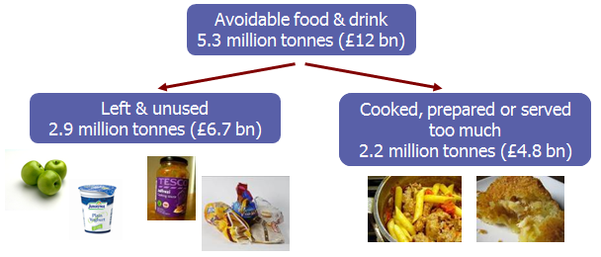
Key behaviours:
Planning
Buying
Storage
Preparation
Use
Notes:
The ‘food journey’ provides a number of touch points at which you could intervene to prevent food waste
However, people’s food journey is often habitual, underpinned by individual attitudes, values etc.
Their ability to prevent waste can be determined by their skills and knowledge or the tools they might have to help e.g. measuring scales, cook books, freezer
Food packaging also helps i.e. reclosable to retain freshness, freezable, portioned etc.
This reflects the complexity of what we are trying to influence!

Slide 10
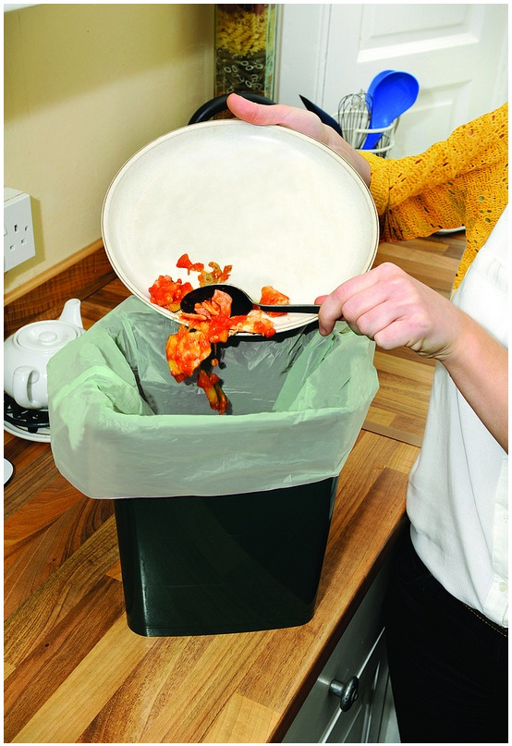


Strategy

Slide 11

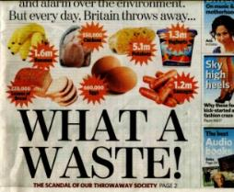

Slide 12


Slide 13


Slide 14
Simple messages around 5 key behaviours
■ planning
■ knowing date labels
■ savvy storage
■ lovely leftovers
■ perfect portions
Because it saves people money: £60 per month
Notes:
To sum up, the top five ways to reduce your food waste are to;
It pays to plan - check what’s in the cupboard, fridge and freezer, plan your meals and know what your going to buy before you go shopping
Know your dates - check the dates on food regularly, use foods with the shortest date first, and freeze for later foods you won’t get round to eating in time
Savvy Storage - most leftovers will keep for up to two days in the fridge well wrapped, most fruit and veg will stay fresher for longer stored in the fridge, and wrap well or store in air-tight containers fresh foods once opened
Lovely leftovers – be creative with using up leftovers
Perfect portions - Measuring portion sizes helps us to avoid cooking, preparing or serving too much food

Slide 15
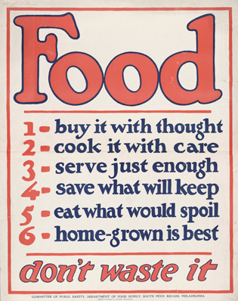
World War I Era
Poster,
US Department of
Food Supply

Slide 16
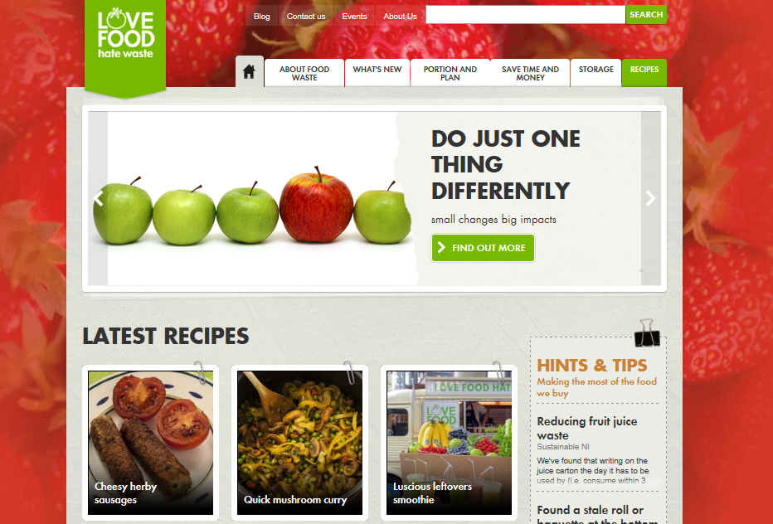

Slide 17
Channels
Local Partnership Advisors
LFHW website
Local authorities
Retailers, brands and industry bodies
Campaigning groups e.g. WWF
Community groups
Press
Lifestyle media
PR & word of mouth
Social media

Slide 18


Slide 19



Slide 20


Slide 21

Industry engagement: Courtauld Commitments
Packaging
Household food waste
Supply Chain waste

Slide 22



















































Courtauld Commitment Phase 3 Signatories
Notes:
Welcome, many familiar faces from signatories who have been signatories for several years and also like to welcome some new companies – Kingsland Wine, Aldi, Highland Spring, Dawnfresh.
We are not stopping at 45 with several more new signatories expecting to sign in coming few months.

Slide 23
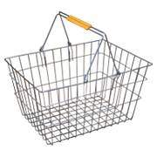


Objective
To change the retail environment to help consumers:
Buy the right amount
Keep what is bought at its best
Use what is bought
- Pack size range and availability
Promotions
Planning / ordering tools
- Packaging functionality, re-close
- Clear storage guidance
- In-home tools
- Consistent, simple use of dates
- Maximum shelf life
- Portioning tools
23

Slide 24

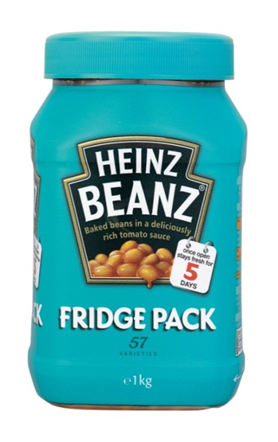

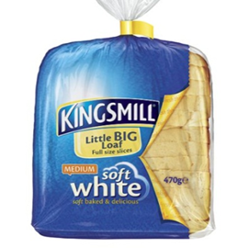
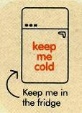
Changes in store

Slide 25

Impact
Notes:
The best fitting stadium I can find is the MetLife (new Giants) Stadium in New Jersey, home of the NY Giants and NY Jets. This sits adjacent to the old Giants Stadium.
A few interesting facts should you need them: According to Wikipedia: In 2011, MetLife, an insurance company based in New York City, acquired the naming rights to the stadium. At a construction cost of approximately $1.6 billion, it is the most expensive stadium ever built and is the largest stadium in the NFL in terms of permanent seating capacity. On May 25, 2010, it was announced that Super Bowl XLVIII, to take place in 2014, was awarded to the stadium, the first time a Super Bowl would be played in the New York metropolitan area, and the first time that a non-domed stadium in a cold-weather city would host it.
It has a total volume of 1,830,000m³ which is just under half of the volume for Wembley, (4,000,000m³).
This means 1 (new) Wembley Stadium = 2.2 Giants Stadiums, (just over double).
NB – categorisation
avoidable waste – This is food and drink that would have been edible at some point prior to being thrown away, for example slices of bread, apples, yoghurts etc.
possibly avoidable - This includes things like bread crusts and potato peelings that some people eat but others do not.
unavoidable waste – This includes things that cannot be eaten like tea waste, banana skins, poultry bones, onion skins and orange peel
Total includes all three categories

Slide 26
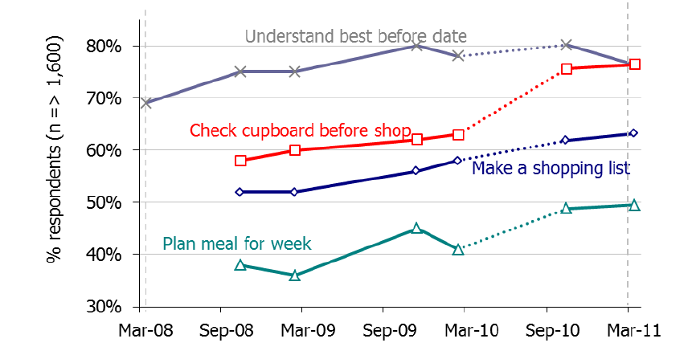
Trends in food-waste reducing behaviours (% reporting all of the time or most of the time) and those understanding best-before dates (note that y-axis does not start at zero)

Slide 27
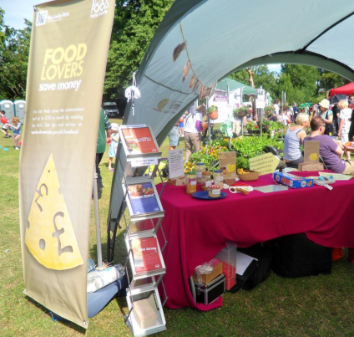
City Campaign
    Co-ordinated PR, Marketing, cascade training & charity work
    6 month campaign in west London
    Food waste decreased by 15%
    For every £1 spent up to £8 saved in avoided disposal costs

Slide 28
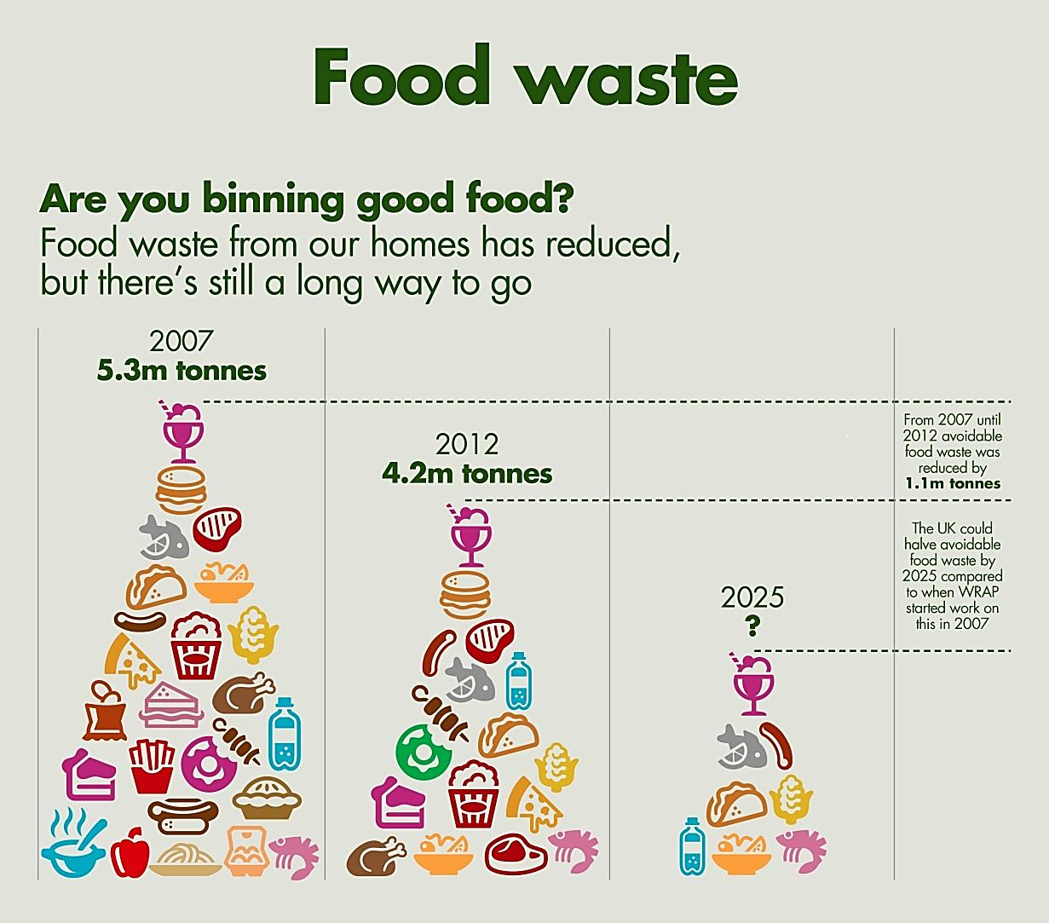
Future?

Slide 29

FUSIONS has 21 project partners from 13 different countries.

Slide 30
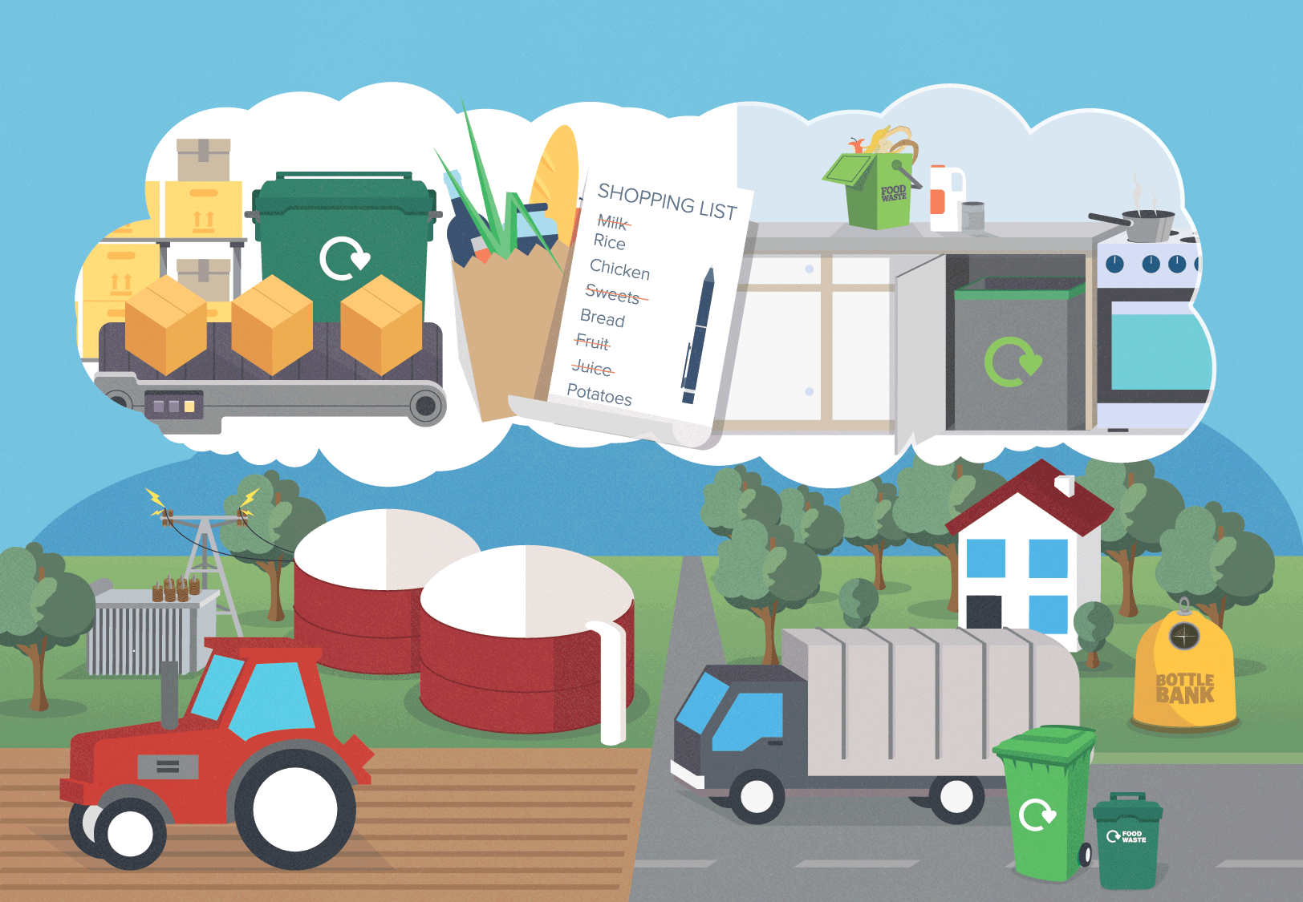

Slide 31
Conclusions
Significant opportunity & challenges
Key Features:
        Clear Strategy
        Build Partnerships
        Measure Impact
Potentially replicable

Slide 32


For more information:
www.wrap.org.uk
www.lovefoodhatewaste.com
www.eu-fusions.org
Richard.Swannell@wrap.org.uk

Slide 33


Questions?
Zanolli.Ashley@epa.gov
(206) 553-4425
How to join EPA’s Food Recovery Challenge: www.epa.gov/smm/foodrecovery
West Coast Climate Forum website: www.westcoastclimateforum.com/food
To be notified when the Food: Too Good to Waste Toolkit is ready
for public use, please email westcoastforum@epa.gov

Slide 34
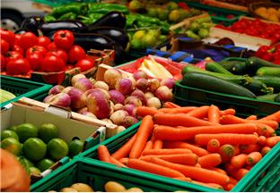
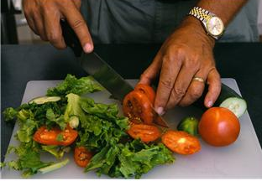
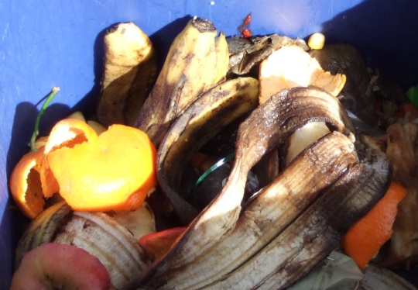
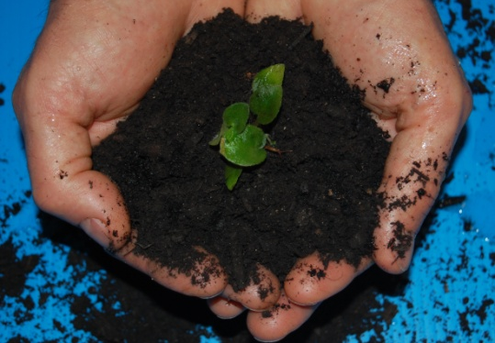
Not Just the Low-Hanging Fruit:
Opportunities to Reduce Wasted Food
Ashley Zanolli
FMI/GMA Global Sustainability Summit
August 14, 2014
Notes:
Build off of UK WRAP’s success

Slide 35

Why Target Food Waste in the US?
Costs US $165 billion annually.
Contributes to 14% of domestic GHG emissions.
1 in 6 Americans lack a secure supply of food.
(Citations: USDA, EPA; Photo credit: Rose Bowl website)
Food is simply too good to waste!

Slide 36
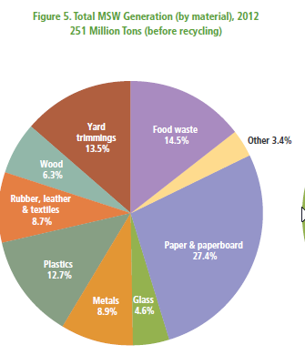
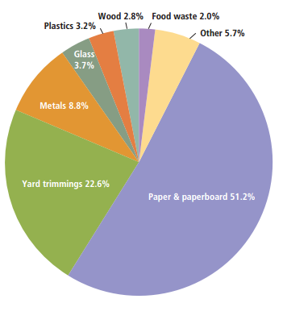
Food waste one of the single largest and least recovered waste streams in the U.S.
Total MSW Discards (by material), 2012
251 Million Tons (after recycling and composting)
Total MSW Recovery (by material), 2012
87 Million Tons
5% Food waste recovery rate!

Slide 37
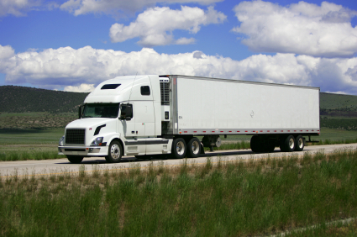
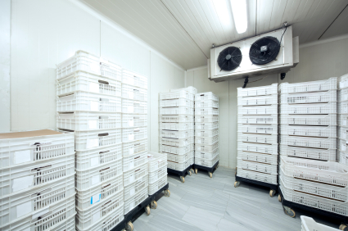
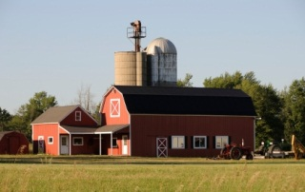
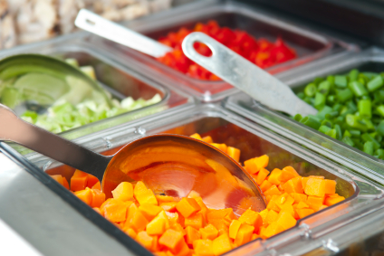
Prevention is the Key:
Cost Savings and Environmental Impacts
LOADING
PREP
TRANSIT
PRODUCTION
FARM
STORAGE
SERVICE
Every food item we throw away results in a large amount of invisible embedded energy and other resources being wasted.

Slide 38
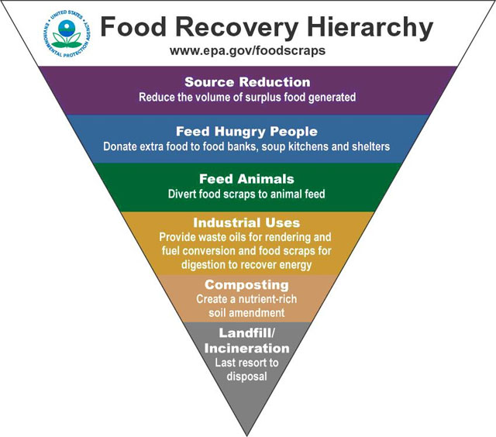
EPA’s Sustainable Food Management Program
Commercial
Food Recovery Challenge
Residential
Food: Too Good to Waste
www.epa.gov/smm/foodrecovery

Slide 39














Who has joined EPA’s Food Recovery Challenge?
(687 participants nationwide)

Slide 40
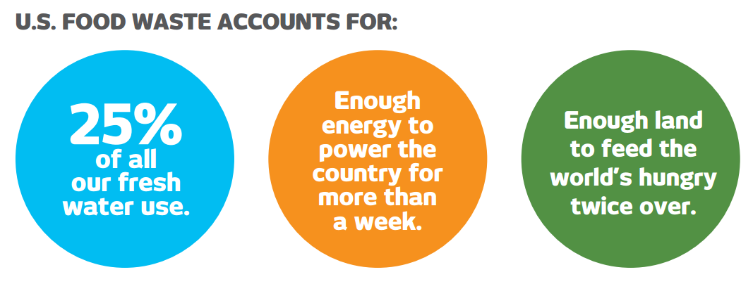
EPA and USDA
387 billion kcal wasted in the US every day.
Wasted Resources
Wasted Nutrients
Sources: EPA; USDA

Slide 41
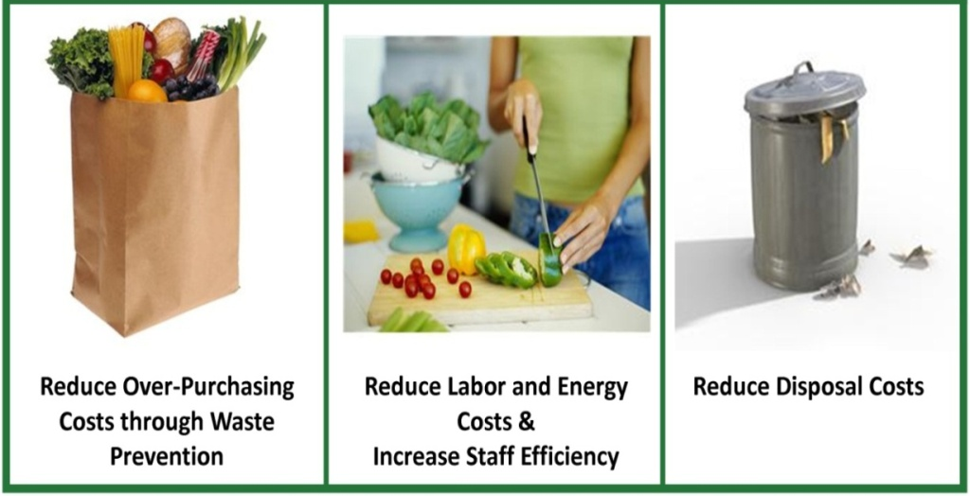

Opportunities to Reduce Wasted Food
                Consider:
                Joining the Food Recovery Challenge as a participant
                Endorsing FRC as an association
                Taking advantage of these toolkits:
Toolkit for reducing food waste and packaging (back of the house)
Food: Too Good to Waste
(front of the house)

Slide 42
Food Waste Source Reduction Toolkit
Excel spreadsheet tool for measuring food and packaging wastes
Helps identify:
  why food is wasted
  how to reduce waste
  how to recover waste
  how to calculate cost savings

Slide 43
Toolkit Components
                Goal: To prevent household wasted food
Main message: Food is too essential to throw away.
Implementation guide
Message map
Behavior change tools, including:
  fruit and vegetable storage guide
  shopping list template with meals in mind
  “eat what you buy” refrigerator prompt
Outreach Tools, including:
  infographic/poster
  factoids across the supply chain
  workshop presentation for community participants

Slide 44

Simple messages around 5 key behaviors
Get Smart: See how much food (& money) you’re throwing away
Smart Shopping: Buy what you need
Smart Storage: Keep fruits and vegetables fresh
Smart Prep: Prep now, eat later
Smart Saving: Eat what you buy
Saves a family of four about $1600 per year!

Slide 45
Community-Based Social Marketing
Pilot Design
Top 5 Strategies | Benefits | Barriers | Tools
Get Smart – Measurement Matters |  |  | Measurement tool Instructions
Smart Shopping | Waste aversion Saving money | Dynamic lifestyle Time Automatic behavior | Shopping list template
Smart Storage | Waste aversion Health Saving money | Knowledge Time Not enough room in fridge | Storage guide
Smart Prep | Convenience Saving money Health | Skills Knowledge | Website tips Social media platforms
Smart Saving | Waste aversion | Gratification Convenience | Refrigerator prompt Links to recipes
Audience: Families with young children, young full-time workers

Slide 46
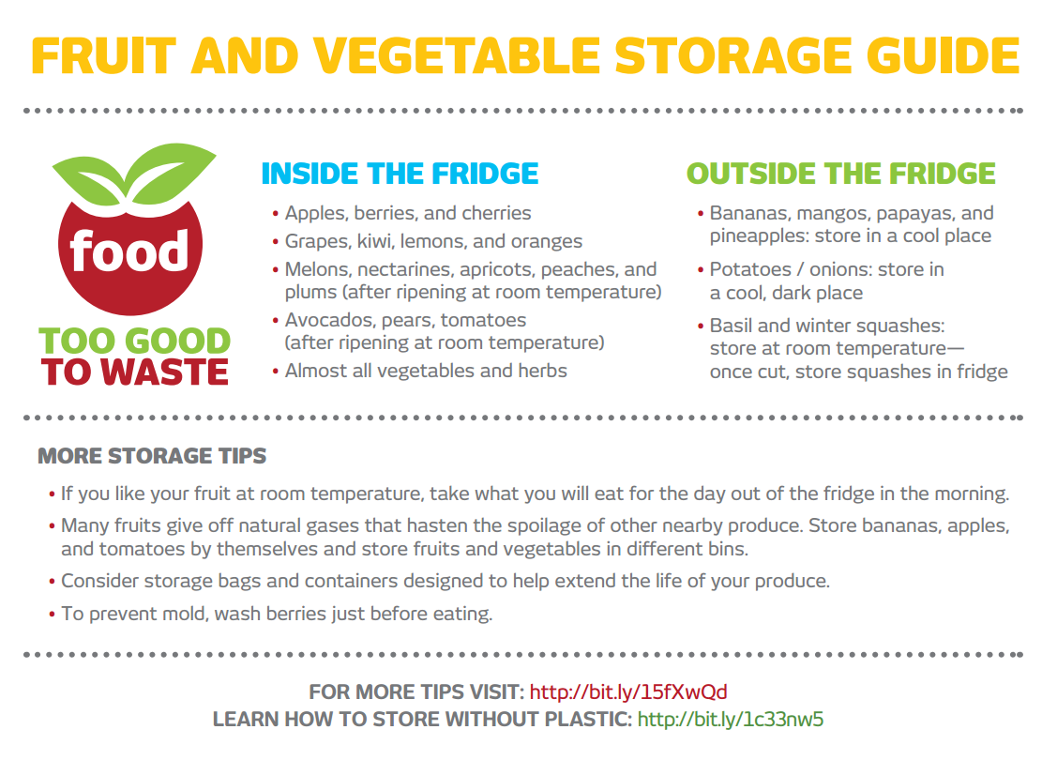
Fruit and Vegetable Storage Guide
Notes:
Fruit and vegetable storage guide (size 8” wide x 5.75” tall) – This guide provides useful information on keeping produce fresh as well as reduces the knowledge barriers associated with keeping fruits and vegetables fresh.
-Spanish Versions available

Slide 47
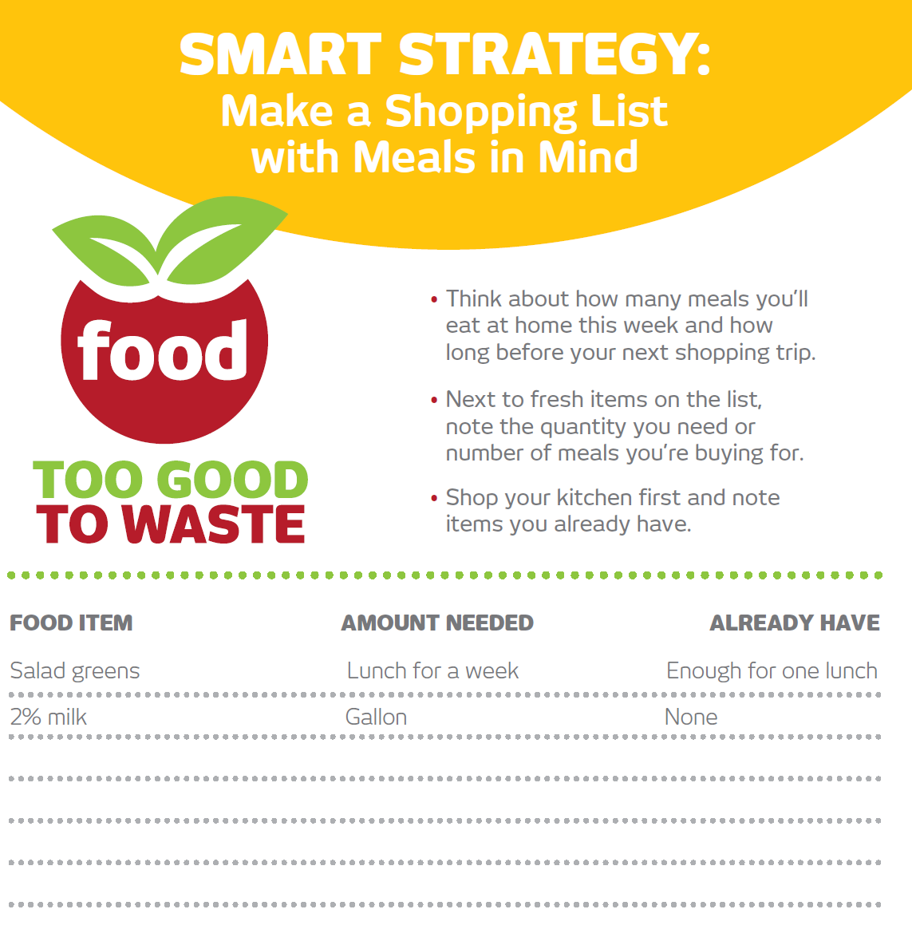
Shopping List Template
Notes:
Shopping list template (size 4.25” wide x 11” tall) - The shopping list template provides an easy to use tool for making a list with meals in mind. The tool also focuses on the cost saving strategy of using up food that has already been purchased.
- Spanish versions available

Slide 48
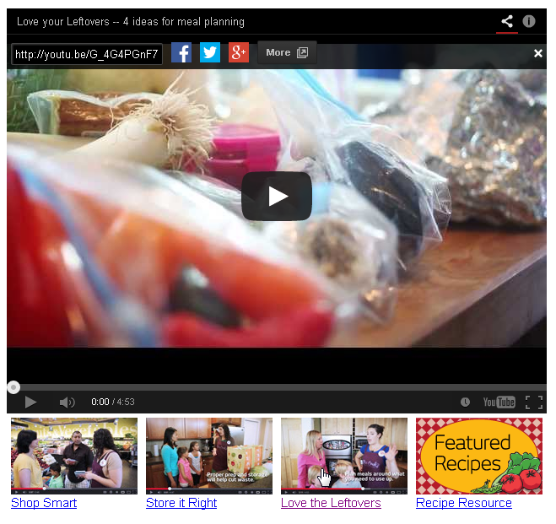
Collaborating with NW Grocers
King County and PCC Natural Markets Videos:
Shop Smart
Store it Right
Love your Leftovers
www.recyclefood.com
Fox Q13 News coverage

Slide 49
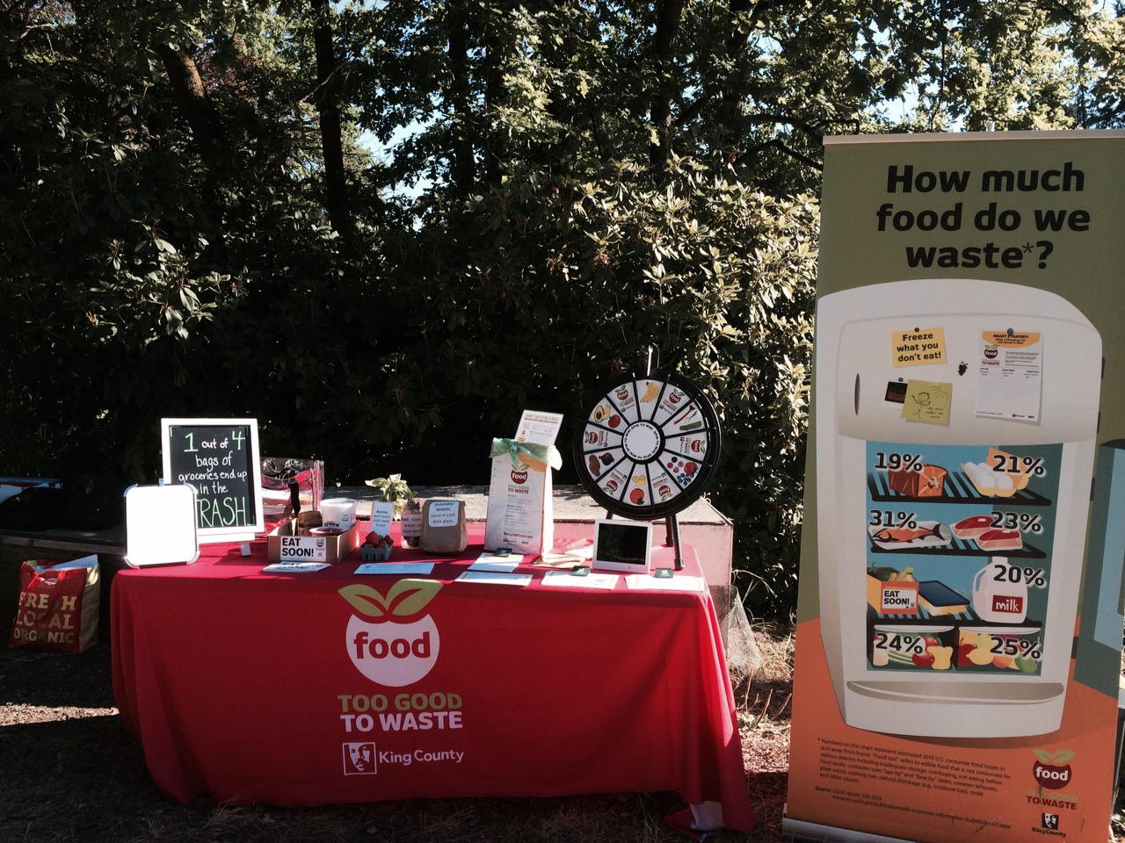
Local governments tabling at grocery stores
Notes:
Talk about tabling in grocery stores!
CBSM focuses on changing people’s behavior and attitudes using a variety of tools such as prompts, incentives, social norms, commitments and vivid communication at the community level through direct involvement. It focuses on removing barriers to an activity while at the same time enhancing the activity's benefits for the participants.

Slide 50
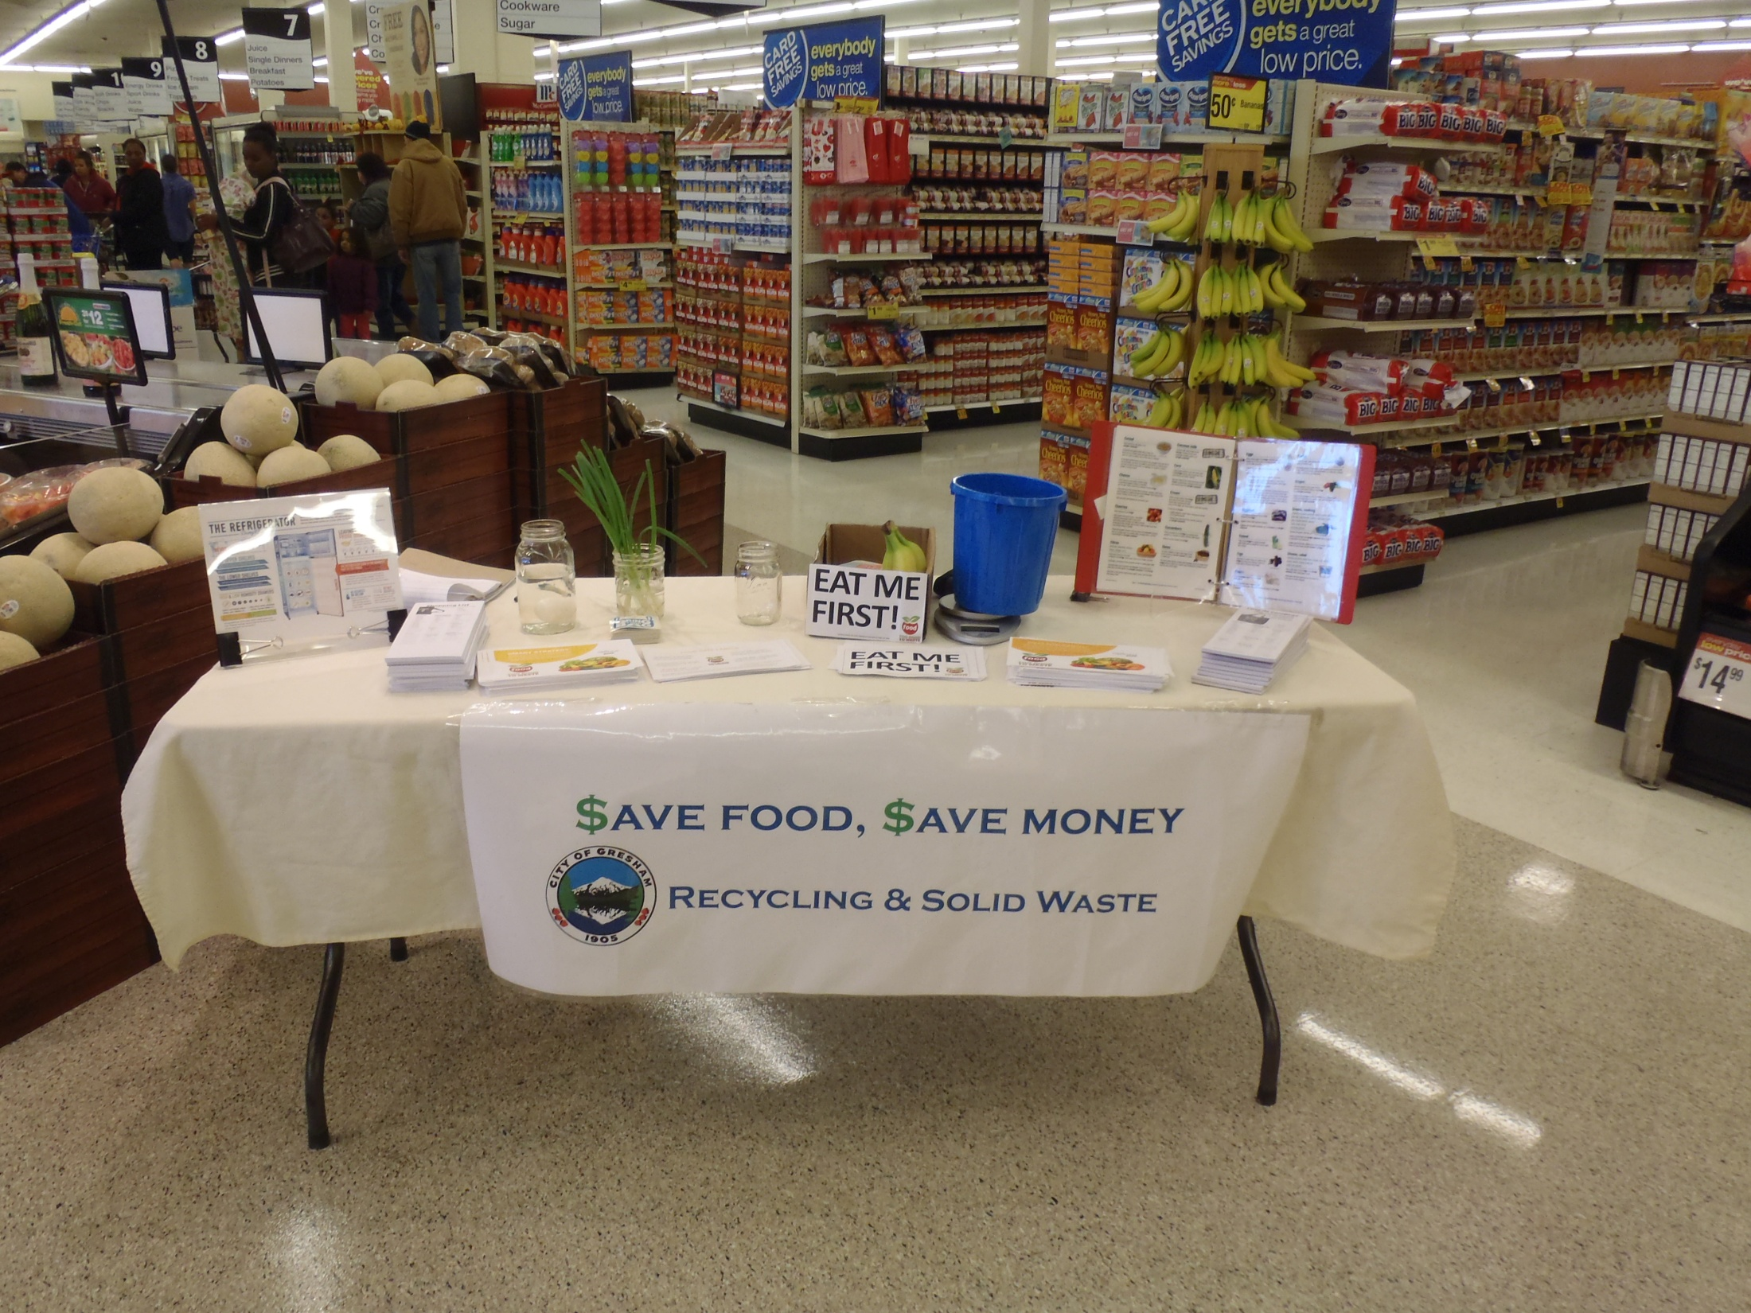

Slide 51
Implementing Partners
Original Implementing Partners:
  King County (WA)
  San Benito County (CA)
  Boulder County (CO)
  Seattle (WA) – baseline
  Results:
Initial data indicates that pilot implementation could
influence a 25% decrease in household food waste.
Current Implementing Communities:
  Honolulu (HI)
  Santa Monica (CA)
  Oakland (CA)
  Chula Vista (CA)
  Gresham and OR Metro (OR)
  King County scale-up (WA)
  Thurston County (WA)
  Oak Park (IL)
  Iowa City (IA)
  Minnesota Pollution Control Authority
  Rhode Island Food Policy Council
  University of Denver (CO)
  State of Vermont
  Sustainable Jersey City (NJ)
Notes:
Personal recruitment more effective than email.
Creating food waste awareness is key to lasting impact in food waste reduction.
Tools tied to specific behaviors are most effective.
Initial data indicates that toolkit use and pilot implementation could influence a 25% decrease in household food waste.
Develop and test food waste prevention outreach strategies in places where people are already interacting with food:
Community kitchens/meals
Farmers markets
Community gardens and farms
Food banks and meal programs
School lunchrooms
Grocery stores
Government programs that have expressed interest in food waste reduction include waste management (composting), climate change response, and food programs.
Schools may wish to integrate information on food waste prevention into their curriculum and colleges and universities often support sustainability programs aimed at the young adult demographic.
Civic or community groups and non-profits may have constituencies who are parts of the target audience or an interest in related issues. These organizations are able to do outreach through their social networks.
Grocers, Restaurants and other businesses may assist with outreach and also provide incentive goods (see the discussion below on measurement/awareness tools). Farmers markets, community supported agriculture (CSA) businesses and municipal waste management companies are also likely partners.

Slide 52
Scale-Up Next Steps
Toolkit posted to www.epa.gov/smm this summer
Zero Food Waste Forum in Berkeley Oct. 16-17, 2014
Social media campaigns in WA’s Thurston and King Counties and Honolulu, HI
Program evaluation and per capita waste reduction goals (January 2015)
Coordination with USDA, and other organizations for scale-up to a national campaign
  Beyond awareness, program delivery is critical!
Notes:
EPA is currently evaluating how to scale up these tools as part of the national Sustainable Food Management program. If you would like to be added to our mailing list to be notified when the toolkit is available for product review please email westcoastforum@epa.gov

Slide 53
What’s in it for You?
Cost savings for your business and your customers
Build brand value and consumer loyalty by helping your customers stretch their food budgets further
Help raise public awareness and expand the conversation on sustainability
Exhibit leadership and provide new products and services your customers need
Learn from peers and experts and increase your competitive advantage
Notes:
leveraging funding, managing problem, reducing costs
Other benefits: source reduction and improved post-consumer organics management from taking action in the back-of-the-house and in prepared foods

Slide 54
Questions?
Zanolli.Ashley@epa.gov
(206) 553-4425
How to join EPA’s Food Recovery Challenge: www.epa.gov/smm/foodrecovery
West Coast Climate Forum website: www.westcoastclimateforum.com/food
To be notified when the Food: Too Good to Waste Toolkit is ready
for public use, please email westcoastforum@epa.gov

