Slide 2

App-ifying sustainability
2014 Global
Sustainability
Summit
Creating an ecosystem of apps to drive sustain-ability and resource productivity into core business and consumer decision making
Steven Swartz
McKinsey & Company

Slide 3

Topic
Timing
1
Introduction: App-ification
5 minutes
2
Case example: Fostering buyer-supplier collaboration with RedE
10 minutes
3
The opportunity: Information flows and transparency that enhance sustainability
10 minutes
4
Group breakout: apps to enhance specific information flows and decision making
20 minutes
5
Report out: Rapid-fire pitches from each groups on their proposed solutions
10 minutes
6
Closing: Summary, voting for best app, and commitments to help development
5 minutes

Slide 4


What do we mean by “app”?
A self-contained program or piece of software designed to fulfill a particular purpose; an application, especially as downloaded by a user to a mobile device
Technology platform that leverages either the web or internal information systems to improve the availability, transparency, and/or quality of information to users
SOURCE: Google

Slide 5


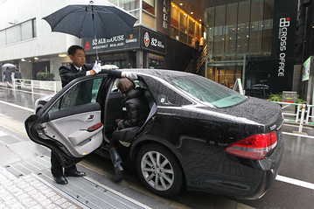

Great apps improve the quality and availability of existing data and unlock new information flows, with Uber as a prime example
An everyday example…
OLD
Customer
Service
Provider
NEW
3
Dispatch service
Riders
Taxi drivers
1
1
2
2
Improved transparency of availability, cost, and wait times
Eliminates live payment with stored credit card information
Rider and driver reviews reward all user’s experience
Increased avg. drivers wages
Riders
4
Taxi drivers
1
Customers choose drivers based on location, rating
3
2
Drivers accept customers, contact directly en route
1
Customers call dispatch or attempt to hail a cab by hand
3
Riders rate drivers for future riders
2
Dispatch identifies, notifies closest cab
4
Drivers rate customers for future drivers
3
Limited/no direct information flow
SOURCE: Uber, Bloomberg

Slide 6

A deep dive on an app more relevant to retailers, bringing together buyers, their suppliers, and affiliated groups to drive resource productivity
Retail buyers
Suppliers
NGOs
Industry groups

Slide 7
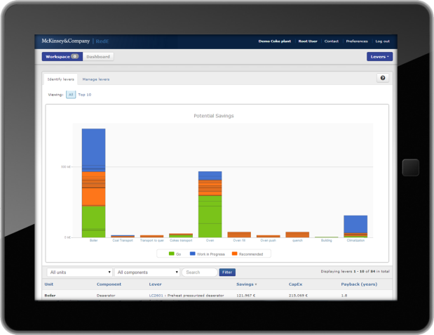
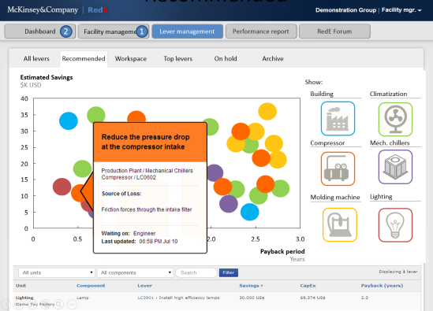
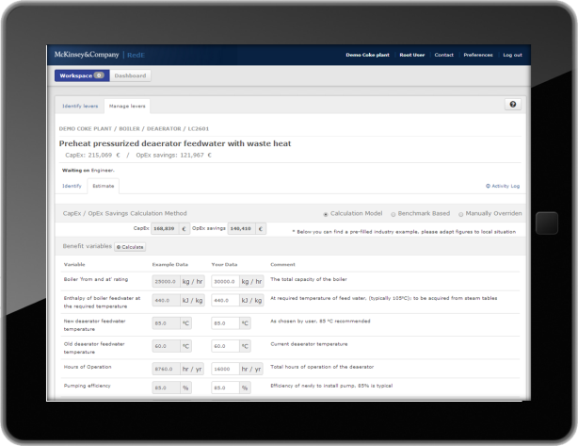
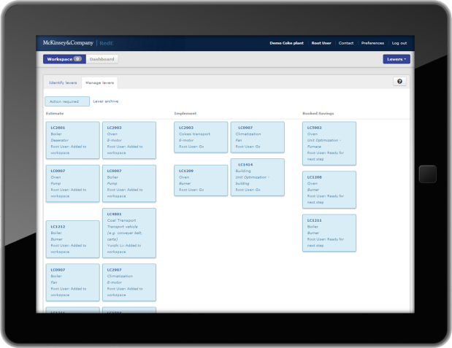
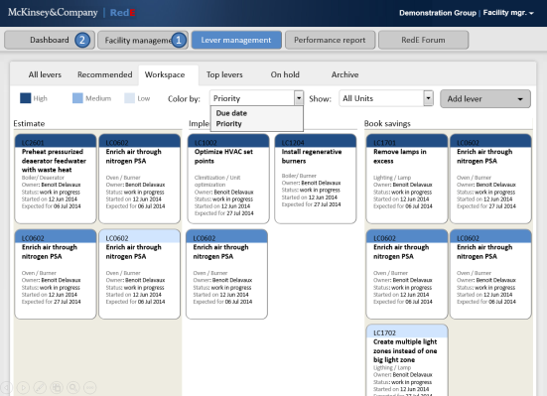
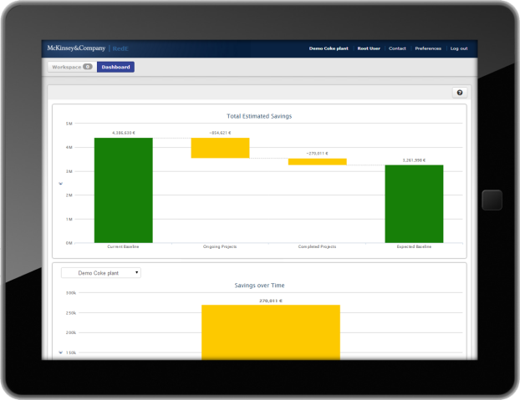
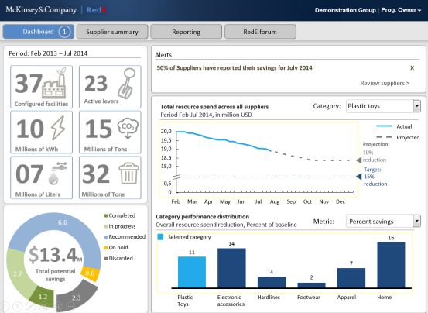
RedE is a simple web-based tool that allows buyers to help suppliers drive resource efficiency, lower costs, and improve supply chain transparency
RedE – HOW IT WORKS
1
Identifies a set of facility and process-specific levers, including savings and capex estimates to help users select what projects to consider
2
Helps users prioritize what levers to pursue using dynamic business cases based on actual user data
Provides a visual approach track implementation of projects from identification to booked savings
3
Enables performance management with a simple dashboard that tracks impact and peer performance
4
SOURCE: McKinsey

Slide 8

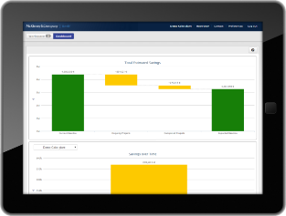
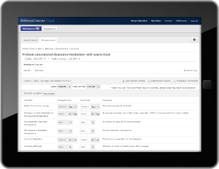
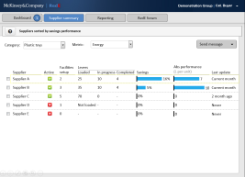
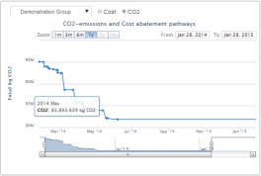
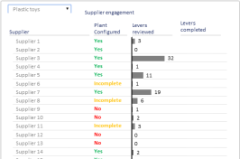
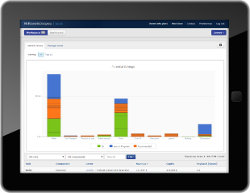
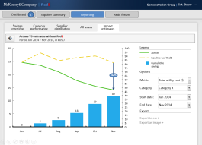


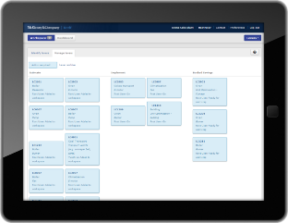
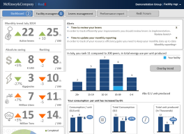


RedE provides a single platform to both disseminate EE project guidance across a network and monitor individual and aggregate performance
INFORMATION FLOWS
Program owners view individual site savings¹ and total impact, with performance management tools to track participation
Program owners sets up facility templates in RedE, loads custom levers relevant to their processes, and enroll sites/suppliers
Program owner
Centralized reporting
Project dissemination
Sites/suppliers track progress in cost and emissions reduction, as well as performance versus peers
Sites/suppliers select the recommended levers they want to pursue and use RedE to mature projects to completion
Sites/suppliers
1 Owned facilities only; individual supplier cost or energy savings data is not shared with the parent organization

Slide 9
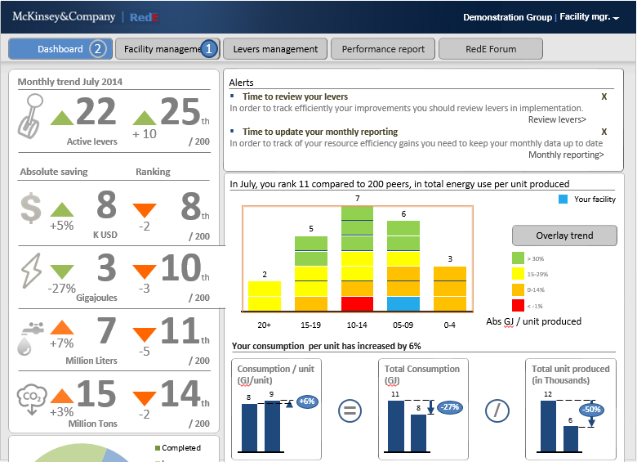
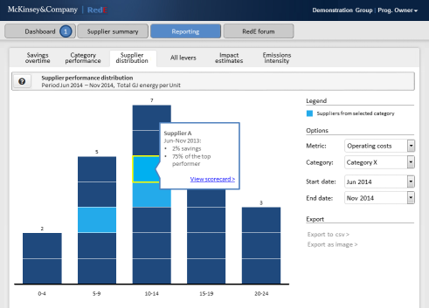
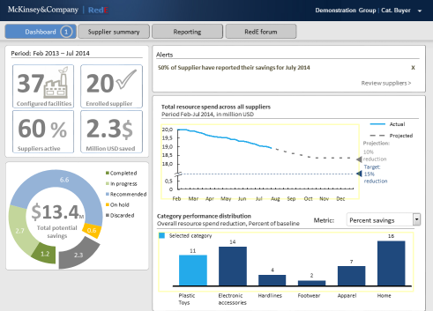
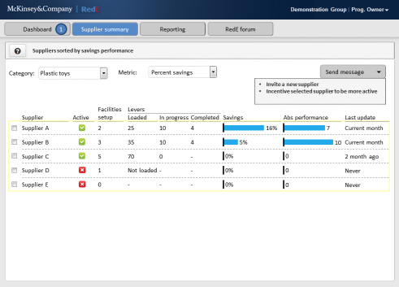
As the use of the RedE tool grows it provides insights into relative plant or supplier performance and encourages a ‘race to the top’
PERFORMANCE MANAGEMENT
  Performance dashboards can be linked to internal metrics and goals or standardized KPIs already in use by other RedE users
  Data accessibility for buyers to understand supplier participation, aggregate performance, and opportunities to accelerate savings
  Data for buyer procurement and sustainability teams to understand the impact they are driving and to use as a guide to source products

Slide 10
The retail value chain presents a host of opportunities for apps to improve the availability and quality of information
Raw materials
Tier 2/3 suppliers
Tier 1 suppliers
Potential Information flows
Workers
Consumers
Buyers
Demand forecasts
Production capacity
Product info
Raw material info
Stores
Product feedback
Working conditions
Best practices,
technical guidance

Slide 11

RedE aims to drive buyer and supplier collaboration to disseminate best practices and drive collective resource efficiency
RedE
Raw materials
Tier 2/3 suppliers
Tier 1 suppliers
The Resource efficiency deploy-ment Engine
Workers
Consumers
Buyers
Driving supply chain resource efficiency through technical and peer community support
Stores
Product info
Raw material info
Best practices,
technical guidance

Slide 12

Compass would share demand and availability forecasting across a network of small suppliers, enabling direct farm sourcing of produce
COMPASS
Raw materials
Tier 2/3 suppliers
Tier 1 suppliers
Compass
Supply chain planning and coordination
Consumers
Workers
Buyers
Transparent sharing of long-term produce needs and yield projections, enabling direct farmer relationships
Stores
Demand forecasts
Production capacity

Slide 13
Acre would combine several disparate sources of commodity data into a single database. Improving data quality and availability
ACRE
Raw materials
Tier 2/3 suppliers
Tier 1 suppliers
E
AcrE
Agricultural commodity research Engine
Workers
A
CR
Consumers
Buyers
Combing governmental, NGO, and proprietary crop knowledge into a simple assessment tool
Stores
Raw material info
Best practices,
technical guidance

Slide 14
Nth enables workers to drive social compliance by cataloguing and publically sharing violations and potential hazards
Nth
Raw materials
Tier 2/3 suppliers
Tier 1 suppliers
^
Nth
Twitter with a back-wards Snapchat
Consumers
Workers
Buyers
Workers photograph, share compliance violations, while auto-delete preserves individual anonymity
Stores
Working conditions

Slide 15
Index_{c} provides clear, comprehensive product sustainability visibility to consumers while communicating their preferences and feedback upstream
INDEXc
Raw materials
Tier 2/3 suppliers
Tier 1 suppliers
Index_{c}
More product info for better decision making
Workers
i_{c}
Consumers
Buyers
Product sustainability details at POS; upwards feedback on drivers of purchasing decisions
Stores
Product info
Raw material info
Product feedback

Slide 16

What are some common threads across successful enterprise sustainability apps?
SUCCESS DRIVERS
A positive business case: a simple and clear economic or personal motivation for all actors required to participate
IP protection: systems that guard essential proprietary data, and inspire confidence in the impacted parties
A catalytic actor: stakeholder willing to test and drive adoption, with enough influence to motivate all necessary participants
Collaboration: overarching “common goal” motivation for participants, coupled to long-term value capture/creation
Game-ification: leveraging peer competition wherever possible, with public leaderboards and recognition

Slide 17

Help develop one of our thought-starters… or create a novel idea
GROUP BREAKOUTS
  STEP
  1. Choose your group. Help develop one of our four existing ideas or work in one of two teams to create a novel solution
1
2
3
4
5
6
A
CR
E
?
?
^
i_{c}
  2. Brainstorm the concept. With the common success drivers as a guide, sketch out the problem, actors, platform, and features of your app
  3. Prepare your pitch. Refine and condense the essential elements of your solution for a 90-second pitch to the group
  TOOLS
  Each group should have: Easel and a hardcopy of the materials

Slide 18
Common threads and a set of corresponding questions to think through
BREAKOUT GUIDANCE
A positive business case: a simple and clear economic or personal motivation for all actors required to participate
IP protection: systems that guard proprietary data, and inspire confidence in the impacted parties
A catalytic actor: stakeholder willing to test and drive adoption, with enough influence to motivate all necessary users
Collaboration: overarching “common goal” motivation for participants, coupled to long-term value capture/creation
Game-ification: leveraging peer competition wherever possible, with public leaderboards and recognition
Who are the main actors and what are their incentives to use the app?
What is the revenue model?
What proprietary or sensitive information is needed?
How will it be protected/anonymized?
How would the app get off the ground?
Who would push its adoption and how would they engage the critical users?
What is the common goal?
What elements are built into the system to remind users of the greater goal?
How can peer pressure be leveraged?
What information would you make available to the greater network?

Slide 19


Let’s pick a winner…
VOTING
1
2
3
E
A
CR
^
4
5
6
?
?
i_{c}

Slide 20
For those interested, a chance to help make a new app a reality
NEXT STEPS
Signup to join our working group for the new app
Participate in a monthly group call/VC to refine the concept
Join the external board of a possible future commercial venture with McKinsey Solutions
No rights reserved on the IP generated today – no limit if folks want to run with ideas

