Slide 1
Climate Change:
Engagement on all Levels
Curt Spalding
August 14., 2014

Slide 2

Notes:
Success of Environmental Policy through the years: Specifically New England Success (ACADIA Nat’l Park)
For 40 years, EPA has carried out a mission to protect the air we breathe, to safeguard the water that flows through our communities and into our homes, to ban unsafe chemicals and pesticides, and to care for the land where we build neighborhoods, schools and businesses.
Boston Globe Columnist, Tom Kane talked about environmentalism in the United States in one of his columns.
He referenced two environmental movements thus far:
The era of environmental conservation under Teddy Roosevelt NEXT SLIDE

Slide 3
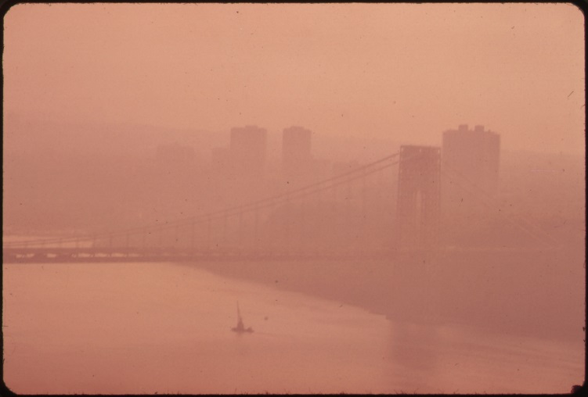
Notes:
Second movement: the reaction to degradation and poisoning (Silent Spring Era): (NYC Haze, Documerica photo)
It’s clear that there is a constant wave of negativity around environmental regulation, but if you consider where we came from, it’s even more clear that we have improved the health of our environment significantly.
It’s even hard to imagine some of the environmental horrors of only a few decades ago: rivers running colors, thick smog and haze covering cities, unregulated factories where workers were exposed to toxic chemicals…etc.
Today, the challenge of climate change dominates our focus. It’s a different kind of challenge. One that threatens not only the health of our environment and our people, but also our economic well being, and generally our way of life.

Slide 4
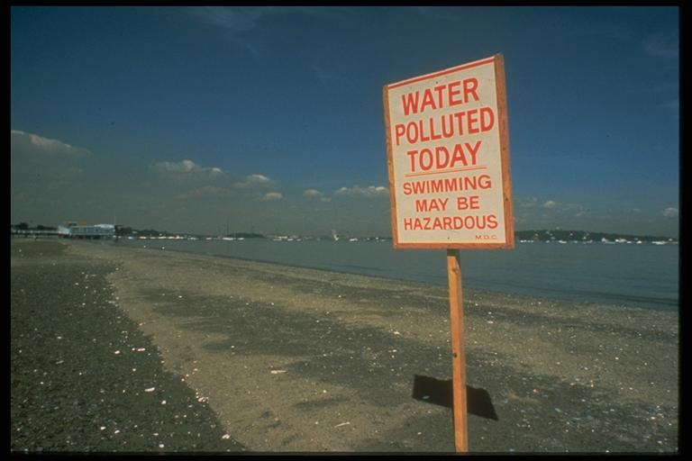
Notes:
POLLUTED BOSTON HARBOR
Message: Boston Harbor used to be one of the dirtiest harbors in America: the Aspen Institute referred to it has having ‘disturbing environmental conditions.’
Raw sewage was dumped into the waters openly and freely

Slide 5
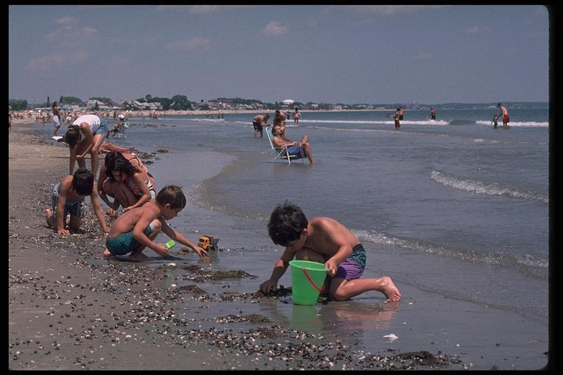
Notes:
BOSTON HARBOR TODAY
Message: Today regulations and massive cleanup efforts have managed to make the harbor swimmable again.

Slide 6

Notes:
CLIMATE CHANGE: NEW AGE PROBLEM
The systems we have built our lives on depend on stability. We are going to see instability in our economic, political and environmental systems because of Climate Change.

Slide 7
“. . . those who claim the science is unsettled or action
is too costly are simply trying to ignore the problem . . .”
-Henry M. Paulson Jr.
Notes:
Economic Uncertainty:
Risky Business
…viewing climate change in terms of risk assessment and risk management makes clear to me that taking a cautiously conservative stance — that is, waiting for more information before acting — is actually taking a very radical risk. We’ll never know enough to resolve all of the uncertainties. But we know enough to recognize that we must act now.”

Slide 8
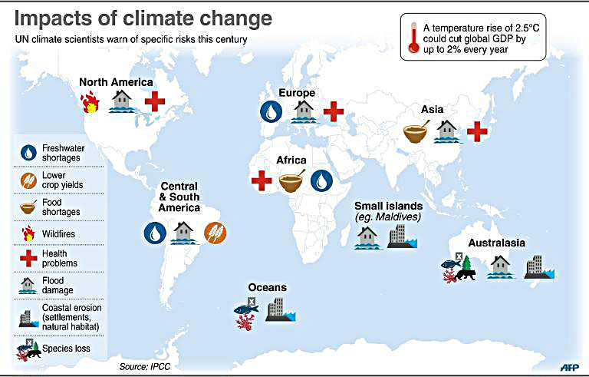
Notes:
Here you can see political, economic and environmental impacts
Water shortages, lower crop yields, food shortages, wildfires, health problems, flood damage, coastal erosion, species loss
Economic Risk
Message: Climate Change leads to uncertainty in our economic system. Uncertainty is risk…
Henry Paulson Op Ed: (points)
-For too many years, we failed to rein in the excesses building up in the nation’s financial markets. When the credit bubble burst in 2008, the damage was devastating
-We’re making the same mistake today with climate change. We’re staring down a climate bubble that poses enormous risks to both our environment and economy. The warning signs are clear and growing more urgent as the risks go unchecked.
Comparison: We are building up excesses (debt in 2008, greenhouse gas emissions that are trapping heat now). Our government policies are flawed (incentivizing us to borrow too much to finance homes then, and encouraging the overuse of carbon-based fuels now). Our experts (financial experts then, climate scientists now) try to understand what they see and to model possible futures. And the outsize risks have the potential to be tremendously damaging (to a globalized economy then, and the global climate now).
Bottom line: the decisions we’re making today — to continue along a path that’s almost entirely carbon-dependent — are locking us in for long-term consequences that we will not be able to change but only adapt to, at enormous cost.

Slide 9

Notes:
Food Risk
Agriculture is an important sector of the U.S. economy. In addition to providing us with much of our food, the crops, livestock, and seafood that are grown, raised, and caught in the United States contribute at least $200 billion to the economy each year.
Agriculture and fisheries are highly dependent on specific climate conditions. Trying to understand the overall effect of climate change on our food supply can be difficult. Increases in temperature and carbon dioxide (CO₂) can be beneficial for some crops in some places. But to realize these benefits, nutrient levels, soil moisture, water availability, and other conditions must also be met. Changes in the frequency and severity of droughts and floods could pose challenges for farmers and ranchers. Meanwhile, warmer water temperatures are likely to cause the habitat ranges of many fish and shellfish species to shift, which could disrupt ecosystems. Overall, climate change could make it more difficult to grow crops, raise animals, and catch fish in the same ways and same places as we have done in the past. The effects of climate change also need to be considered along with other evolving factors that affect agricultural production, such as changes in farming practices and technology.

Slide 10
“Climate change … can add to the challenges of global instability, hunger, poverty, and conflict.”
-Chuck Hagel, United States Defense Secretary
Notes:
Security Risk
Food and water shortages, pandemic disease, disputes over refugees and resources, more severe natural disasters – all place additional burdens on economies, societies and institutions around the world.”
rights reserved by Nick Mulcock (night shot of NYC/NJ)

Slide 11
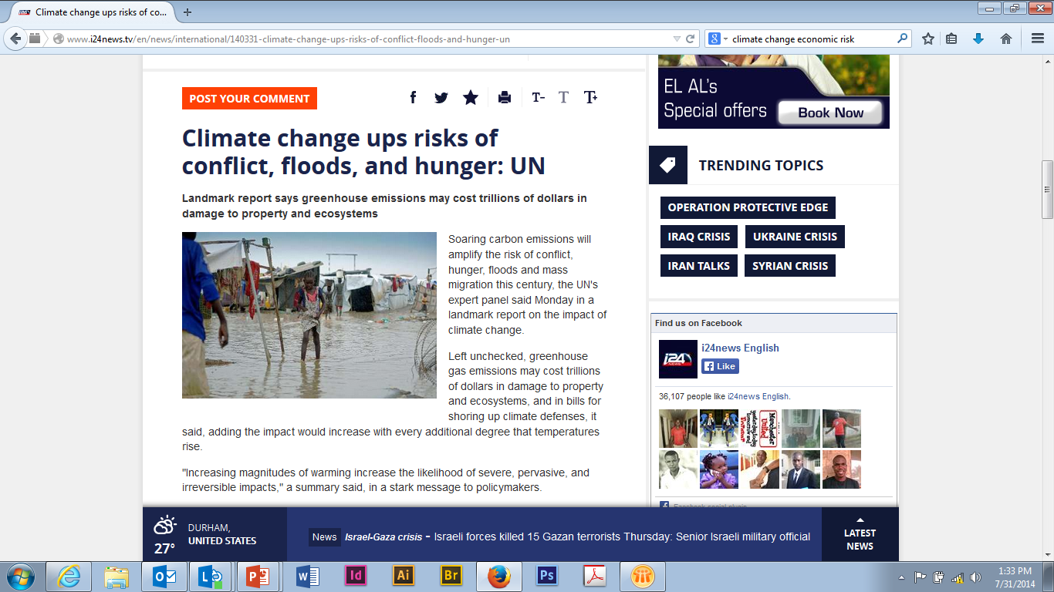
Notes:
Security Risk
Message: Climate Change can lead to extreme situations (such as drought, and agriculture loss) that can increase the risk for conflict in other countries
Security Risk and Climate Change:
Thomas Friedman Op-Ed:
Climate Change doesn’t just impact economic stability, it also impacts security.
Thomas Friedman– an op-ed columnist from the New York Times has written a few articles about the impacts of increasing drought in the Middle East. He references a study that was co-produced by the Center for American Progress, the Stimson Center and the Center for Climate and Security from 2006 to 2011, up to 60 percent of Syria’s land experienced the worst drought ever recorded there — at a time when Syria’s population was exploding and its corrupt and inefficient regime was proving incapable of managing the stress
In 2009, they noted, the U.N. and other international agencies reported that more than 800,000 Syrians lost their entire livelihoods as a result of the great drought, which led to “a massive exodus of farmers, herders, and agriculturally dependent rural families from the Syrian countryside to the cities,” fueling unrest.

Slide 12
INCREASE IN EXTREME PRECIPITATION 1958-2011
Notes:
Environmental Risk
In New England we are focused on water
more heavy precipitation: from 1958-2011, there has been a 71 percent increase in the amount of precipitation falling in heavy precipitation in New England (74% in north east)
impacts leave our communities vulnerable
Hurricanes and tropical storms are increasing in intensity.
Superstorm Sandy cost the American economy an estimated $65 billion dollars.

Slide 13
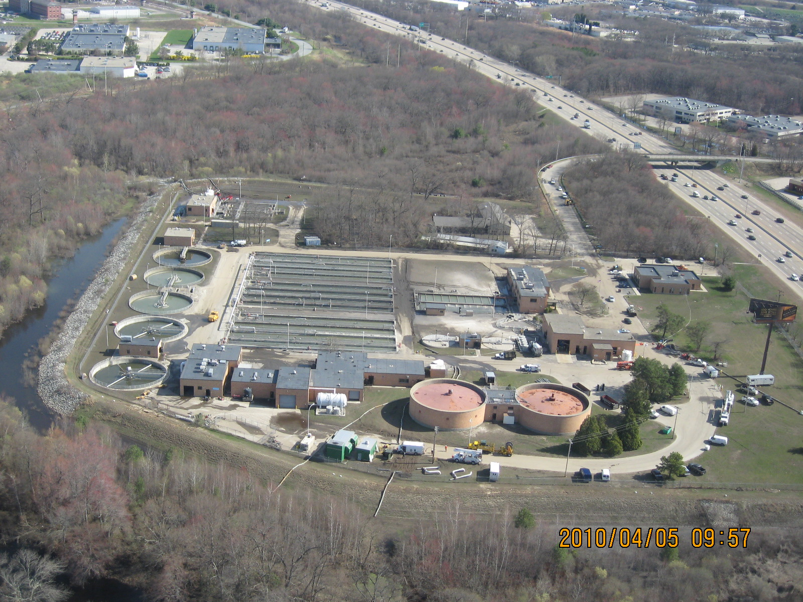
Notes:
Warwick, RI before 2010 floods

Slide 14
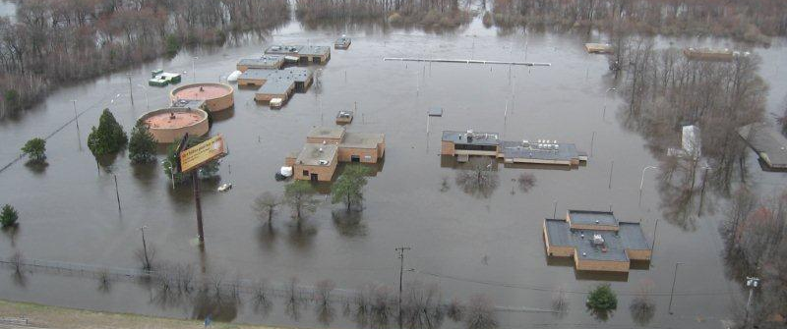
Notes:
Warwick after2010 floods

Slide 15
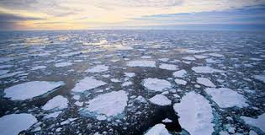






Engagement at
all levels
Notes:
Who is working on Climate Change?
Climate Change: ALL GOVERNMENT EFFORT:
All levels of government are engaged on Climate Change– and need to be because it impacts all of us. It’s a complicated problem with a lot of minds working at different levels– the challenge is to make connections and leverage resources to come up with sustainable solutions for local communities.
Federal Government:
3 Branches of Govt
White House
EPA and other Agencies like EPA
State Government
VT State
VT Department of Environmental Conservation
Local Government
City of Burlington, VT

Slide 16

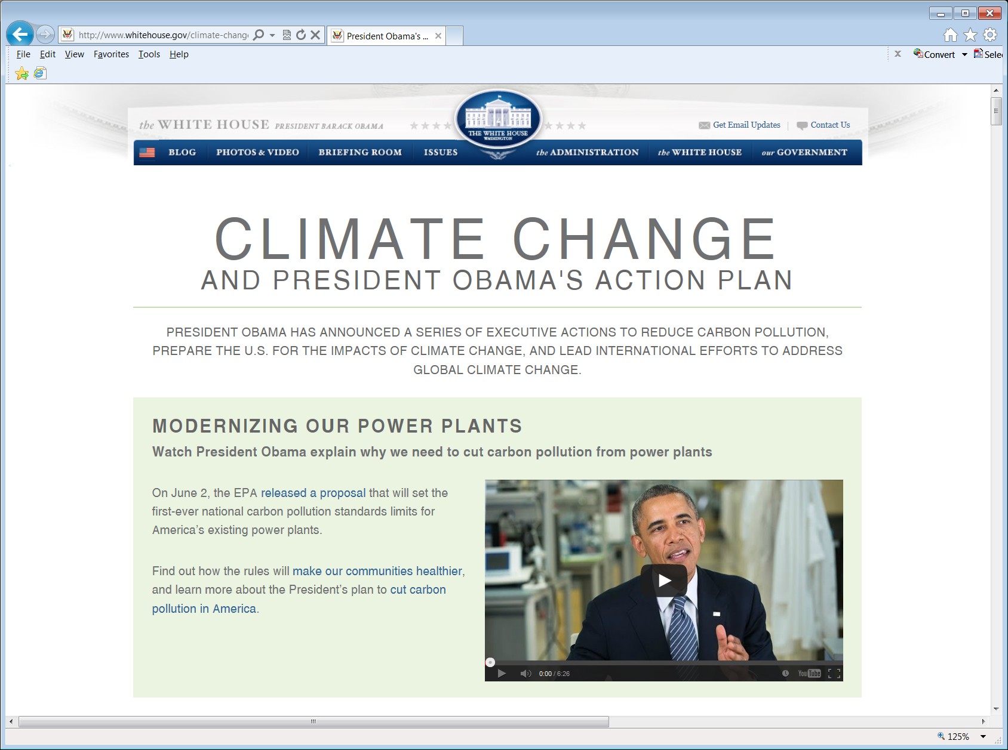
Notes:
EXECUTIVE BRANCH and EPA
We all know, the Northeast region from DC to Maine is increasingly vulnerable to heat waves, coastal and river flooding, and all the challenges that come with more extreme weather.
The costs of inaction are mounting and we are already paying a price- Extreme conditions stress resources and hurt the economy
Last year there were 11 different weather and climate disaster events that resulted in a total of more than $110 billion dollars in estimated damages
Weather events have a negative effect on GDP and economic growth, look at last winter
we have to plan ahead.
At the federal level that means committing to both mitigation and adaptation efforts.
President Obama and Administrator McCarthy are dedicating to action on Climate Change. The President outlined his plans for both mitigation and adaptation in the Climate Action Plan—something we are taking major steps on.
The Climate Action Plan looks at multiple angles of Climate Change that I’m going to talk to you about today.
Reducing our carbon footprint on both large and small scales is a big part of the Climate Action Plan

Slide 17
Mitigation:
Emissions Reduction
Reducing Carbon Pollution
Accelerating Clean Energy
Notes:
MITIGATION: Reducing Carbon Pollution and Accelerating Clean Energy
Reducing our carbon footprint while improving energy efficiency and tightening systems

Slide 18
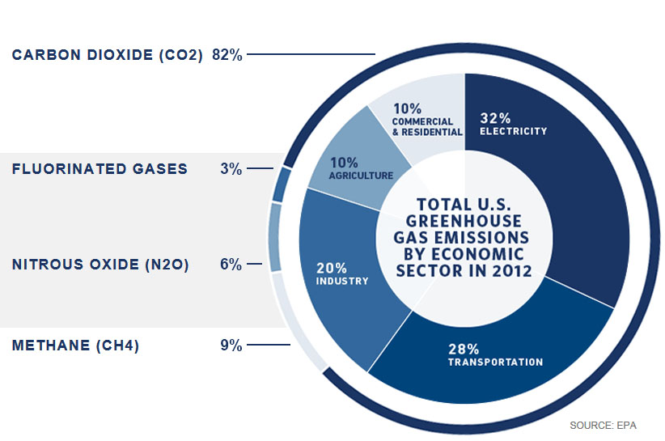
The Clean Power Plan Proposal Addresses the Largest Source of Green House Gas Emissions in the U.S.
Notes:
(Clean Power Plan): targeting the largest source of GHG first
On June 2, EPA proposed the first national guidelines to cut carbon pollution from existing power plants.
Power plants are the largest concentrated source of carbon dioxide emissions in the United States.
Nationwide, by 2030, this rule would achieve CO2 emission reductions from the power sector of approximately 30 percent from 2005 levels, while starting to make significant reductions in 2020.
In the proposed rule, EPA establishes goals for states for CO2 emissions reductions, and it is up to the states to come up with plans for meeting those goals.

Slide 19
Clean Power Plan focuses on four building blocks as strategies for states to achieve reductions goals
  MAKE
  fossil fuel power
  plants more
  efficient
USE
lower-emitting power sources
BUILD
more zero/low-emitting energy sources
BE
more efficient
with electricity
Notes:
Clean Power Plan focuses on four building blocks as strategies for states to achieve reductions goals
Make fossil fuel power more efficient
Use lower emitting power sources
Build more zero/low emitting energy sources
Be more efficient with electricity

Slide 20
Strategy EPA used to calculate the state goal
  MAKE
  fossil fuel power
  plants more
  efficient
USE
lower-emitting power sources
BUILD
more zero/low-emitting energy sources
BE
more efficient
with electricity
Efficiency Improvements
Dispatch changes to existing natural gas combined cycle (CC)
Renewable Energy
Certain Nuclear
Demand-side energy efficiency programs
Notes:
Strategy EPA used to calculate the state goal: figure out where states are on the spectrum and how we get to a national goal of 30% reductions
EPA’s proposed guidelines work by setting state goals that reduce a state’s carbon intensity rate, or ‘pollution to power ratio’ over time.
To set these state specific goals, EPA looked at all the great work that states, cities and utilities are already doing to lower carbon pollution from the power sector. We also gathered publically available data for each state, from 2012, which is the most current info available.
This was the starting point, then EPA looked ahead to see what could reasonably be accomplished by 2030. We took the energy and emissions data for each state and plugged it into the formula to be fair to all states.
Bottom line: states have a huge amount of flexibility.
It’s really up to the states to make the program work in a way that suits them best. Which is exactly how the Clean Air Act envisioned this program should work.

Slide 21
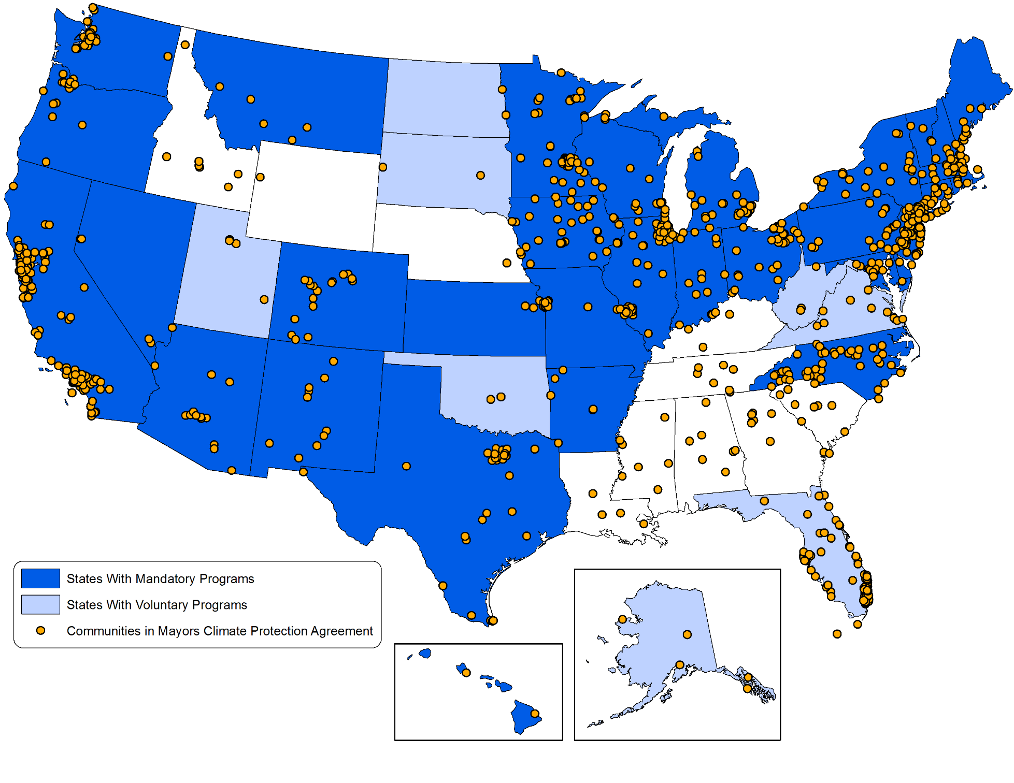
States and Communities with Programs that Reduce Carbon Pollution
Notes:
New England States Already Invested in CO2 Emissions
It’s important to mention here that many states and local governments are already invested in programs to meet CO2 emissions reductions.
Look at New England—our states and local governments have signed onto a significant number of programs to work on the four building blocks
Programs like RGGI and Renewable Portfolio Standards. These sorts of programs are all part of an all of the above energy strategy to look at overall emissions across states and across regions.
As you can see, New England and a lot of the country will be building on the programs and progress we have already seen here. In fact, there is potential to export our capability to implement strong programs and new technologies in other parts of the country.
NEXT SLIDE: WHAT DO THE DOTS ON THE MAP MEAN…

Slide 22
New England Economic Growth and ISO New England System Emissions
Data Sources: 2012 ISO New England Electric Generator Air Emissions Report, US Department of Commerce, Bureau of Economic Analysis
Notes:
What’s happening in New England: Emissions Down, GDP Up
For us, reducing CO2 emissions has been a success. In New England, we have seen the economy grow as CO2 emissions decreased. That is a sweet spot that we are looking to replicate across the country. We don’t have to choose between environmental health and the economy.
Another huge piece of this is competitiveness
New England has been working on refining programs and improving energy efficiency for over a decade
Our focus means opportunity now to export expertise
Investment in innovation/clean tech: example greentown labs

Slide 23
Transportation
Notes:
All of the Above Energy Strategy: Transportation: second largest GHG source
Now, the Clean Power Plan is a big step forward to seeing real reductions in the power sector nationwide. But if we go back to the slide showing the other major polluters of Greenhouse Gases….we notice the transportation sector is a close second behind power plants.
And this is a sector we have made huge strides in. EPA and National Highway Safety Administration have put in place historic greenhouse gas standards and fuel economy standards for cars and light duty trucks.
A couple of months ago, the President also directed EPA and DOT to improve efficiency for heavy-duty trucks as well.
Fuel efficiency is energy efficiency—transportation consumes approximately 28 percent of the nation’s energy, and of that 60 percent is used by personal vehicles.

Slide 24
Notes:
FUEL STANDARDS
Our new standards will double the distance we go on a gallon of gas.
They will slash 6 billion tons of carbon pollution by 2025. That’s as much as the US emitted all together in 2010.
American families will save up to $8,000 dollars at the pump over the life of their cars.
In 2011, we exported almost 33% more cars than we did in 2009—a clear sign of a healthy industry.
Since Chrysler and GM emerged from bankruptcy, the auto industry has added nearly 250,000 jobs, the best period of job growth in over a decade.
New England is pushing the envelope on our action to become less dependent on fossil fuels across multiple sectors.

Slide 25
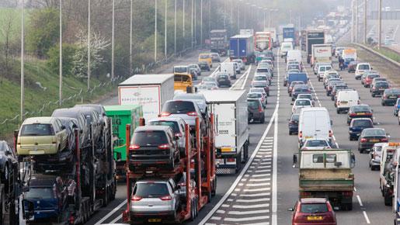
Notes:
Light Duty Vehicle Standards
AND
Heavy Duty Vehicle Standards
EPA and National Highway Safety Administration have put in place historic greenhouse gas standards and fuel economy standards for cars and light duty trucks.
This year the President also directed EPA and DOT to improve efficiency for heavy-duty trucks as well.
Fuel efficiency is energy efficiency—transportation consumes approximately 28 percent of the nation’s energy, and of that 60 percent is used by personal vehicles.
<<<BEGIN TRANSITIONING TO Program efforts to reduce energy waste in businesses and homes: energy star, net zero…)>>>

Slide 26

Notes:
Smaller scale transportation program that directly impacts you as food manufacturers and reltailers
I want to just mention a voluntary EPA program for freight fuel efficiency that’s been going strong for 10 years, and has been termed by the great minds in MIT’s Center for Transportation & Logistics as “the Gold standard for freight carbon tools.” The Food Marking Institute is an Affiliate in the program, and many of you are partners in SmartWay already-- Wal-Mart, Delhaize, Stop&Shop, H-E-B, Safeway, Giant Eagle.... I could go on.
So why does EPA care about transportation supply chains?
Freight accounts for about 1/16th of all U.S. GHG emissions. That’s not huge, but it’s a segment we can do something about.
Since 1990, the rate of growth of GHG emissions from freight sources has been twice as fast as that for passenger travel (31.4 percent vs. 15.7 percent).
Freight is a cornerstone of the US economy– transportation logistics costs $836 billion (5.4% of GDP)– so controlling fuel costs can help both shippers and carriers reduce budget uncertainty.

Slide 27
Dynamics
Shippers:
Choose efficient carriers
Optimize mode choice
Shrink carbon foot print
Earn recognition
EPA:
Provide platform & tools
Bring agencies & industry together
Show success
Logistics:
Help both
Earn recognition
Carriers:
Save fuel & money
Attain preferred status with shippers
Earn recognition
27
Notes:
27
What drives the shippers and carriers toward EPA’s SmartWay Transport partnership?
The win-win potential of shrinking their carbon footprints by learning new ways to save transportation costs.
Tools that allow partners to benchmark, improve, and report on their progress to EPA and international carbon accounting programs. (For example, SmartWay is used for Scope 3 reporting to the Green House Gas Protocol’s corporate standard.
Getting helping finding business partners, technologies and strategies that can help them improve.
Being recognized as a good corporate citizen by a data-driven, peer-supported program.
Shippers are at the top of the SmartWay food chain. SmartWay helps them find fuel-efficient carriers, and figure out ways to make their whole transportation supply chain more efficient.
Carriers are the meat and potatoes of SmartWay. EPA shows them technologies and strategies that can save them money, and earn shippers’ business.
Logistics partners (3PLs, etc) can help shipper clients reduce emissions by designing the right mix of fuel-efficient, cost effective carriers. EPA helps them find those carriers, and incentivize those they already use to improve.
EPA supplies the platform: accurate, fine-grained accounting tools; a level, open playing field; equipment testing and certification; and public recognition for accomplishments.
Affiliates like trade associations bring this value to their members, with help from EPA.

Slide 28

SmartWay: Where’s the Beef?
3000 partners
Top 100 U.S. truck carriers
All Class 1 RRs
Fortune 500 shippers
650,000 trucks
50 billion annual truck miles
51 million metric tons of CO₂
120 million barrels of oil and 5 billion gallons of fuel
$16.8 billion dollars in fuel costs
Notes:
SmartWay has been going strong for 10 years and racking up savings. These are savings that increase year-over-year as existing partners help each other improve, and new partners join.
Because SmartWay was designed by industry and EPA, the dynamics are market-based. It’s a very efficient program in terms of EPA and partner resources. Charter & leading partners stay involved in growing, evolving & promoting SmartWay.
Among SmartWay’s 3000+ partners in the US and Canada are 250 Shippers and 500 Logistics providers.
If your company isn’t already a partner, you need to be. Speak to one of the FMI contacts for SmartWay– Patrick Walsh, VP for Supply Chains and Chief Business Development Officer, or Jeanne vonZastrow, Senior Director of Sustainability. Or I can direct you to Abby Swaine, EPA NE’s lead liaison to the national program.

Slide 29
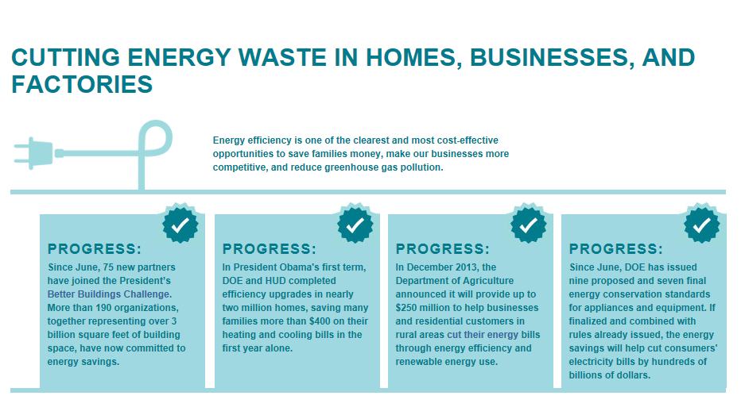
Notes:
SMARTWAY WAS A GREAT TRANSITION INTO THIS NEXT SECTION OF MY TALK
It’s important to recognize that we need an ALL OF THE ABOVE ENERGY STRATEGY, and promoting sustainable approaches in business practices
EPA has a number of programs working on energy reduction, recovery and overall sustainability to reduce waste and improve efficiency while helping curb our carbon footprint

Slide 30
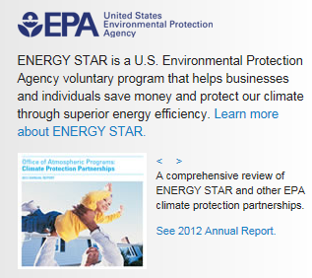
Notes:
Cutting Energy Waste in Homes, Businesses and Factories:
An important part of EPA’s Clean Power Plan and the President’s Climate Action Plan is cutting energy waste. States will have the option to use demand-side energy efficiency measures in their 111(d) plans and the President has set a goal to become at least 20 percent more energy efficient by 2020. I have no doubt that voluntary programs like ENERGY STAR will help both the federal government and states reach our goals.
Over the last 20 years, with help from ENERGY STAR, American families and businesses have saved 297 billion dollars on utility bills and prevented more than 2.1 billion metric tons of greenhouse gas emissions.
Those are some impressive stats! And we’ll be continuing our efforts to save energy and reduce greenhouse gas pollution under the President’s plan:
One example is that ENERGY STAR just added a new specification for clothes dryers earlier this month. This is important because dryers are one of the most energy-intensive home appliances. ENERGY STAR certified clothes dryers will use approximately 20% less energy than what is required by the minimum efficiency standards.
Energy STAR is also supporting interagency efforts to increase efficiency of multifamily housing
As a result of EPA’s partnership with Fannie Mae, they collected the first of its kind energy and water data for multifamily buildings, which EPA is using to create an ENERGY STAR 1-100 score to be released in the fall. EPA will continue to work to bring energy efficiency to the multifamily market with Fannie Mae, HUD and Freddie Mac and other leaders.
In addition, Energy STAR is also:
Facilitating home energy improvements
Promoting EPA’s Portfolio Manager Tool and develop and deliver other tools and support
Encouraging combined heat and power projects (CHP), and
Providing technical and market expertise to state and local governments to help advance climate and energy efforts

Slide 31
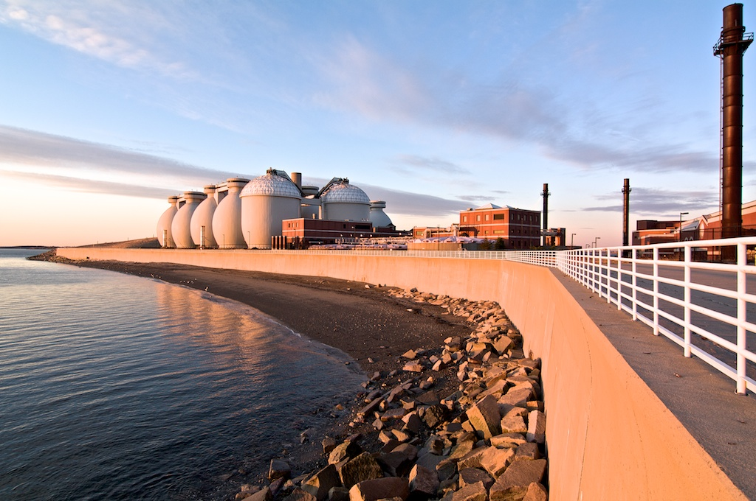
Notes:
Cutting Methane and HFCs, being creative about energy use
The President’s plan also calls for EPA to help cut methane and HFCs, two potent greenhouse gases.
Recognizing the need for an all-of-the-above approach to develop homegrown energy, along with the need for commonsense steps to cut carbon pollution, the President released a Strategy to Reduce Methane Emissions that maps out steps to measure and reduce emissions of this potent greenhouse gas.
The strategy builds on progress to date and takes steps to further cut methane emissions from landfills, coal mining, and agriculture, and oil and gas systems through cost-effective voluntary actions and commonsense standards.
Agriculture: In partnership with the dairy industry, USDA, EPA and DOE will soon release a “Biogas Roadmap” outlining strategies to accelerate adoption of methane digesters and other cost-effective technologies to reduce U.S. dairy sector methane pollution by 25 percent by 2020.
BEING CREATIVE
Picture: Deer Island: uses methane to generate 60% of the energy used at the entire facility.
We have to Assess Vulnerability
Critical Infrastructure is a big vulnerability, especially for the east coast

Slide 32

Notes:
GreenChill
GreenChill is an EPA Partnership with food retailers to reduce refrigerant emissions and decrease their impact on the ozone layer and climate change.
GreenChill works to help food retailers:
Transition to environmentally friendlier refrigerants;
Lower refrigerant charge sizes and eliminate leaks; and
Adopt green refrigeration technologies and best environmental practices.
The GreenChill Partnership has three main programs that help food retailers reduce their refrigerant emissions:
The Food Retailer Corporate Emissions Reduction Program
The Store Certification Program for Advanced Refrigeration
The Advanced Refrigeration Promotion Program

Slide 33
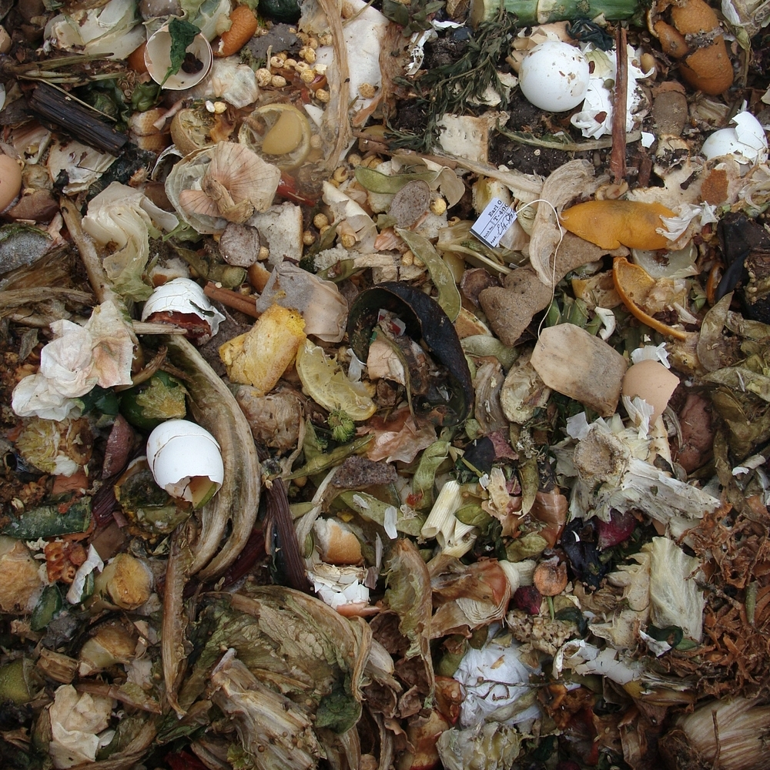
Notes:
Cutting domestic greenhouse gases
Wasted food contributes twice as much GHG as air traffic
Food wastage is equivalent to twice the amount of GHG emissions from US road traffic in 2010
From farm to fork to landfill, food contributes 14% of our total domestic greenhouse gas emissions
Food scraps can be used to generate renewable energy, enhance soil as a fertilizer and feed animals
Diverting food waste from landfills conserves landfill space and reduces methane.
Nationally, according to EPA’s Municipal Characterization Report Americans are wasting more than 36 million tons of food per year,
96% of which is thrown away into landfills or incinerators
The National Resource Defense Council estimates that this translates into a loss of approximately $165 billion annually.
At the same time, 14.9 percent of households in the U.S. were food insecure in 2011, meaning they did not know where their next meal would come from.

Slide 34
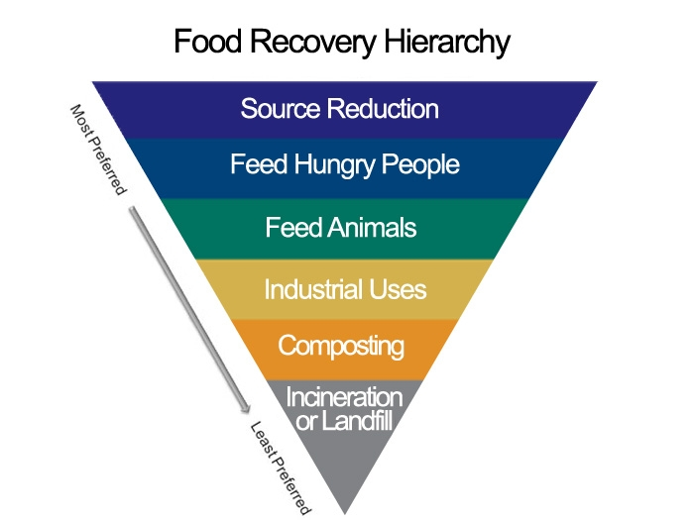
Notes:
Financially, wasted food costs America more than $100 billion annually
Food Recovery Challenge Program: a national initiative aimed at encouraging businesses and institutions to actively participate in food waste prevention, surplus food donation and food waste diversion from landfill or incineration. EPA’s Food Recovery Challenge targets College and Universities, Supermarkets, Wholesale/Membership Clubs, Healthcare Facilities, Hospitality and venues that traditionally manage large quantities of food and food waste.
BJ’s Wholesalers just joined this program

Slide 35
“My administration will work with tech innovators and launch new challenges under our Climate Data Initiative….ultimately focused on how all these changes to weather patterns are gong to have an impact up and down the United States” -President Obama
Notes:
Now, I want to close by coming full circle here. We started today talking about some of the risk involved with climate change. EPA is committed to addressing this challenge by reducing our carbon footprint from a variety of sectors, as I’ve demonstrated today.
EPA is also committed to adapting to some of the changes we are already seeing. That is illustrated by the White House announcement on food resilience as part of the Climate Adaptation Initiative and Climate Data Initiative.
It means empowering the agriculture sector to understand vulnerability, and improve resilience by investing in and working on programs like some of the ones I’ve described today.

Slide 36
Boston Harbor - MWRA
Slide 4 getty images
Slide 6 chart source: IPCC
Slide 9 by Bert Kaufmann,
Slide 28 MWRA Deer Island http://www.flickr.com/photos/rawhead/4376312654/
Slide 25 www.europeanceo.com

