Slide 1
The Science of Shelf Life
Ron Cotterman Daniel McKamy
Vice President, Sustainability Director of R&D Food Solutions
Sealed Air Corporation Sealed Air Corporation
August 2014

Slide 2

Outline
Food Waste Emerges as a Priority
Food Science and Shelf Life
Consumers Attitudes Towards Food Waste
Collaborating to Reduce Food Waste
2

Slide 3
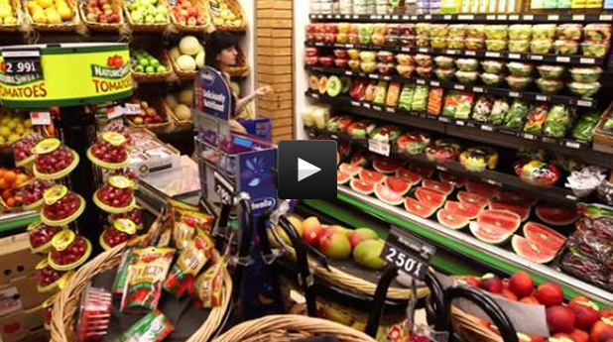
Sealed Air Consumer Food Waste Survey
3

Slide 4
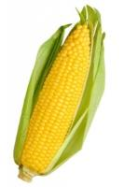
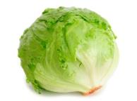

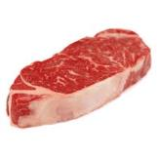
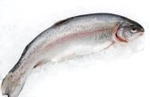
Estimates of Global Food Waste
Annual Global Food Waste as a % of Production
58%
37%
18%
Fruits & Vegetables
Cereals
Milk
23%
40%
Fish
Meat
Over one third of the food we produce is never consumed
Source: Food and Agriculture Organization of the United Nations (2011)
4

Slide 5
U.S. Retail and Consumer Food Waste
Weight of Food Loss
31% of retail food supply goes uneaten, valued at $162 Billion
Economic Value of Food Loss
Caloric Value of Food Loss
Source: USDA (2014)
5

Slide 6
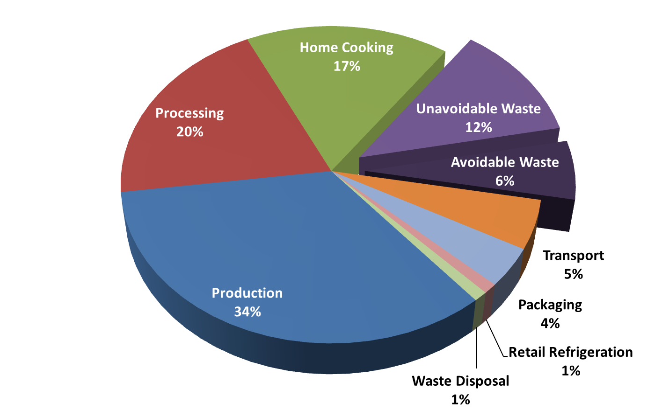
Impacts of Food in the Supply Chain
Greenhouse Gas Contributions
U.S. Poultry Supply Chain
Overall food waste environmental impact can be significant, and occurs after resources have been invested
Source: AMERIPEN Value of Packaging (2013)
6

Slide 7
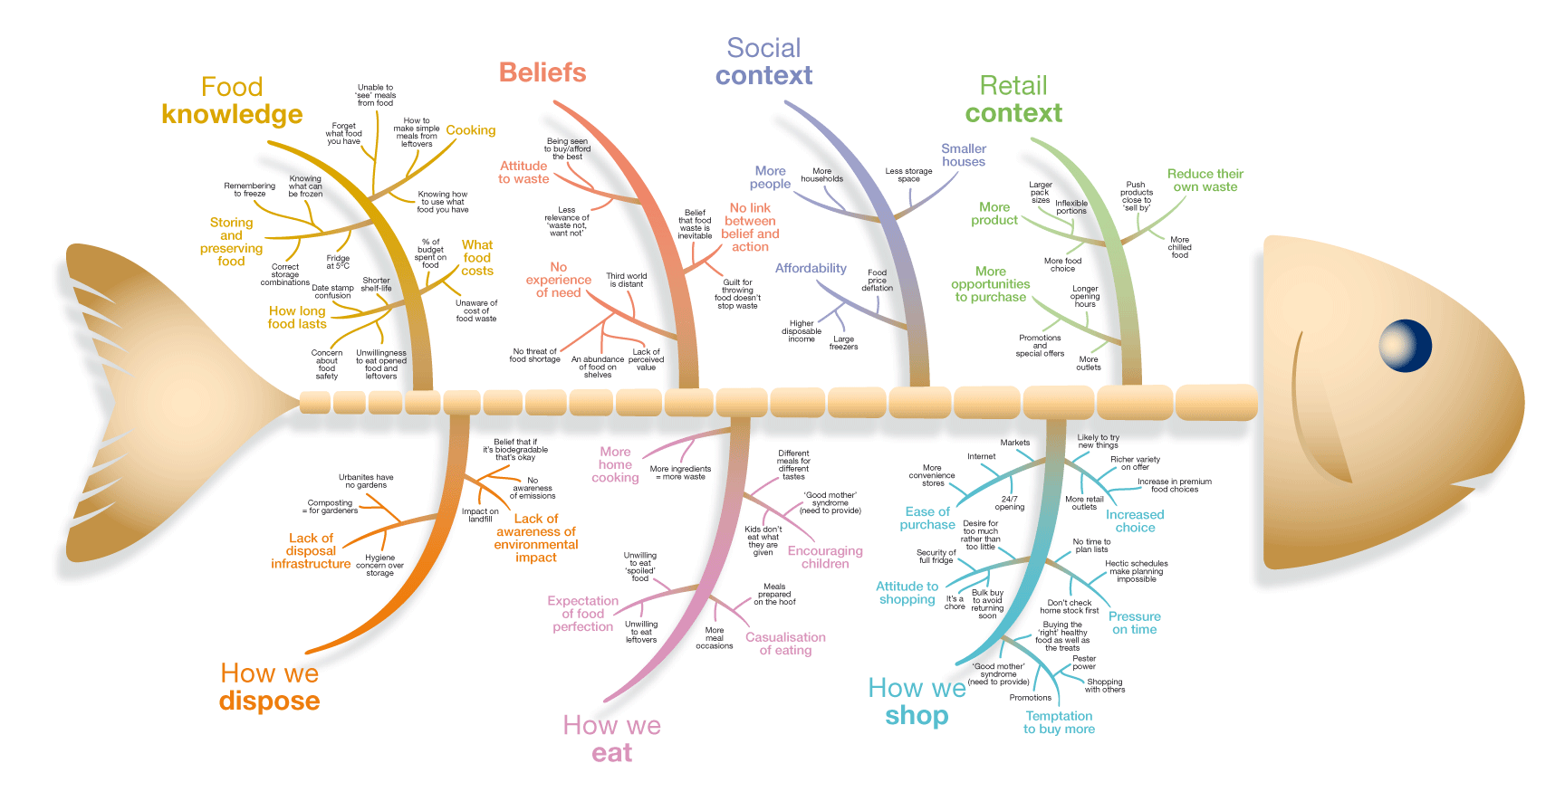

The Origins of Food Waste
It is important to understand the root cause of food waste to prevent it
7

Slide 8
Consumer Food Waste in the UK
Over 60% of consumer food waste is avoidable
Source: WRAP (2013)
8

Slide 9
Consumer Food Waste Causes
Avoidable Food Waste Among UK Consumers
Shelf life of perishable foods is responsible for over 50% of loss
Source: WRAP (2013)
9

Slide 10
Avoidable Food Loss from UK Consumers
Date labels contribute to consumer food loss
Source: WRAP (2014)
10

Slide 11

Food Science and Shelf Life
11

Slide 12
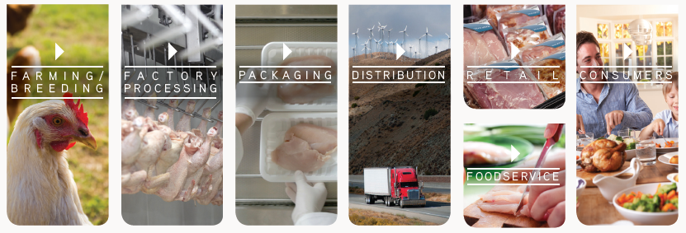
What is Food Science?
The study of all aspects of food
  Raw production
  Handling
  Processing
  Packaging
  Distribution
  Final consumption
12

Slide 13

What Determines Shelf Life?
All quality aspects of the food
  Color
  Texture
  Flavor
  Aroma
  Nutritional Value
  Food Safety
  Food Spoilage
13

Slide 14
How Do We Extend Shelf Life?
By processing
  Refrigeration
  Freezing
  Canning
  Drying
  Formulation
  (added salt, sugars, acids)
  Chemical and Physical
  Disinfection
  (Blanching, Irradiation)
DISINFECTION
CHEMICAL
PHYSICAL
CHEMICAL
DISINFECTANTS
HEAT
RADIATION
WET
DRY
UV
G RAY
Non-Food Contact
Food Contact
14

Slide 15

How Do We Extend Shelf Life?
By Cleaning and Sanitation
  Follow Hygiene standards (HACCP, USDA, FDA, CODEX, BRC, SQF, IFS, ISO 22000… etc.)
  Proper Cleaning and Sanitation Protocols
  Hygienic Design on Equipment, Building and Facilities
  Personnel and Personal Hygiene Practices
  Non-Food Contact (surfaces) Chemical Disinfection
  Food Contact Chemical Disinfection
  Direct Food Contact (Antimicrobial Treatments)
  End-To-End approach (Farm to Retail)
  Internal and External Audits
15

Slide 16

How Do We Extend Shelf Life?
By Packaging
  Protects and preserves the product
  Improves ease of handling, distribution, and storage
  Means of advertising and labeling
  Extends product shelf-life, reducing waste.
16

Slide 17
How Do We Extend Shelf Life Through Packaging?
Modified Atmosphere Packaging (MAP)
  Allows for centralized packaging and distribution
  Food preservation - extends product shelf-life
    Retards microbial growth
    Delays senescence/ripening of fruits
    Reduces transpiration
    Reduces physical damage
    Slows enzymatic activity
Fresh Food Category | Refrigerated Shelf Life (days)
 | Non-MAP | MAP
Fresh red meat (low O2) | 2-3 | 21
Fresh pasta | 3 | 60
Lettuce | 2-4 | 14
Cheese | 7 | 180
17

Slide 18
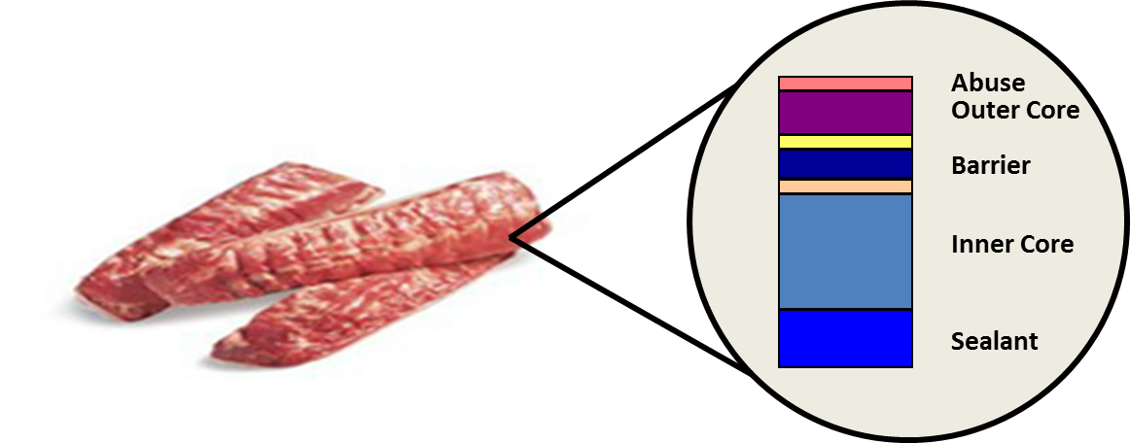
How Do We Extend Shelf Life Through Packaging?
Vacuum Packaging
  Reduces the volume of air within a package
  Usually requires a “barrier” material
  Commonly used with Fresh Red Meats
Gas Flushing
  Generally uses a “barrier” material. Produce packaging is an exception.
  Typically incorporates a pre-determined mixture of gases to dilute the atmosphere.
Packaging is engineered to withstand abuse, provide barrier and make air-tight seals
18

Slide 19
How Do We Extend Shelf Life Through Packaging?
Controlled Atmosphere Packaging
  Used primarily for bulk storage and gassing
  Common in the produce - fruit industry
Passive Packaging
  Modification of the atmospheric concentration within a hermetically sealed package
  Typical of respiring products such as fruits and vegetables
Active Packaging
  Modification of the packaging material with the intent of causing some change in the package environment or packaged product.
  Examples include oxygen scavenging, antimicrobials, and pathogen identification systems.
19

Slide 20
Fresh Red Meat
What are issues with FRM?
  Color changes
  Microbial spoilage
  Rancidity
  Water loss
  Address through O₂ and H₂O barrier
Red Meat Color Change
Myoglobin
Oxymyoglobin
Metmyoglobin
Oxidation
20

Slide 21
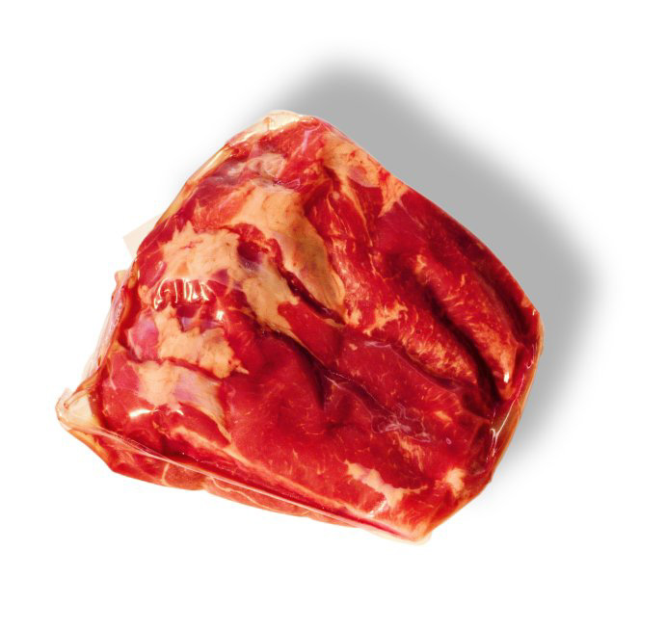
Fresh Red Meat
Barrier Bag
Vacuum packaged
Prevents ingress of oxygen
  Reduce microbial spoilage
  Reduce rancidity
  Protects meat color
Reduces water loss
21

Slide 22
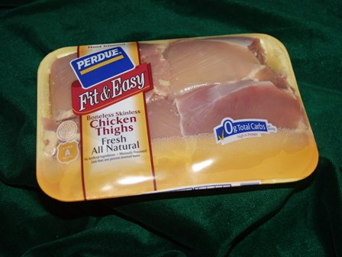
Fresh Poultry Packaging
Fresh poultry carries bacteria that break down protein and create a strong sulfur odor
  Shewanella putrefaciens
Packaged in non-barrier structures to allow odors to escape
22

Slide 23
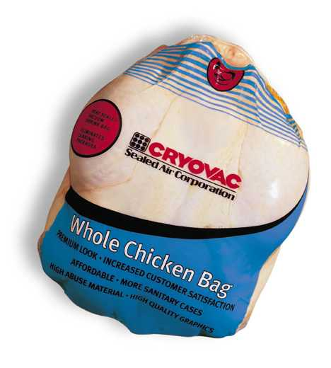
Fresh Poultry Packaging
Bags
Whole birds, Turkey breasts
Breathable/ non-barrier bags
Abuse resistance
High shrink
Sealability
23

Slide 24
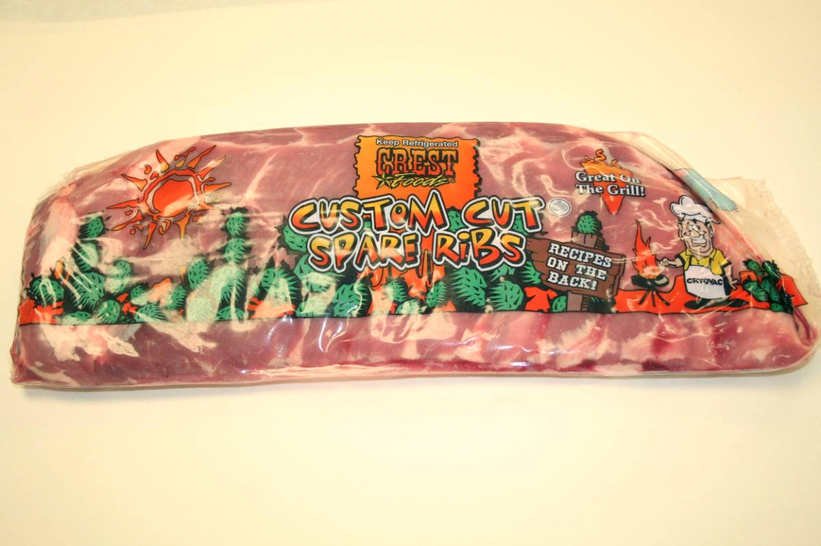
Smoked and Processed Meats
Ribs Example
Abusive product
Requires good oxygen barrier
Barrier bag provides O₂ barrier and abuse resistance
24

Slide 25
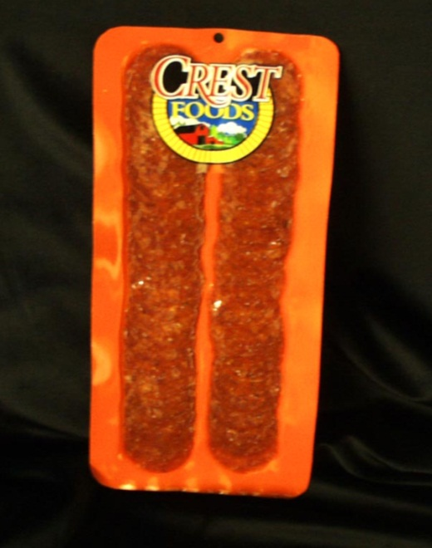
Smoked and Processed Meats
Sliced Pepperoni Example
Presence of oxygen causes
  Discoloration
  Rancidity
  Mold growth
  Flavor changes
Can address by
  Vacuum package
  MAP + sachet or oxygen scavenging film
25

Slide 26
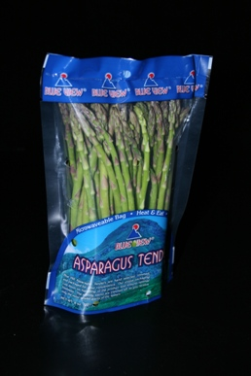
Fresh Produce
Fresh produce respires. It is “alive”.
  Uses oxygen and gives off carbon dioxide
Packaging must be permeable to allow oxygen to get to the product
Packaging must be tailored to the respiration rate of the product
26

Slide 27
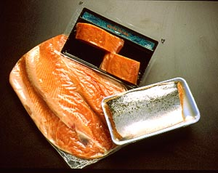
Fresh Seafood
Fresh seafood must be packaged in highly permeable material material per the FDA (10K oxygen transmission rate).
This allows for safe packaging for distribution and retail display
C. botulinum concern
27

Slide 28
Food Science and Shelf Life
Summary
The shelf life of various foods is determined by their composition, how they are processed and packaged, and how they are stored.
While fresh foods are desirable it is only through processing and packaging that we can extend shelf life, minimize waste, and provide good quality foods to global consumers.
28

Slide 29

Consumer Attitudes Toward Food Waste
29

Slide 30
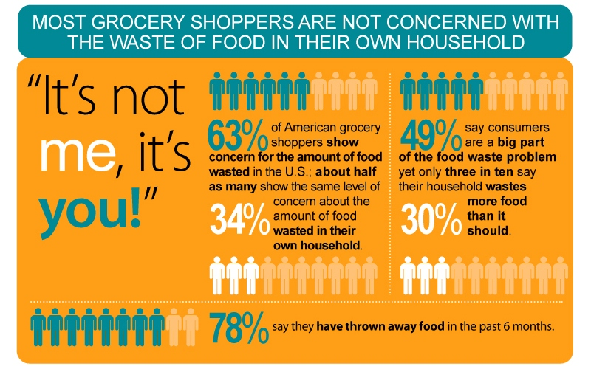
U.S Consumers Attitudes and Behaviors
Source: Harris Poll on Consumer Food Waste (2014)
30

Slide 31
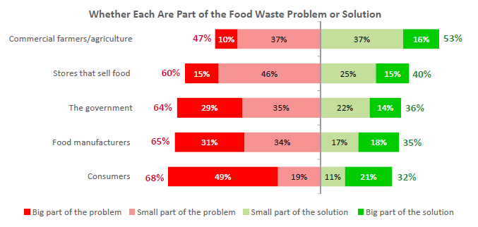
Plenty of Blame to Go Around
Source: Harris Poll on Consumer Food Waste (2014)
31

Slide 32
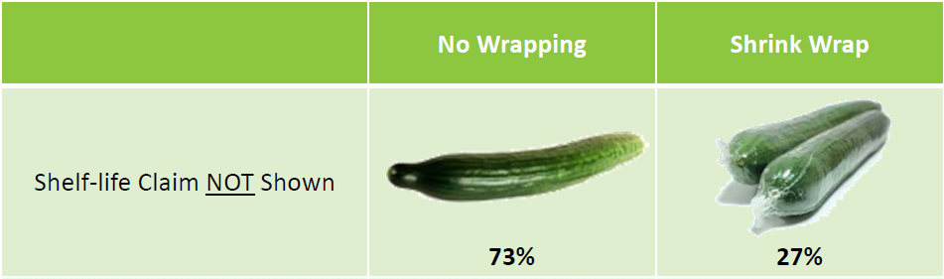
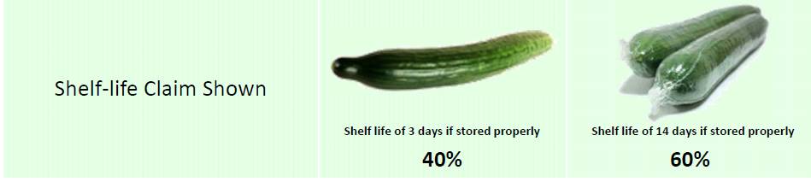
Consumer Packaging Preference
Source: Harris Poll on Consumer Food Waste (2014)
32

Slide 33
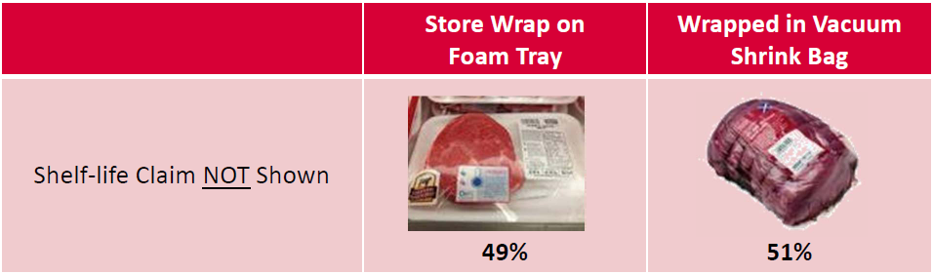
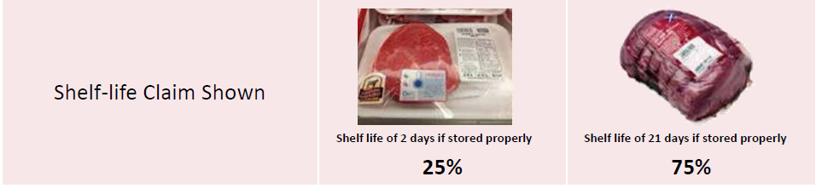
Consumer Packaging Preference
Source: Harris Poll on Consumer Food Waste (2014)
33

Slide 34
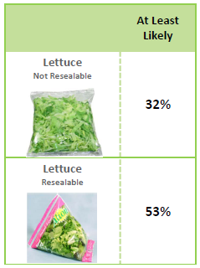
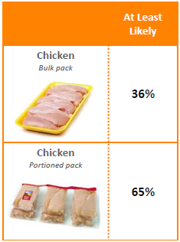
Likelihood to Reduce Waste
Resealability
Portioning
Source: Harris Poll on Consumer Food Waste (2014)
34

Slide 35

Reputational Impact on Stores and Brands
I would think more highly of…
Stores that sell products that help consumers not waste the food they buy
Food brands that use packaging that helps me reduce food waste
Strongly/
Somewhat Agree
Strongly/
Somewhat Agree
81%
78%
Source: Harris Poll on Consumer Food Waste (2014)
35

Slide 36

Collaborating to Reduce Food Waste
36

Slide 37
Working the Top of the Pyramid
Prevention of Food Waste
Source Reduction
Reduce the volume of food waste generated
Feed Hungry People
Donate extra food to food banks, soup kitchens and shelters
Feed Animals
Donation
Divert food scraps to animal feed
Industrial Uses
Provide food scraps for rendering, digestion and fuel conversion
Composting
Recycling
Create a nutrient-rich
soil amendment
U.S. EPA Food Waste Hierarchy
Landfill/
Incineration
Last resort
for disposal
Disposal
37

Slide 38
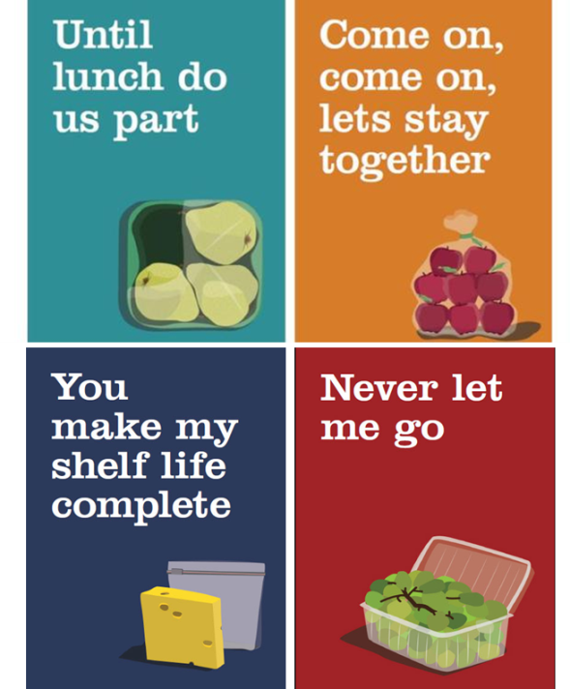


UK Partnership: Fresher for Longer
Recognizes role that packaging plays in preventing food waste
Packaging and innovation deliver benefits consumers are looking for – keeping food fresher for longer, saving money and reducing the impact of food waste on the environment
38

Slide 39






U.S. Food Waste Partnerships
Collaboration across the supply chain
Benchmarking global initiatives—driving best practices.
New linkages forming between industry, ngo’s, government and academia
39

Slide 40



Conclusions—The Science of Shelf Life
Knowledge of food science and innovative ways to extend shelf life can reduce food spoilage and waste
Innovation
Understanding consumer attitudes can provide insight into how to modify behavior and avoid food waste
Education
New alliances and collaborations are bringing companies together to drive solutions that can prevent food waste
Partnerships
40

