Slide 2
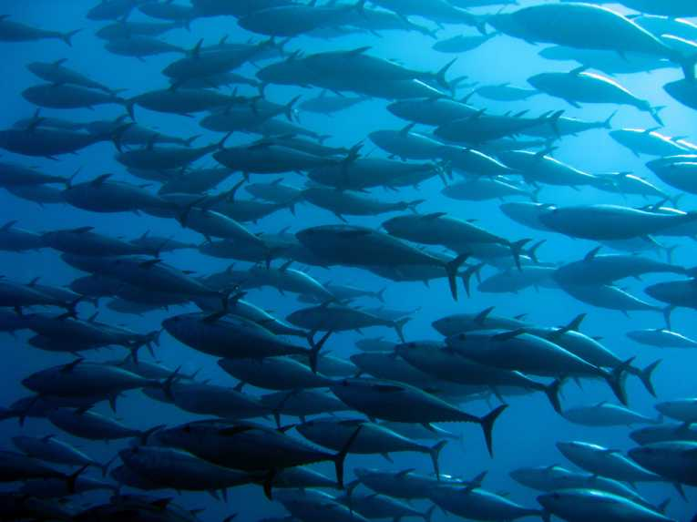
Pre-Competitive Partnerships in Action
Speakers:
Carl Salamone, Vice President, Sustainable Seafood, Wegmans Food Markets
Mike Kraft, VP of Corporate Social Responsibility & Fisheries Management, Bumble Bee Foods
Bill DiMento, Director, Corporate Sustainability, High Liner Foods
Moderator:
Nadine Bartholomew, Principal Consultant, N. S. Bartholomew Consulting

Slide 3
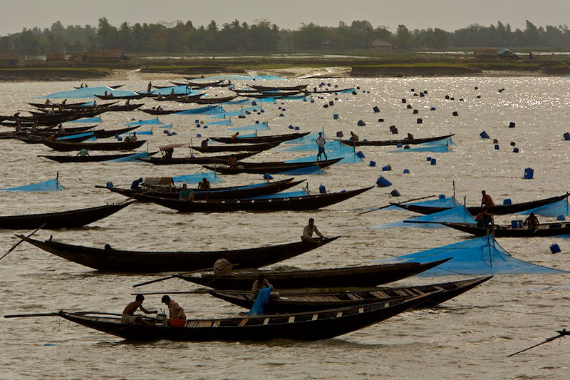
What is a Fishery Improvement Project (FIP)?

Slide 4
A Fishery Improvement Project (FIP) involves the collaborative efforts of various
supply chain stakeholders to improve the sustainability of a fishery by helping to
rebuild the stock level of a target species. These efforts often include:
  Acting to conserve fishery resources
  Supporting enforcement of international fishing agreements
  Promoting fishing in line with conservation principles
  Providing for the implementation of fishery management plans (FMPs)
  Establishing Management Councils or Groups to steward fishery resources
  Developing underutilized fisheries
  Protecting essential fish habitats
  Reducing by-catch and establishing fishery information monitoring systems

Slide 5
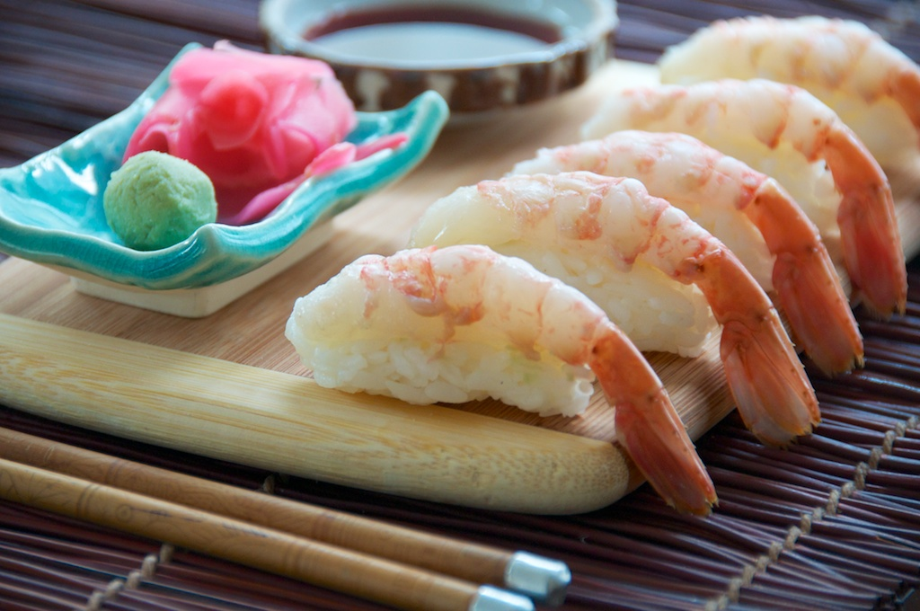
Why Participate in a Fishery Improvement Project (FIP)?

Slide 6
According to the Food and Agriculture Organization of the United Nations (FAO), capture fisheries and aquaculture (fish farming) supplied the world with about 140 million tonnes of fish for human consumption in 2013; to the tune of US$132.2 billion. The U.S. imports 91 percent of its seafood, half of which is from aquaculture.
The FAO fact sheet entitled Trends in Capture Fisheries Development states that some 73 percent of the 392 global seafood stock items or species the FAO routinely track are in need of improved management if they are to avoid becoming overfished or, in the case of those already overfished, if they are to be rebuilt.

Slide 7
Most stakeholders get involved in Fishery or Aquaculture Improvement Projects at the request of their NGO partners or advisors. However, for those who do not work with an NGO or those who want to initiate a FIP and/or AIP on their own, here are three things to consider when getting started:
  The importance of the seafood species to the company (as determined by the overall sales or customer demand for the product)
  Your level of influence in the fishery and the associated supply chain (as determined by the volume of product you source or your relationship with suppliers and other key stakeholders in the fishery)
  The urgency or need for improvement (as determined by the environmental, social, and economical status of the fishery/fish farm and your ability to have a positive impact)

Slide 8
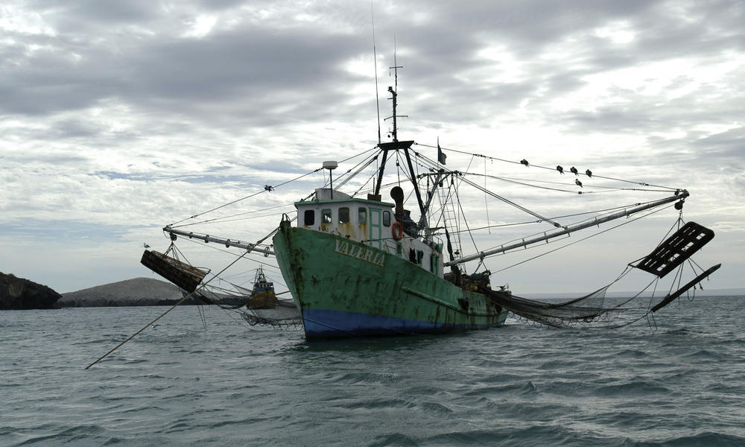
How are Fishery Improvement Projects (FIPs) Managed?

Slide 9
The four key steps of managing Fishery Improvement Projects (FIPs) include:
Step 1
Data collection – where you work to identify fisheries and/or farms in the greatest need of improvement and those most important to the company.
Step 2
Stakeholder engagement – where you identify and partner with the individuals and groups impacted by the fishery and/or farm.
Step 3
Goal development – where you agree to and help develop a work plan that outlines project activities, timelines, goals, budgets, et cetera.
Step 4
Project implementation – where you schedule regular updates from all stakeholders involved based on the agreed timeline (e.g., from x to y by when).

Slide 10
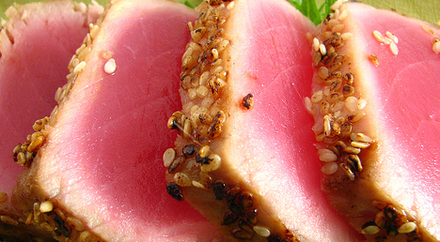
What are the benefits of Fishery Improvement Projects (FIPs)?

Slide 11
Fishery Improvement Projects (FIPs) protect seafood species and habitats. They also create new and unique ways to:
  Engage local communities by increasing awareness of critical seafood issues among customers – giving them the opportunity to use their purchases to support a healthier, more sustainable food system
  Build collaborative relationships with key supply chain stakeholders by engaging and empowering forward-thinking fishermen and seafood suppliers
  Support environmentally sustainable and socially responsible business practices in emerging countries
  Mitigate resource risks in the seafood supply chain by utilizing innovative management models to ensure the continuity of the global seafood supply

Slide 12
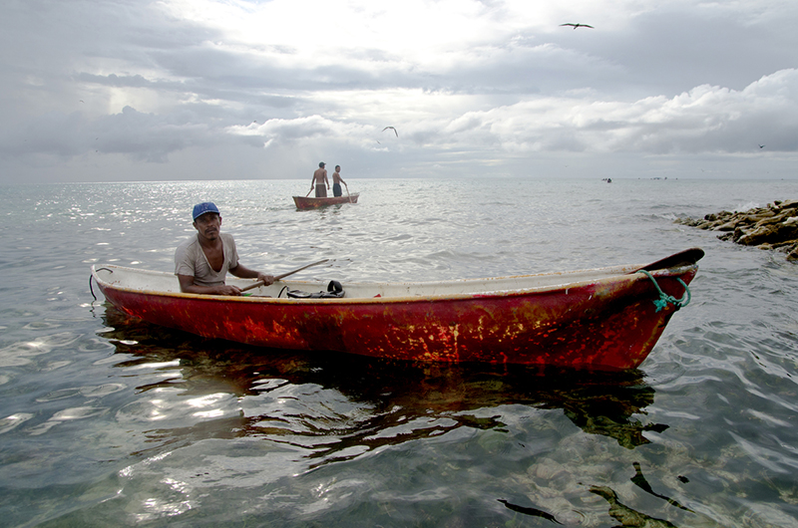
Join in the discussion as we explore how the FIP Model can be:
  Applied to other departments and product categories
  Used to create social change
  Employed to influence government policy
Why Participate in a Fishery Improvement Project (FIP)?

Slide 13
Shrimping in U.S. Gulf Waters
Identify the Problems
Non-species by-catch
Final shrimp quality—no chemical usage

Slide 14
Brainstorm The Root Causes
Ask “WHY”
Plot the causes (NOT solutions)
Fishbone
  People
  Equipment
  Procedures
  Materials

Slide 15
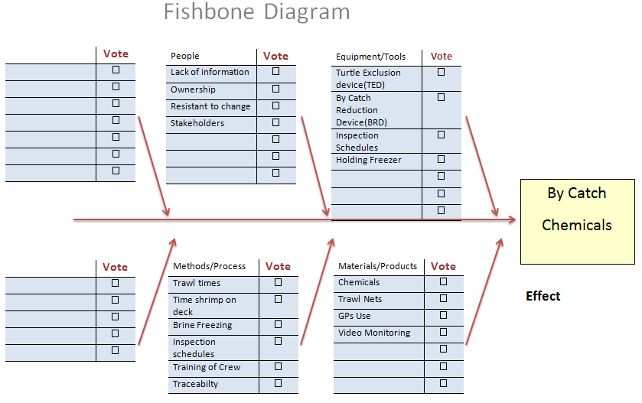

Slide 16
Identify Stakeholders
Boat Owner
Boat Captain
Boat Crew
Supplier
Retailer

Slide 17
Root Cause of Non-species By-catch (People)
Correct use of By-catch Reduction Device (BRD)
Correct use of Turtle Exclusion Device(TED)
Trawl time

Slide 18
Root Cause of Poor Shrimp Quality(Procedures, Equipment)
Trawl time
Time shrimp is on deck
Brine freezing of shrimp
Holding freezer temperature

Slide 19
Project Plan Next steps
Align stakeholders
Attain agreement on issues
Attain agreement on resolving issues (MOU)
Begin a Fishery Improvement Project (FIP)

Slide 20
Fishery Improvement Project
FIP—A FIP is a stepwise approach to enhancing the sustainability of a fishery.
Harvesting continues while continual improvements are achieved.
An alliance of seafood buyers, retailers, processors, suppliers, producers and non-governmental organizations (NGOs)

Slide 21
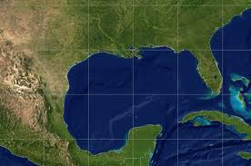
Florida Shrimp FIP
Gulf of Mexico and South Atlantic

Slide 22
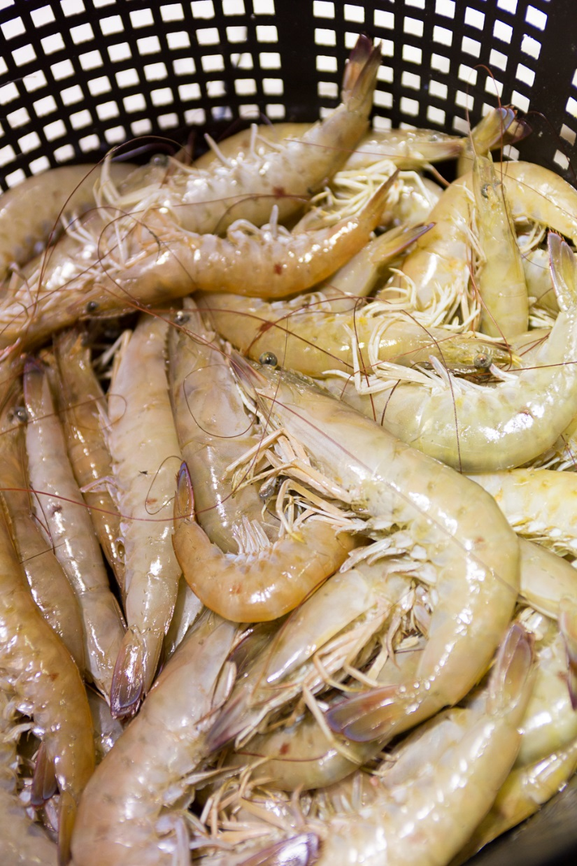
Species
Brown Shrimp
White Shrimp
Key West Pink Shrimp

Slide 23
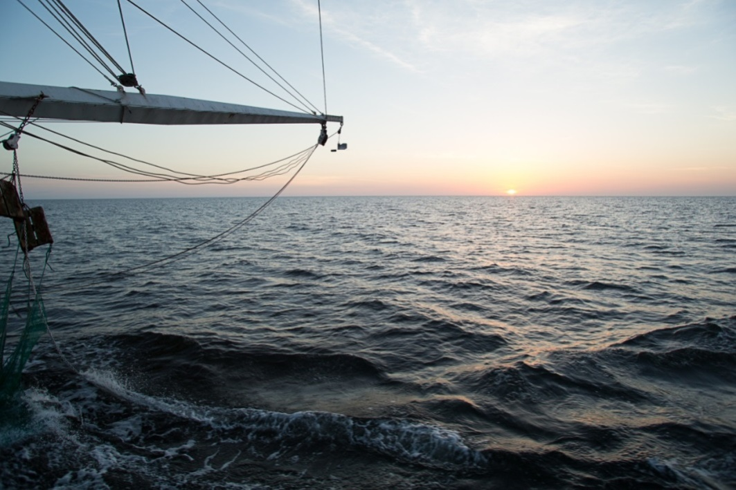
FIP Coverage Area
Florida State Waters-3 nautical miles in Atlantic, 9 in the Gulf
Federal waters
U.S. Gulf of Mexico and U.S. Atlantic Ocean

Slide 24
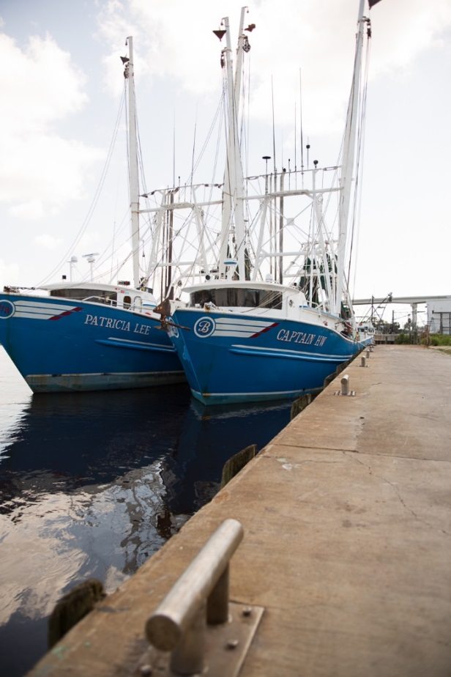
FIP Participants
Wood’s Fisheries (Supplier)
Wegmans Food Markets (Retailer)
Patricia Lee (Vessel/Fleet)
Captain HW (Vessel/Fleet)
Michael Branning (Fleet Owner)

Slide 25
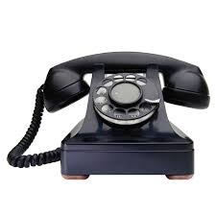
FIP Objectives - Part One
Reduce by-catch by educating vessel captains and crew
Each crew will be instructed by the Florida Fish Conservation Commission(FWC) to ensure knowledge on how to tune the By-catch Reduction Device (BRC) and Turtle Exclusion Device (TED) to
operate correctly.

Slide 26
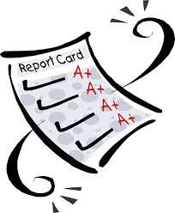
FIP Objectives - Part One
Inspection of BRD and TED use and compliance
Each vessel will schedule regular state, federal and 3rd-party inspections. All gear inspections, pass or fail, will be documented and made public
as part of the FIP.

Slide 27
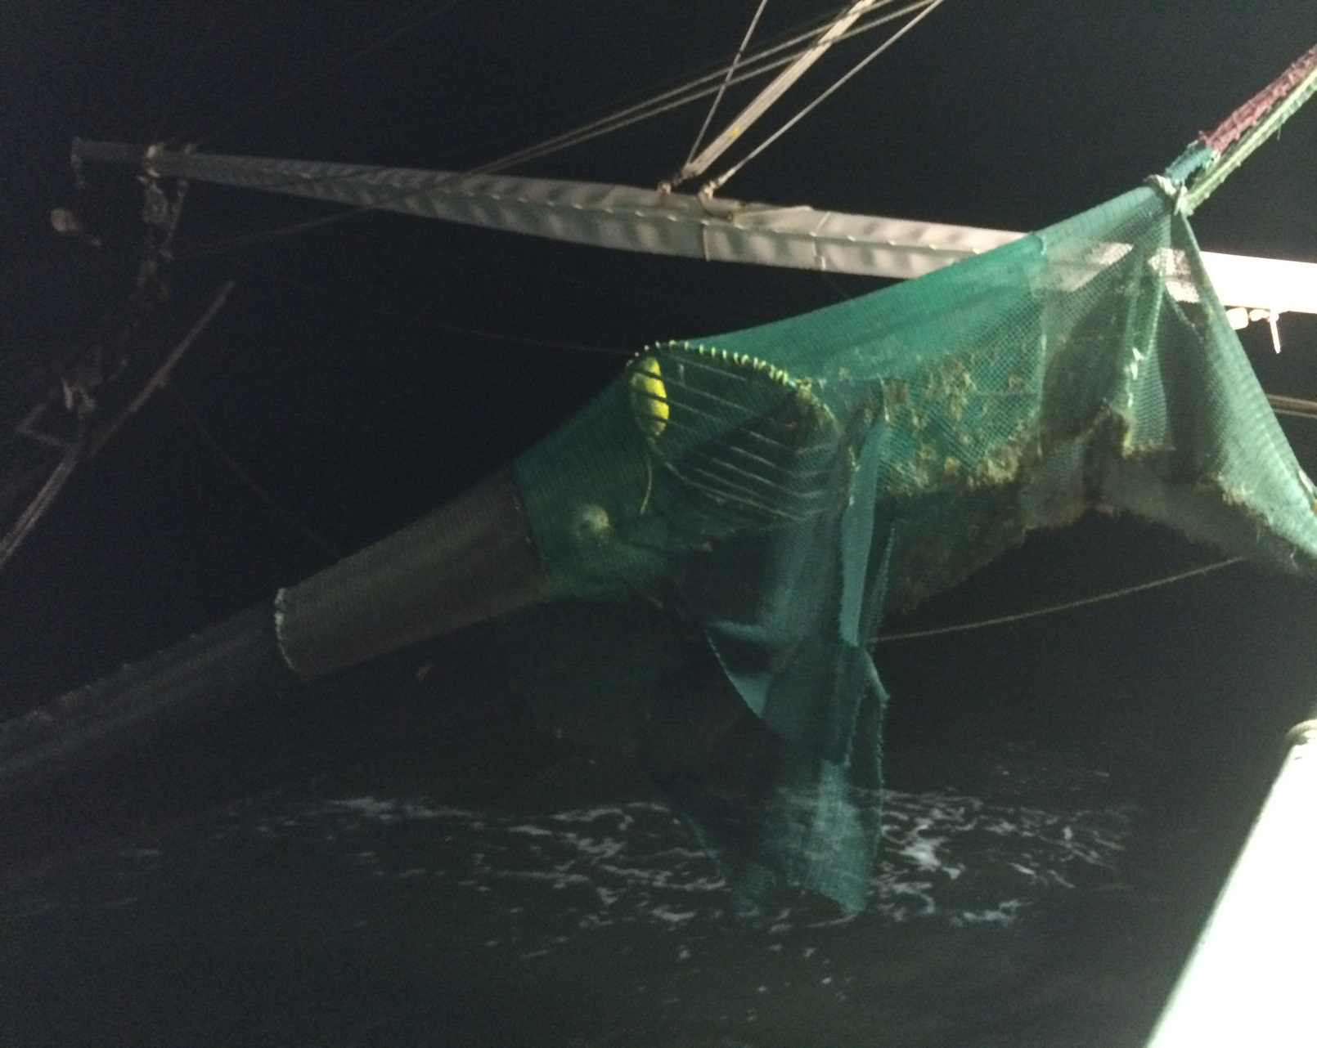
Turtle Exclusion Device

Slide 28
FIP Objectives - Part Two
Trawl Times
Issue
  Trawl time vary from trawl to trawl and boat to boat
  Too long trawl time cause shrimp to die and begin to decompose.
  Too long trawl time cause any turtles in nets to stress and die
Solution
  Use GPS to log time of each trawl
  Trawl time 2 hours or less in winter months
  Trawl time 60 to 70 minutes or less during the summer months

Slide 29
FIP Objectives - Part Two
Time on Deck
Issue Too long on deck shrimp will die and start to develop melanosis and other quality issues.
Solution
Reduced trawl time will cause less by-catch and less time for shrimp to be on deck, thus allowing for quicker cull and faster net-to-freeze time.

Slide 30
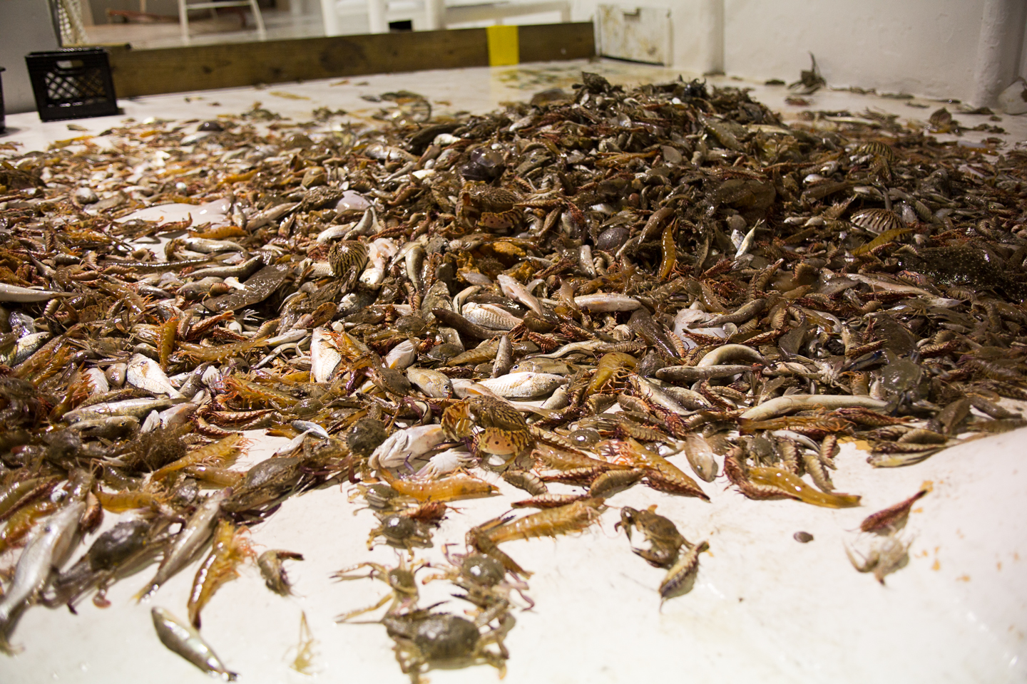

Slide 31
FIP Objectives - Part Two
Freezing
Issue
Brine freezing is most effective way to quick freeze on board
Solution
  Brine temp must be at optimum temperature of 24 to 26ºF
  Brine salinity must not be high enough to cause salt burn to shell
  Brine water change out must take place every 24 hours to maintain proper usage

Slide 32
FIP Objectives - Part Two
Holding Freezer Temperature
Issue
Boats allow temperature to warm
Solution
Monitor holding freezers to maintain a temperature of 0 to 10ºF

Slide 33
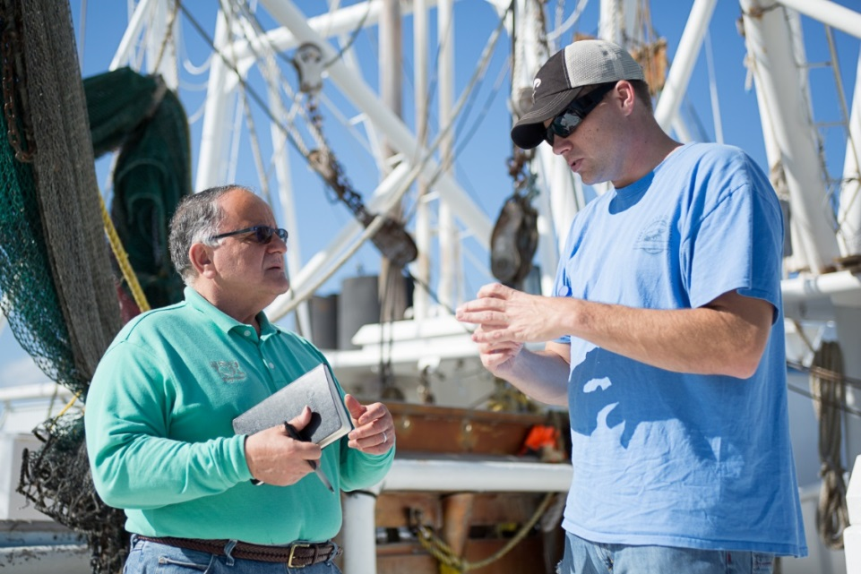
Retailer (Wegmans) Involvement
Face-to-face meeting with supplier (Wood’s Fisheries)
Face-to-face meeting with shrimper captain and crew
Shrimp with crew to validate all aspects of FIP are being worked on
Verify trace
information (Trace
Register) is properly
loaded

Slide 34
Plan the Work
Activities
Budgets
Timelines (X to Y by when)
Set goals based on time lines
Documentation

Slide 35
Work the Plan
Regular updates
X to Y by when
Continuous Improvement Process is important in this phase
Small steps leading to goal
Make public on websites, both Wegmans and Wood’s Fisheries

Slide 36
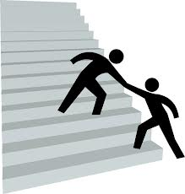
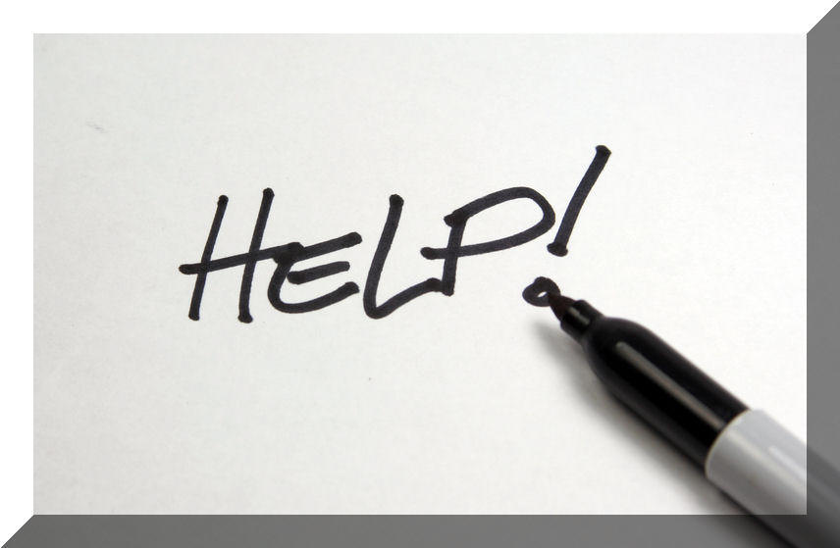
Conclusion
Be persistent
Easy on paper
Tough in reality

Slide 37
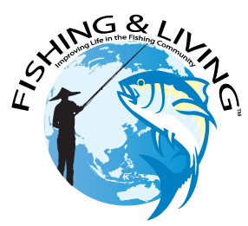

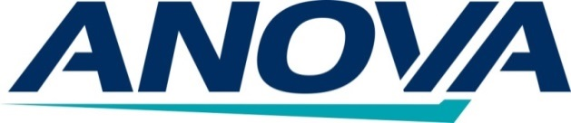

The Case of the Small Scale Tuna Industry in Indonesia

Slide 38
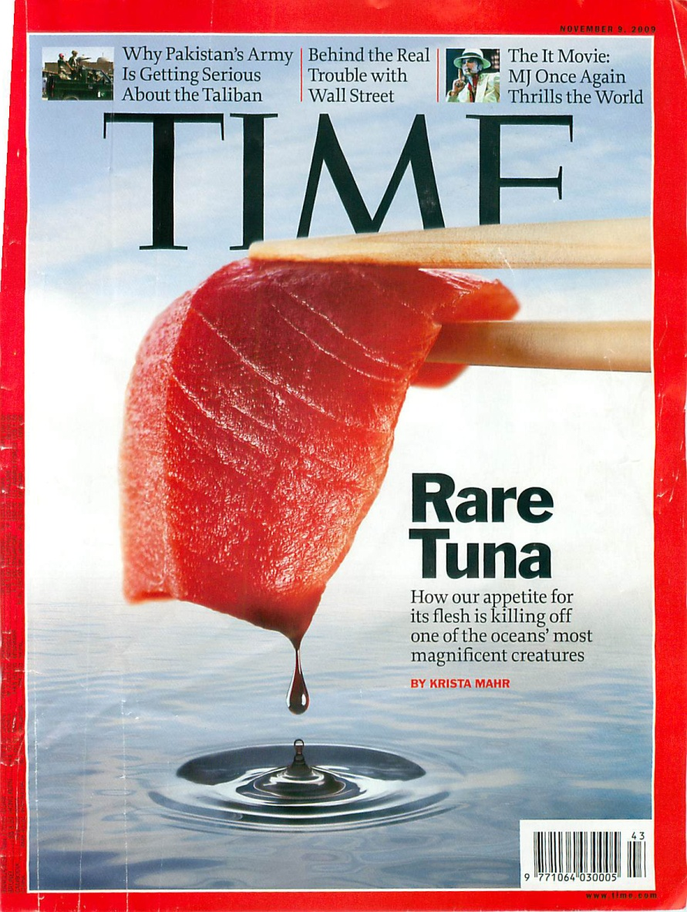
Identifying the Problem: Global
Rare Tuna
An article which may stick in the minds of many within the tuna industry…. this November 9th 2009 Time article outlining the serious decline of the tuna fishery in General Santos, Philippines.
In short, the Western Pacific tuna fishery was described to be near financial and ecological collapse due to the combination of:
  commercial greed,
  uncontrolled access and overfishing by tuna vessels,
  lack of implementation of tuna fishery management by individual countries and RFMOs

Slide 39
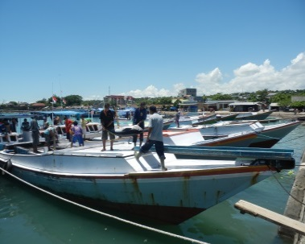
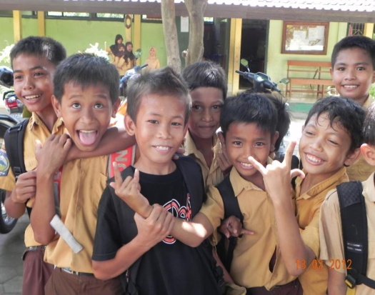
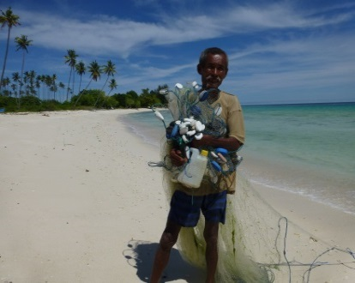
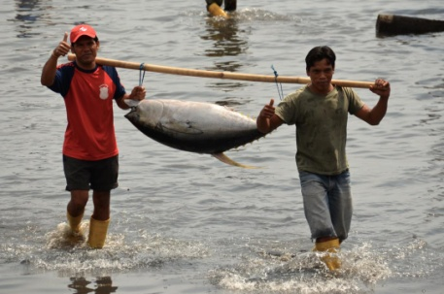
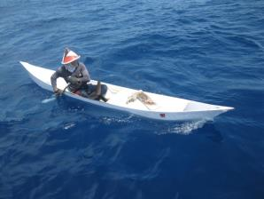
Identifying the Problem: Indonesia
Indonesia
While Indonesia is not the Philippines, the challenges are similar and perhaps more difficult to address
  Millions of small scale fishermen - the bottom of the human food chain
  Disorganized and unmanaged: a very ‘large’ small scale fishery
  Quality issues: bringing product to market
  Lack of data to identify problems: no data = no management
  Lack of awareness within local industry on changing market demands

Slide 40
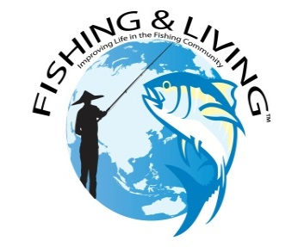
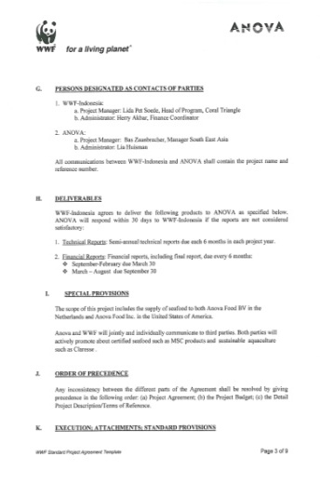
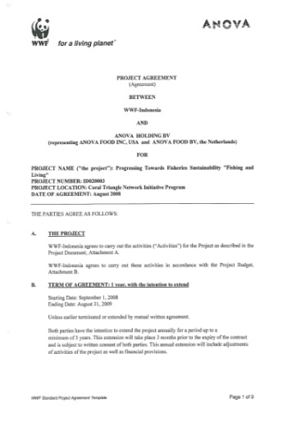
Fishing & Living: Timeline
Fishing and Living / MDPI
2008: Anova collaborates with WWF and local industry to establish the Fishing & Living project with two key objectives:
  Work to achieve sustainable local fisheries
  Achieve MSC certification
2010: Anova formally establishes the
Fishing & Living Initiative
2012: Expansion across East Indonesia
2013: Expansion with support of USAID
funding
2014: Partnership / creation of MDPI

Slide 41
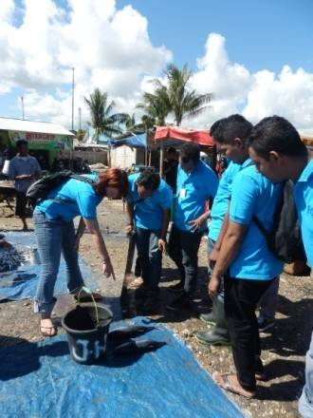
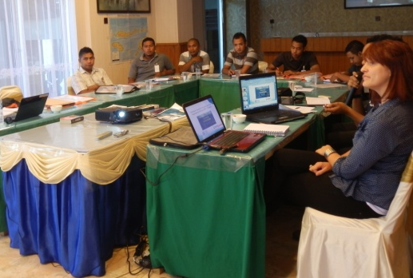
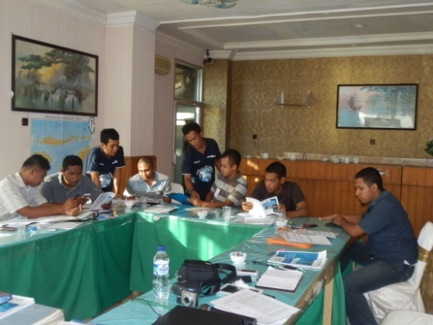
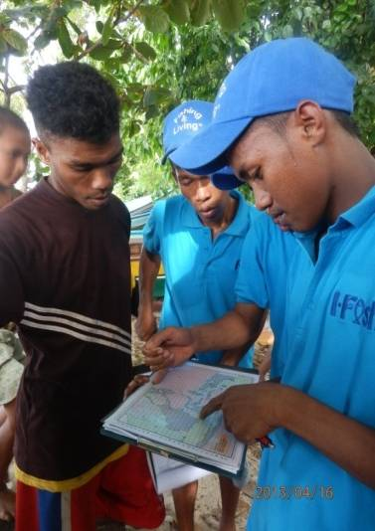
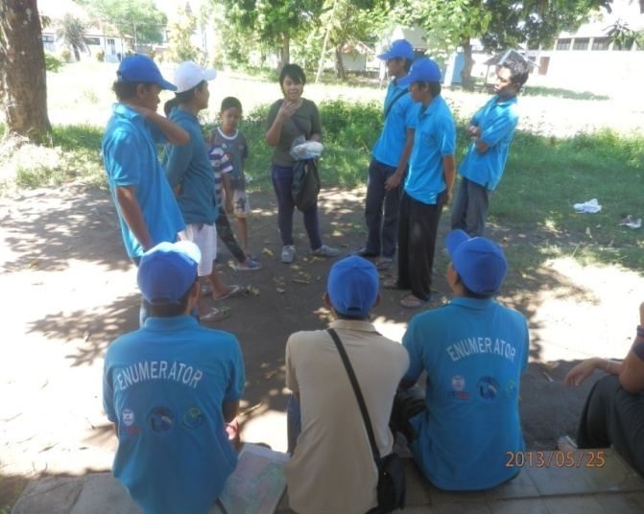
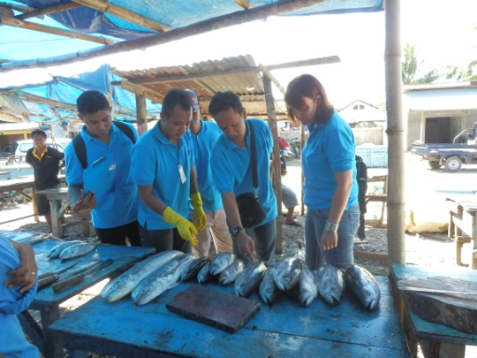
The Fishing & Living Philosophy:
Build a strong local team. An Indonesian team to connect with Indonesian fishermen, trained and knowledgeable on sustainability issues
Notes:
Training enumerator teams to:
Collect data
Identify fish
Interact with fishermen
Understand sustainability and the quest for certifications such as MSC
Community engagement abilities

Slide 42
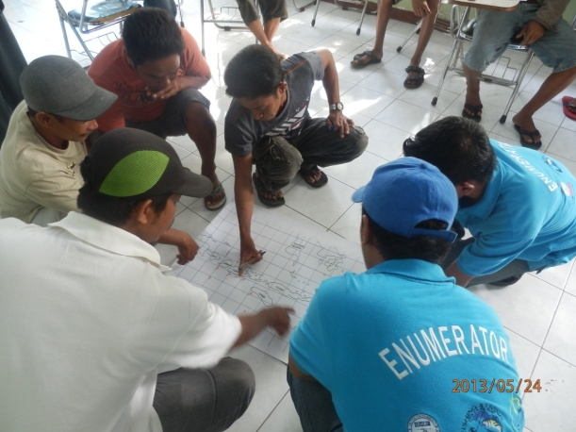
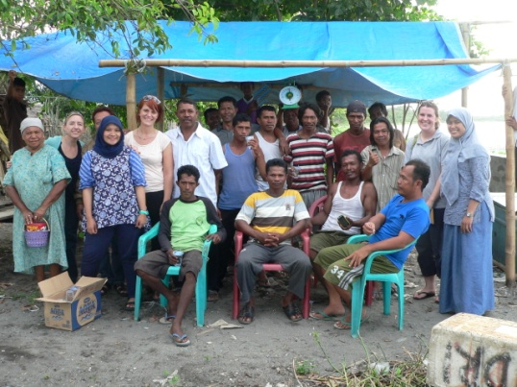
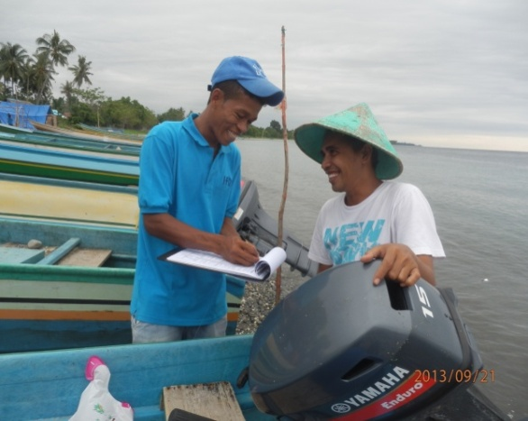
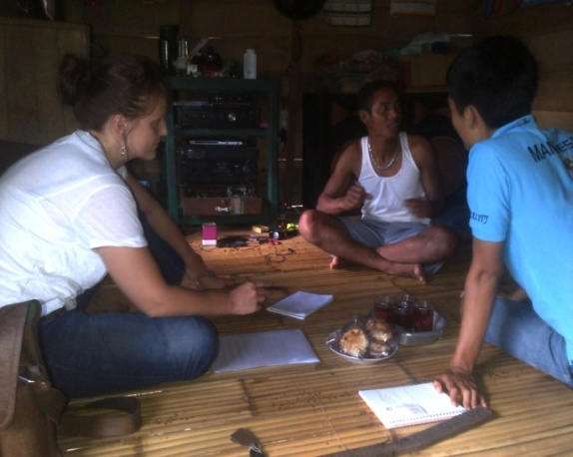
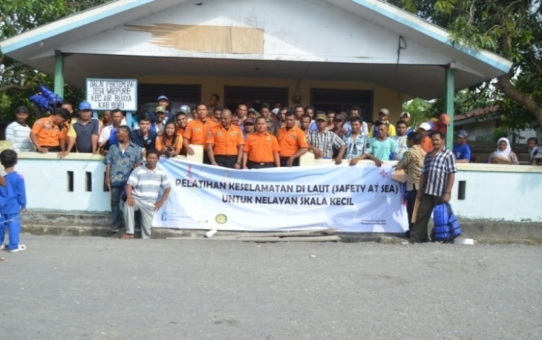
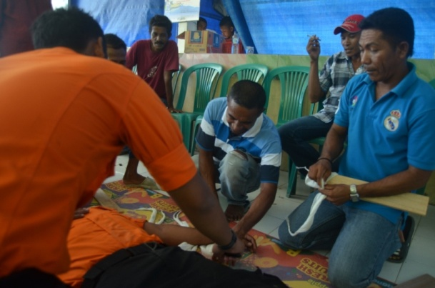
The Fishing & Living Philosophy:
Work in the community with the community. Implementing aspects such as co-management, a fair trade approach, quality improvement, data collection, safety at sea training, etc.
Notes:
1. Co-management is done by bringing together the fishers, local government, local universities, local industry- starting dialogue on how local management of the resource can benefit the fishers
2. Fair trade stipulates that fishers should form groups/ fisher associations. We work with these fisher associations to strengthen their knowledge, support them in moving towards more sustainable practices, empower them to understand more on market, empower them to help themselves
3. Qualioty improvement is used as a method to improve product to market but also to ensure higher and more stable prices to the fishermen. Work is also done on infrastructure improvement- boats, landing sites, water facilities etc
4. Data collection based on RFMO standards, to improve Indonesias abilities to meet its requirements to RFMO data submission, especially related to small scale data which is still very much lacking

Slide 43
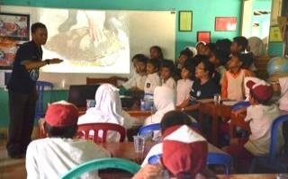
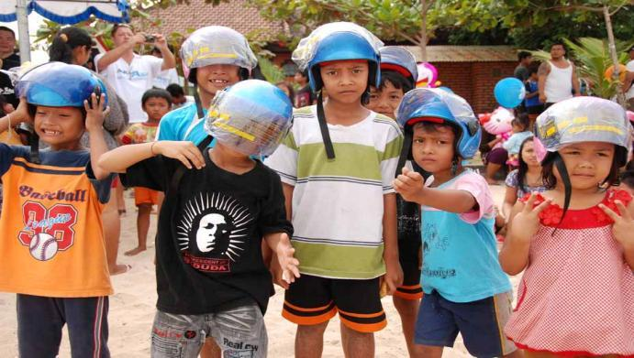
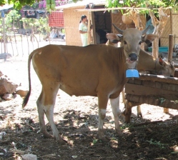
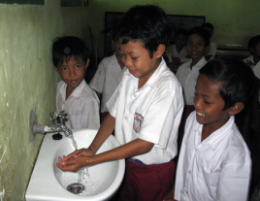
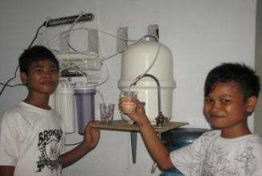
The Fishing and Living Philosophy
The community needs are a priority. Community CSR projects at heart of all work we do: helmets for children, ‘adopt a school’, ‘cows for the commons’, water purification, infrastructure improvement
Notes:
We cannot go to a village and only bring a calipers to measure fish…..we supplement the sustainability approach by bringing aspects and support to the small rural communities and supporting alternative livelihood, infrastructure etc

Slide 44
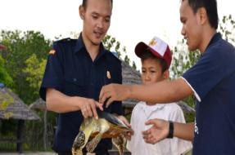
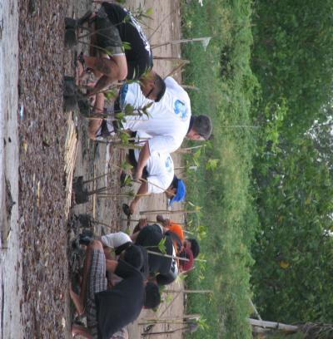
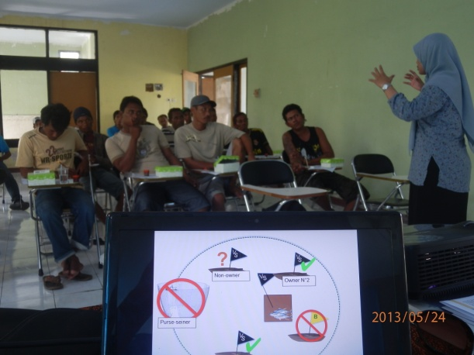
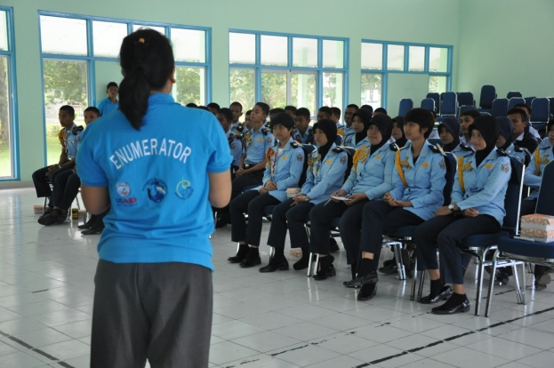


The Fishing & Living Philosophy
Awareness and education is key to success. Awareness campaigns on sustainability, responsible fishing, pollution, endangered, threatened and protected species, safety at sea, etc.
Notes:
Education is no.1 if we want the fisheries to survive into the future.
Education and awareness programs to many sectors: government, fishermen, industry, schools, universities on varied topics.
Showing by doing: getting involved in mangrove rehabilitation projects, beach cleaning activities, recycling etc

Slide 45

Fishing & Living Becomes MDPI
MDPI (Masyarakat dan Perikanan, Indonesia)
An independent Indonesian foundation
Same principles as Fishing & Living
Broader scope, more species, gears, regions
Foundation which supports industry improvements towards sustainability while always focusing on community development

Slide 46




MDPI Approach to FIPs and Sustainability
FIPS and Sustainability
Follows FIP approach towards improvement (following CASS guidelines)
Strong focus on collaboration with industry, government and academia
Partnering with WWF and SFP and integrating both approaches to fisheries improvement
Aiming for MSC while using a Fair Trade approach
Developing an approach that is transferrable to other small scale fisheries and scalable to developing coastal nations around the world

