Slide 2
General Mills Sustainability
Global Sustainability Summit
Sustainable Sourcing
August 13, 2014

Slide 3
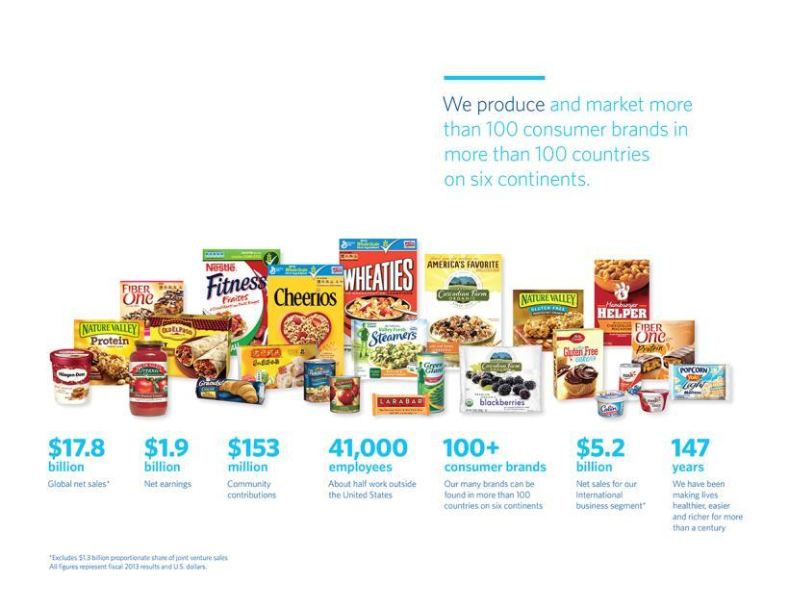
General Mills at-a-glance
Notes:
These numbers give you a better sense of our size and global scope.
As you can see, we truly are a global company. Nearly 30 percent of our net sales come from our International business segment, and about half of our employees work outside the United States.

Slide 4
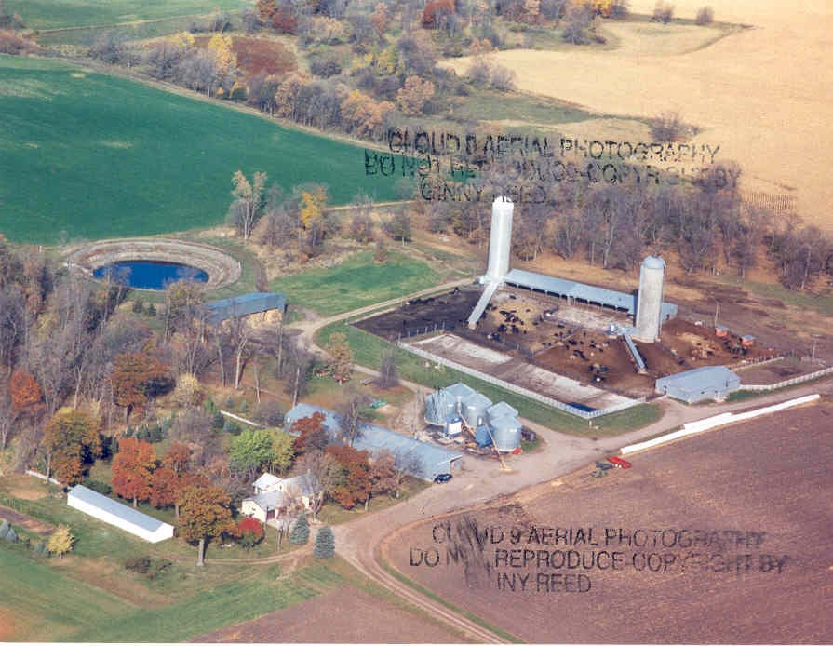
My Farm
Notes:
Slow-talking MN accent, Pragmatic, Sustainability = Business value

Slide 5
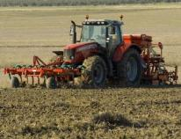
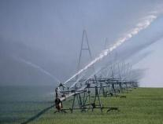

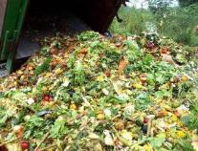
Food’s Big Impact
40%
World’s Land
70%
World’s Water
1/3
Greenhouse Gases
120 Billion Pounds
Food Waste
Notes:
Sustainability is not only an outgrowth of our values, it is an imperative to our business.
As a food company we are a big user of earth’s resources and these resources are increasingly being squeezed.
Providing food to the world:
-Uses 40% of the world’s land
-Uses 70% of the world’s freshwater
-Creates 1/3 of the world’s greenhouse gas emissions; and
-Generates huge amounts of waste.
As a global society we waste more than 30% of the calories produced every year. In a world where 1 billion people go hungry every day, this clearly is NOT the right thing to do.

Slide 6
Crunch Ahead!
Resources
Demand
Notes:
So what we have, is a vicious cycle. On one hand we have accelerating demand. On the other had many of society’s current tools to keep up with this demand are driving a decline in nature’s fundamental ability to produce these resources in the first place. We have a challenge, and our usual way of meeting the challenge only makes the challenge harder.
As I mentioned before, this vicious cycle is part of what’s driving the inflation we’re experiencing right now…today. If you look into the future, it will challenge the “sustainability” of our business.
Remember that these resources we’re talking about are the exact same resources we depend on as a company. When you look at this challenge from a resource perspective, Sustainability is not an option for us. It is not just something nice to do so we have beautiful landscape and interesting animals to observe, although that’s valuable. It is not just a good thing to do for society. It is not just the right thing to do, sustainability is an absolute must if we are to continue to run our business.
Now we wouldn’t be here today if we didn’t believe we can address this challenge. In fact it’s the very reason we’re here today. We are doing some very good work in this area and as you can see we need to do more and we need all of you to be a part of it.

Slide 7
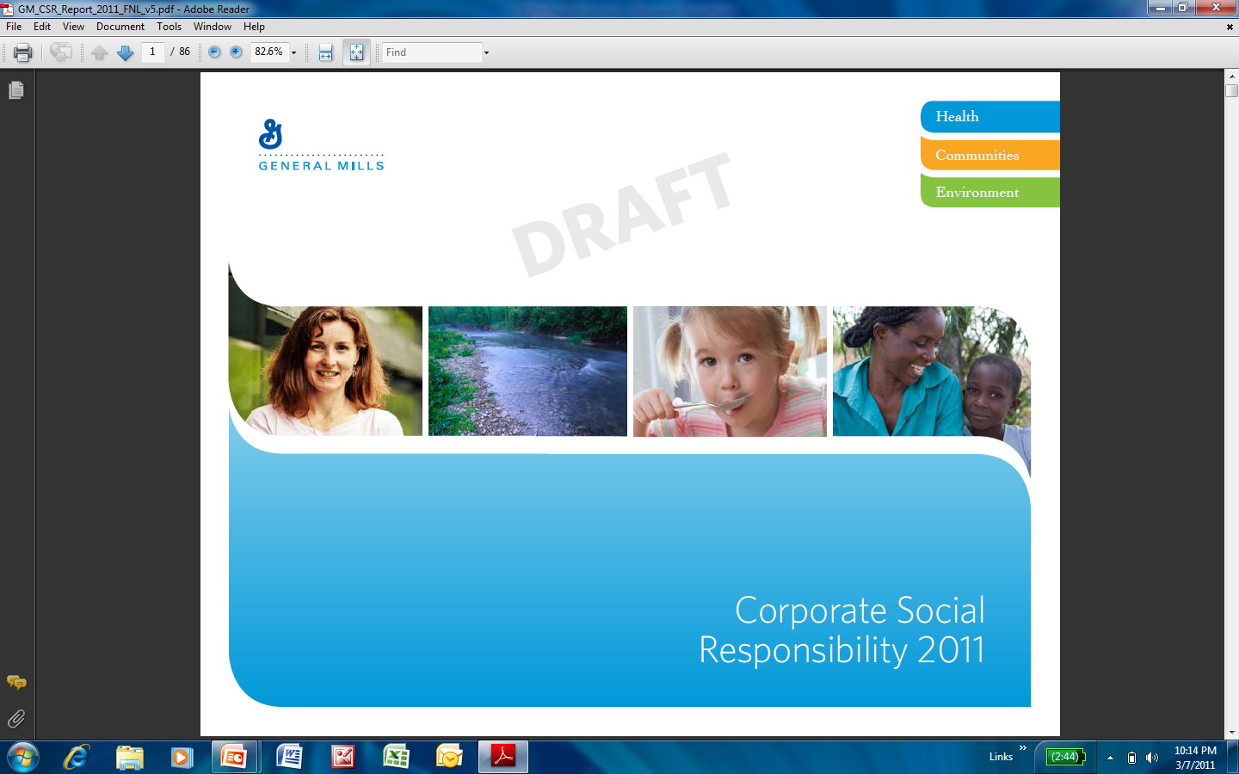
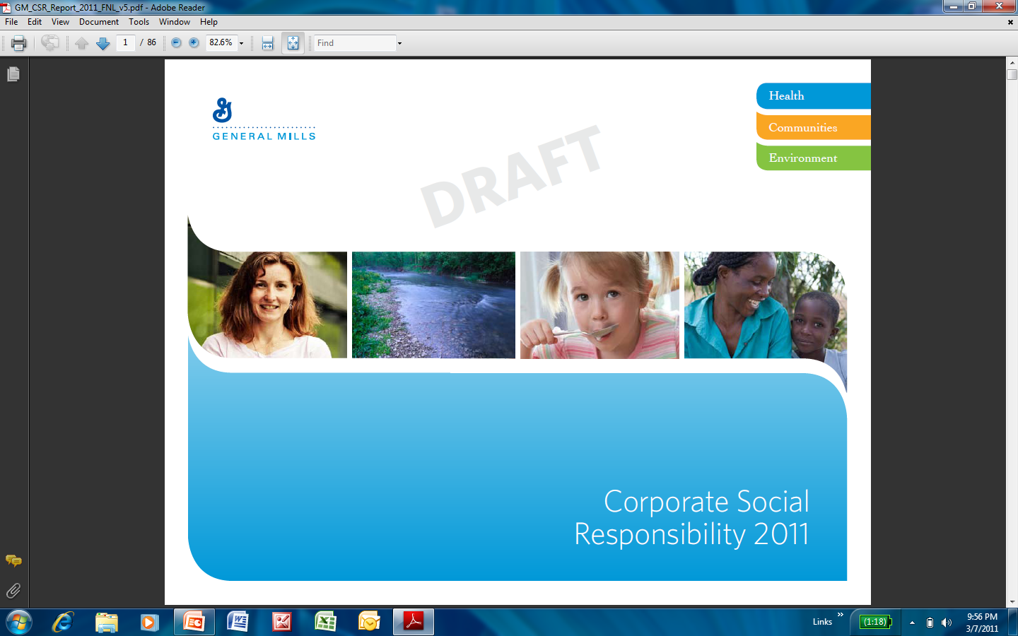
Our Mission: Nourishing Lives
HEALTH
Nourishment we provide
COMMUNITIES
People we serve
ENVIRONMENT
Planet we share
www.csr.genmills.com
Notes:
The efforts -- plentiful and powerful around the world – are grouped in three key areas: health, community and the environment.
The full CSR report, available online, provides rich detail on each segment, but let me give you a taste of each.

Slide 8
Conserve Resources and Strengthen
Communities Upon Which our Business Depends
Economic Efficiencies
Risk Management
Growth
Value Levers

Slide 9
Internal Supply Chain Metrics
F12 Results v F15 Goals
 | Waste (lbs waste/lbs produced) | Water (gallons/lbs produced) | Energy (Kwh/lbs produced) | Greenhouse Gas (m-Tons/lbs produced) | Packaging (% Improved) | Logistics (gallons/ton shipped)
2015 Goals | -50% | -20% | -20% | -20% | 40% | -35%
F12 Total Co | -40% | -10% | -10% | -11% | 52% | -17%
Extend Packaging Metric to 60% by 2015
Volume deleverage -7% F12 v F10
Energy team Big G

Slide 10

Why Sourcing Matters
GHG Emissions Water Consumption
GMI is working on Sustainability programs across:
75% of our GHG footprint
99% of our water consumption

Slide 11
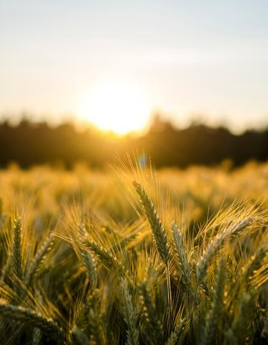
Sourcing
OUR GOAL is to sustainably source the raw materials we use in our products. We are committed to sustainably sourcing 100 percent of our 10 priority ingredients by 2020.
Our Strategies
Increase sustainability of ingredients
Collaborate to improve global water stewardship
Advance socially responsible supply chains
Notes:
In 2013, we committed to sustainably source 100 percent of our 10 priority ingredients by 2020. These ingredients represent 50 percent of General Mills’ total raw material purchases. It’s one important way we’re tackling the areas of greatest environmental impact in our supply chain.
Agriculture uses 70 percent of the world’s fresh water. Conserving water resources is crucial for the environment and for our business. We focus both on conserving water throughout our supply chain and improving the health of the watersheds we access.
By purchasing sustainable raw materials and promoting sustainable processes throughout our supply chain we can start to make a real difference. Because of the scope and scale of our supply chain, we work closely with growers, industry partners, nongovernmental agencies and other stakeholders to improve the sustainability of our value chain.

Slide 12
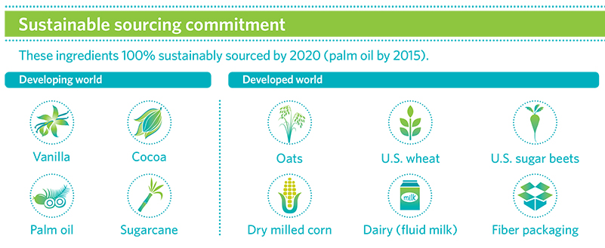
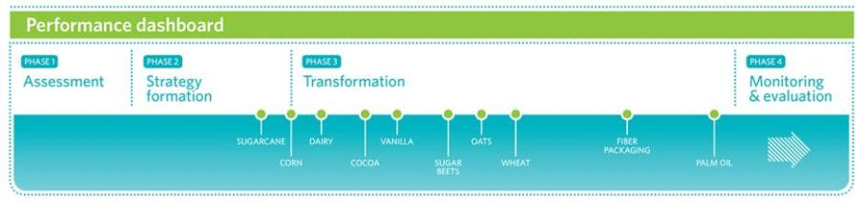
Increasing sustainability of ingredients
Notes:
Here you see our 10 priority ingredients and the progress we’re making toward our 2020 sourcing goal. Nine ingredients are in the transformation phase. Worthy of note: we’re on track to meet our 2015 commitment to source 100 percent of palm oil from sustainable, responsible sources.
Our approach is tailored for each ingredient and geography, whether we’re working with smallholder farmers in developing economies or commodity agriculture in developed economies.
In developed economies, we’re collaborating with industry groups, suppliers and North American growers to increase the sustainability of row crops such as oats, wheat, sugar beets and corn.
Take oats as an example. Oats are an environmentally friendly crop requiring less irrigation, fertilizer, chemicals and other inputs to grow compared with other row crops. General Mills is partnering with industry groups and farmers to increase sustainability in four key North American growing regions: the Snake River Valley in Idaho; the Red River Valley in North Dakota and Minnesota; the Northern Plains; and western Canada (Manitoba and Saskatchewan).

Slide 13

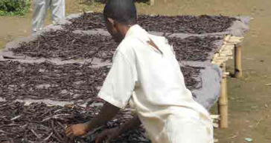







Definitions of Sustainability
Certification
Continuous Improvement
Origin Direct Investment
Self Verification
Sugarcane
Palm Oil
Row Crops: oats, wheat, sugar beets, corn
Dairy
Vanilla
Cocoa
Fiber Packaging
Animal welfare
Notes:
1:30
So what does sustainably sourced mean? It means something different for each one of the categories. GMI does not define what sustainability is. We work with key stakeholders and industry groups to determine it. We have classified the definitions of sustainability into 4 different types. 1) Certification 2) continuous Improvement vs an industry recognized framework 3.) Origin direct investment 4) Self verification. The important thing is to be clear in our communication on what it means.

Slide 14
What is Field to Market®?
A collaborative stakeholder group
  Producers, agribusinesses, food and retail companies, conservation associations, universities, and NRCS
  Established as a 501(c)(3) with staff and headquarters in Washington, DC in 2014
Identifying supply chain strategies to define, measure, and promote continuous improvement for agriculture
  Addressing the challenge of increasing demand and limited resources
Developing and implementing outcomes-based, science-based metrics and tools
  Fieldprint Calculator®, a free, online tool to help growers analyze their operations and help the supply chain explain how food is produced
  National Report on environmental and socioeconomic trends over time for U.S. commodity crops

Slide 15
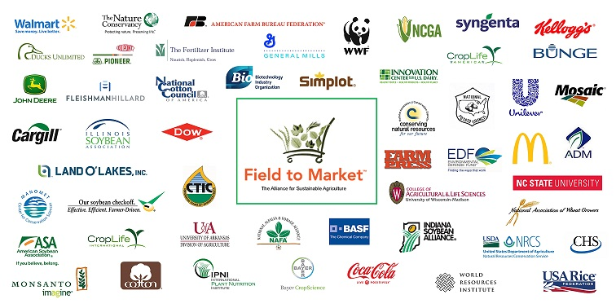
Field to Market Membership

Slide 16
Deliverables: What We Are Doing
National indicators report:
Documentation of overall trends
Supply chain projects:
Direct engagement in continuous improvement
Grower Fieldprints: Individual opportunities for continuous improvement
Public data and models
Collaboratively developed
Outcomes based

Slide 17
Two phase program design
Phase One: 2014 – 2015
  Development of APIs & license agreements for FPC integration with other tools/platforms
  Development of protocols for linking to continuous improvement programs / conservation resources / technical assistance
  FTM supporting “Participation” claims
Phase Two: 2016 – Beyond
  Updated metrics & algorithms (FPC 3.0)
  Integration with a greater number of tools/platforms
  Established partnerships for continuous improvement
  FTM supporting “Measurement” and “Impact” claims

Slide 18
Value of the Field to Market approach
Farmers can evaluate their current footprint and connect with tools, technologies, programs and initiatives that will facilitate continuous improvement within their operations.
Outcomes-based, technology neutral sustainability platform that will help ensure market access for producers while reducing or eliminating a proliferation of supply chain surveys.
Opportunity for commodity organizations to partner with the agricultural supply chain in communicating sustainability messages to the general public.

Slide 19
Value of the Field to Market approach
Grain buyers can report the sustainability of their sourcing areas through a single platform rather than responding to multiple, competing surveys that may not have the same degree of supply chain support or recognition.
Conservation organizations have full confidence in a sustainability framework that can become the focal point of their agricultural work and goals for production and supply chain sustainability.

Slide 20
Value of the Field to Market approach
Food and retail companies can access aggregated data in a pre-competitive fashion to make sustainable sourcing claims.
Agribusinesses have a business opportunity to provide relevant decision support tools, technologies, programs and initiatives to growers.

Slide 21
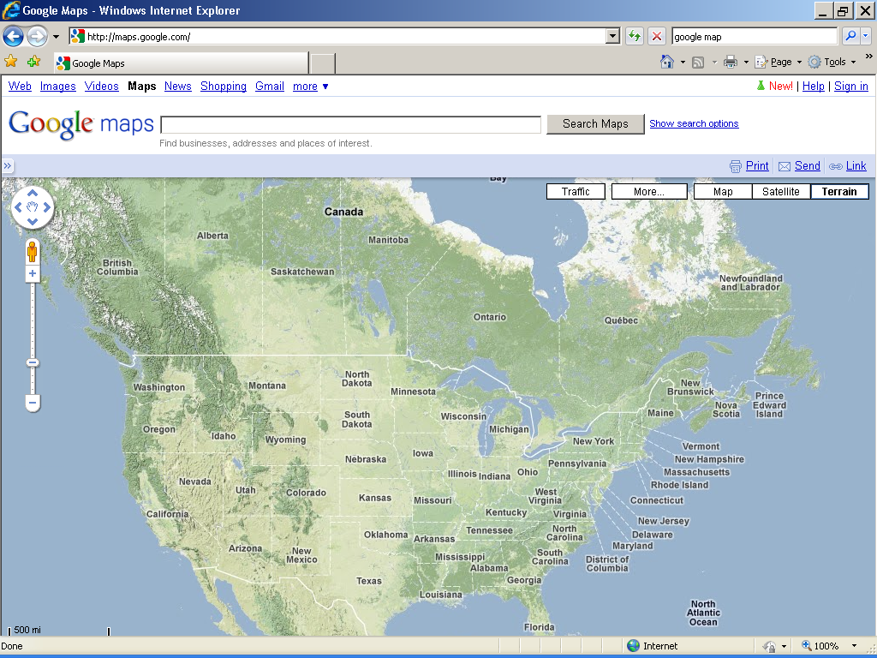

Scale by Validating Key Growing Regions
Using Iseal Claim Methodology
1.Dairy 2.Sugar and wheat 3.Wheat and Sugar 4.Wheat
5. Wheat and Sugar 6.Oats
6
4
2
3
5
1
Notes:
Milk and sugar(beets) from California
Sugar (beets) and some spring wheat from the Red River Valley.
Sugar (beets) and wheat (spring and winter wheat).
Spring wheat from the Northern Great Plains, US leading production area of spring wheat (+50%) and 75%+ of Durham wheat. Also a priority area for WWF US.
Winter wheat from the Central High Plains, US leading production area of winter wheat (~50%).
Oats.

Slide 22

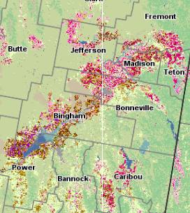

Idaho Regional Engagement: “Paving the Way” for FTM
Opportunities & Incentives for Improvements
Learning’s from Aggregate Information
Potato Processor & Shipper
Field to Market
SE ID Crop & Rotation Analyses
GMI Wheat
Benchmarks
0..
Sugar Processor
Data Facilitators
Grower & Regional Story
Sourcing Region
Sustainable Sourcing Claims Downstream
Efficiency Delivered Through Shared Cost
Grower Pilot Participants Capturing Data with Land.db
(boundaries & participation represent sourcing by GMI & other downstream companies)

Slide 23


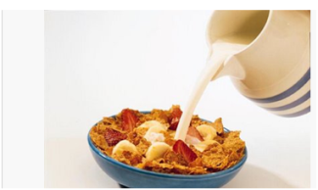



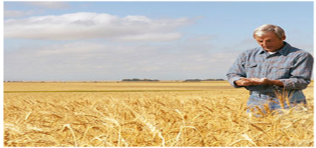












Analyzing the Sustainability Story of Southern Idaho Wheat Production
The Big Picture: Producers Making a Difference
Why measure?
Global attention to agriculture’s impact on the environment is turning to each individual's contribution. We live in a resource constrained world with an increasing population. To meet the future demand for food, we must increase efficient production while sustaining our natural resources.
How are we doing? (Focus areas & progress)
Program is now in it’s fifth year of data collection
Expansion of rotational crops to include spring wheat, winter wheat, potatoes, sugar beets and barley
Individual Grower Reports provide relevant feedback to each grower and Grower Workshops provide guidance for improvements
Did you Know?
Wheat is utilized in dozens of consumer food products and worth more than $500 million dollars to the Idaho economy.
What have we learned? (Understanding trade-offs & opportunities)
Baseline datasets need a minimum of three years of data, with 4-5 years of data preferred
Economics, weather and rotation have major influence on sustainability.
Other contributing factors include quality attributes, pest pressure and
the yield potential of the field
Environmental Performance for Idaho Wheat Production (relative to benchmarks)
21 growers
115,500 acres characterized
4 years of data
6 Field to Market metrics
5 crops characterized
1 farm management recordkeeping system
+11%
+18%
CO₂
Human Element
Soil Carbon
GHG Emissions
+10%
+14%
+16%
Land Use
Water Use
Energy
+10%
+14%
+10%
Nitrogen Use
Yield
Soil Loss
Notes: This evaluation benchmarks pilot participants relative to the 5 year average for the corresponding Crop Reporting Districts. A positive value (upward arrow) suggests improvement in performance and a negative value suggests a decline in performance.

Slide 24
GMI Producer Engagements
Snake River (SE Idaho):
  Wheat:
    115,000 acres
  Wheat, potatoes, sugar beets & barley
  Partner: Syngenta
Western Canada: Manitoba & Saskatchewan:
  Cereal grain: Oats & wheat
  Oil: Canola
  Pulses: Peas & Lentils
  Partners: Pulse Canada, Canola Growers, POGA, Farmers Edge & Agri-Trend
Red River Valley:
  Sugar Beets,
  Partners: RRVSGA & American Crystal Sugar
N Plains:
  Wheat & canola
  Partners: ADM, CHS?
Ohio:
  Wheat, corn & soy
  Mennel Milling, EDF, Syngenta & Farmers Edge
Reed City Michigan:
  Fluid milk
  Michigan Milk Producers Association & DMI

Slide 25
The Sustainability Consortium Alignment Efforts
Proposed Changes to Cereal KPIs
In this prototype you will see changes described below.
No incremental response options- Focus on outcome-based metrics rather than practice-based programs, initiatives, etc.
Alignment of metrics with initiatives- Metrics were added to on-farm KPIs and aligned with tools such as Field to Market Fieldprint Calculator, Cool Farm Tool, and Stewardship Index for Specialty Crops. Initiatives will be added to Additional Guidance or Related Information as appropriate.
Common KPI format with metrics
  Used new on-farm KPIs with metrics across FBA products.
  Used new manufacturing, transportation and packaging KPIs with metrics across sectors.
    Energy use, water use, GHG, worker health and safety
Actionability- Remove all Consumer and Retail Hotspots and KPIs. Remove all Hotspots and KPIs that have limited actionability or only occur in specific circumstances.
  Consumer and Retail Food Waste were removed based on limited actionability by a brand manufacturer.
  Methane Emissions from Rice Production, and Mycotoxin Contamination KPIs were removed due to limited scope of the KPI to the ingredients used.
Redundancy- Remove KPIs if the Hotspots is covered by other KPIs
  Biodiversity Management Plan KPI was removed as the hotspots covered by Crop Protection Chemicals and Deforestation and Land Conversion KPIs.
  Consolidated Human Toxicity and Crop Protection Chemicals KPIs into one.

Slide 26
Thank You & Contacts
Global Responsibility Report
  http://www.generalmills.com/~/media/Files/CSR/2013_global_respon_report.ashx
10 x 20 Press Release
http://www.generalmills.com/Home/ChannelG/NewsReleases/Library/2013/September/sourcing_10
Steve.Peterson@genmills.com

Slide 27
For More Information
www.fieldtomarket.org
  National Report, Calculator, and other resources
Rod Snyder, President
  rsnyder@fieldtomarket.org
Notes:
27

