Slide 1

What Keeps CEOs Awake at Night? Leadership in the Age of Convergence
Pat Walsh
Food Marketing Institute

Slide 2
The FMI Worry Index Tells All
Every issue has intensified in the impact it has on the business.
The economy has reached never before-seen levels (10-point scale, 10=greatest impact)
2004
7.0 Competition
6.4 Interchange fees
6.2 Healthcare costs
5.9 Staffing, hiring, retention
5.6 Energy costs
4.9 Technology investments
4.4 Local/national economy
Current
8.7 Economy
8.0 Competition
7.6 Healthcare costs
7.4 Interchange fees
7.1 Food safety
7.1 Government regulations
6.9 Energy
FMI, The Food Retailing Industry Speaks 2009

Slide 3

Consumer Trends Driving Change
Consumers’ Changing Attitudes
Health and Wellness Focus
Customer ownership of health/wellness
Customer confusion – information transparency need
Government involvement in front of pack labeling
Sustainability/Corporate Social Responsibility Interest
Search for locally made products
Selection of environmentally friendly products
Economizing Behaviors
More meals at home
More use of Private Brands
Less brand/store loyalty

Slide 4
Consumer Trends Driving Change
Shopper Diversity
The Generations Gap: Millennials, Gen Y, Gen X, Boomers, Matures
Targeted offers/products to meet unique desires
Broadened communication methods
Ethnic Diversity
Targeted product/service offerings to meet unique desires
Workforce diversity to serve new customer base
Competitive/targeted retail formats

Slide 5
Consumer Trends Driving Change
The Prepared and Informed Consumer
Coupon usage Up
Greater distribution of coupons
Greater coupon fraud
Price comparison Up
Use of Internet/technology to benchmark prices
Shopping lists usage Up
Fewer impulse purchases

Slide 6
Industry Trends Driving Change
Reduced shopping frequency or transaction size
Drive toward SKU and shelf optimization
Renewed focus on price to maintain market share
Focus on supply chain efficiency to reduce costs
Retailers behaving like Branded CPG Companies
Growth of Private Brands to drive consumer loyalty
Branding shopping experience to drive differentiation

Slide 7
Consumer Behavior Has Shifted
Habitual
Questioning
Limited supply
Unlimited demand
Unlimited supply
Limited demand
Private Label
Private Brands: Better or Equal
Coupons dying
Coupons Reborn
Spending
Saving & Paying Down Credit Cards
Notes:
We’ve witnessed some incredible shifts in consumer behavior during the Great Recession. Prior to the recession consumers were rather habitual in their buying behavior. Now consumers are questioning where they shop and what they buy.
Second, there just is too much supply chasing too little demand. And that’s a very powerful force and makes it very hard as the seller.
Three, we we’re in a world where private label was a fallback, but during the recession retailers started to make private brands, a wonderful option, and a growth opportunity for their businesses. All of a sudden it becomes a very disruptive time for private brands, not private labels.
Five years ago we would have laughed at anybody who thought coupons would even exist five years later. And anybody who was relying on them heavily, we looked down at them as marketers, we said “oh, that’s nineteen eighties, that’s nineties, that’s before, that’s just bad marketing.” And here today, coupon usage is way up, and there are new, very exciting business models being driven by coupons.
And lastly, spending has shifted to saving. And the more consumers save, the less they have to spend.

Slide 8
The Economy (Average: 8.4)
Complex business environment
Shoppers overwhelming desire to save requires response throughout the supply chain.
The need for further efficiencies internally, including personnel decisions
Changes in marketing, merchandising and promotional strategies
Less product and store loyalty. Greater unpredictability.
Changes in the interaction with the customer and their need for information and assistance.
FMI, U.S. Grocery shopper Trends 2010

Slide 9
Recessionary Pressures
Unemploy-ment
Housing Troubles
Lack of Trust
Record decline in consumer confidence, leading to changes in food spending, shopping and consumption
Erosion of investments
Frugality

Slide 10
Consumers Are Feeling the Pinch
Unemployment has been around 10% for more than a year
Personal income declined 1.7% in 2009
First decline since 1949
Combination of unemployment, people working fewer hours and people taking jobs with lower incomes. Unemployed and Under-employed.
Investments and house prices continue to be subdued at best
Leads to decline in confidence in the ability to spend and pay back debt
FMI, U.S. Grocery shopper Trends 2010

Slide 11
Labor Market Trend Was Improving, But June & July Disappointing
Monthly Job Gains/Losses
14.6 MM jobless
July 2010: 9.5% Unemployment
16.5% Underemployed
45% unemployed for longer than 27 weeks
Source: Seasonally Adjusted U.S. Total Non Farm Employment, U.S. Government
Notes:
You’ve seen the job picture…the best we can say so far is that it’s not anywhere near as bad as in the days when we were losing over 500K plus jobs a month; but we need to be creating 200-250K jobs a month to take a solid bite out of the ranks of the unemployed. For three of the past five months we’ve achieved that goal. May saw 432,000 new jobs, but most of those came from the public sector from hiring of U.S. Census workers, so Wall Street didn’t like the numbers. June numbers came in at a disappointing loss of 221,000 as we saw the loss of 225,000 temporary Census workers and job losses in July were 131,000 with the loss of 143,000 U.S. Census workers and the hiring of 71,000 in the private sector.
July unemployment remained at 9.5%.
Including those “underutilized” people that are not working full-time but would like to, the rate stands at almost 16.5% — 1 in 6. And the percent of unemployed longer than 27 weeks is at an alarming 45%.

Slide 12
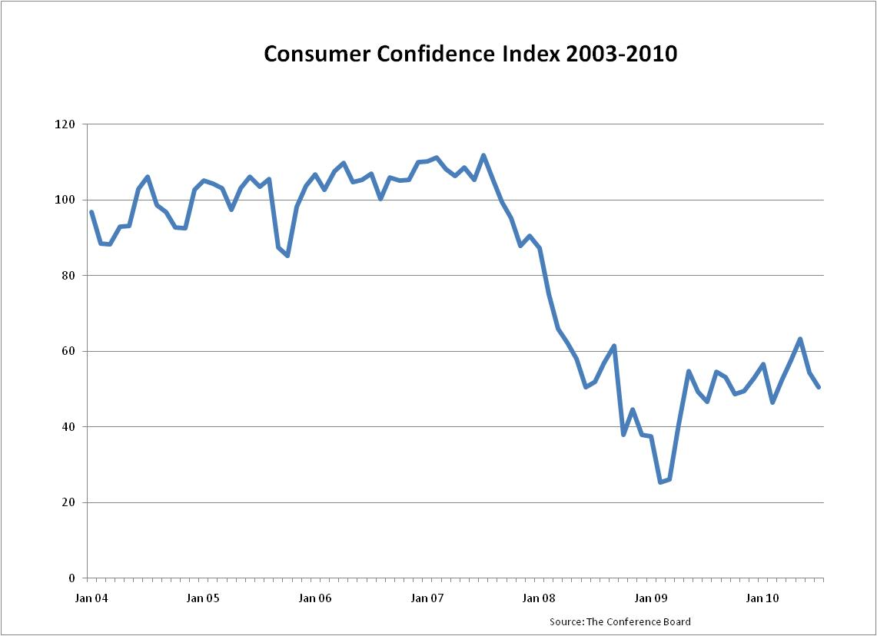
Climbing Back From a 40-yr Low
Low confidence = slowdown in spending
FMI, U.S. Grocery shopper Trends 2010

Slide 13
Recession Driver of Many Changes
Catalyst for new shopping and eating behaviors, “The New Normal”
Eating out less
Saving money at the primary store
Shopping around for sales and specials
Switching primary stores
The new normal requires tactical and strategic understanding amongst retailers and manufacturers
Retool their strategies and brand offerings
FMI, U.S. Grocery shopper Trends 2010

Slide 14
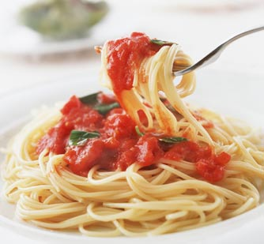
A. Changes in Eating Out
68% of shoppers eat out less in 2010
Dining out down to once a week
52% spend less money when eating out
55% make more home-cooked meals
5.1 meals per week are home-cooked
Even Gen Y is taking to meal preparation
FMI, U.S. Grocery shopper Trends 2010

Slide 15

B. Saving money on groceries
Re-prioritize purchases between wants and needs
Most popular consumer strategies:
Cut back on impulse items
Buy fewer luxury goods
More private brands
Do more with left-overs
FMI, U.S. Grocery shopper Trends 2010

Slide 16
Informed Bargain Hunters Pre-Trip
FMI, U.S. Grocery shopper Trends 2010

Slide 17
…And in the Store
FMI, U.S. Grocery shopper Trends 2010

Slide 18
C. Shop Around for Sales Items
30% of shoppers compare prices across stores
44% visit a variety of stores to capitalize on sales and promotions
The primary store share of both dollars and trips is down, even though total spending and total trips are up.
FMI, U.S. Grocery shopper Trends 2010

Slide 19
D. Switching Primary Stores
Readiness to switch very low (6%)
Great loyalty and levels of recommendation
FMI, U.S. Grocery shopper Trends 2010

Slide 20
Let’s Not Forget the Direct Impact
In addition to the impact of the economy through consumer behaviors, retailers are also affected directly:
Tight credit market
Unemployment benefits
SNAP redemption rates
Erosion of investments
Challenges in growing center store

Slide 21
2. Competition (Average: 8.0)
With gas prices back in line, greater willingness to drive around for bargains
Less primary store loyalty
Top worry remains competition from other supermarkets
Growing influence of value-based formats:
Supercenters
Limited assortment stores
Dollar stores
Warehouse clubs
Drug
FMI, U.S. Grocery shopper Trends 2010

Slide 22
As Prices Fall, So Have Same-Store Sales Trends for These Retailers
Source: Company Press Releases
Notes:
And as prices fall, so do same-store sales trends for these retailers – particularly those with a strong focus on grocery. Price rollbacks are market-wide (i.e., retailers are quick to follow competitive price moves) and they usually yield no competitive advantage for individual retailers — so no inherent traffic gains.
So how do retailers get out of this trend? Can you recall a price war in any industry where anyone other than the customer benefited? Look for opportunities to raise prices on selected items.

Slide 23
Shoppers Buy Food Items All Over
FMI, U.S. Grocery shopper Trends 2010

Slide 24
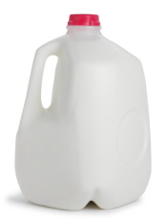
Merchandising and Marketing
Competitive moves require constant evaluation and response
Example:
Aldi announced $0.99 for a gallon of milk in the Dallas area a few weeks ago.
Kroger, Target and Wal-Mart respond within 24 hours.

Slide 25
Need for Service Excellence
Customer service increasingly important to maximize shopper loyalty and basket size. Rising importance of…
Knowledgeable employees
Friendly, courteous service
Fast checkout and personalized service
Advice to shoppers on nutrition and how to cook
Employee training will be key to success.
However, training budgets frequently cut in the battle to manage the bottom line
FMI, U.S. Grocery shopper Trends 2010

Slide 26
Bottom Line Success Means…
Increased competition means greater pressures on pricing and profit margins
FMI research shows that profit leaders control costs. They…
Spend less on salaries
Spend less on benefits
Spend less on training
Have lower debt levels
As a result, most food retailers have had one or more rounds of layoffs or hiring freezes
FMI, The Food Retailing Industry Speaks 2009

Slide 27
3. Healthcare Costs
Retailers have battled increases in costs for years, at times double-digit increases
Average annual increase in health care costs is 8%, affecting 8 in 10 retailers.
New legislation will potentially lead to even greater increases in healthcare spending
To date, 70% of companies have absorbed at least some of the cost increases, but can that last?
FMI, The Food Retailing Industry Speaks 2009

Slide 28
Dealing with Cost Increases
Increase of plan premiums (76%)
Raised co-pays (38%)
Raised deductibles (26%)
Reduced plan benefits (3%)
Increased eligibility requirements (4%)
Health incentives:
Exercise programs (67%)
Preventative screening (59%)
Regular checkups (56%)
FMI, The Food Retailing Industry Speaks 2009

Slide 29
4. Interchange Fees (Average: 7.4)
Credit and debit card interchange fees are a major concern
Average of about 2% per transaction
Average of 0.74 bpts. of total company sales
$126,000 per store annually
During recession, reduced use of credit in lieu of debit and cash
Legislative attention to reduce cost
FMI, The Food Retailing Industry Speaks 2009

Slide 30
5. Food Safety (Average: 7.1)
High on the radar screen of consumers, the industry and the government
Joint industry effort to safeguard food
Product recalls continue to be of big concern
Paid off in highest consumer confidence in food since 2005 at 86%
FMI, U.S. Grocery shopper Trends 2010

Slide 31
In Grocery Stores We Trust
FMI, U.S. Grocery shopper Trends 2010

Slide 32
Social Media Requires Immediacy
Increased media attention for food safety
As shoppers live in a world of immediacy, retailers have to respond fast and with purpose
In-store signage
Past purchases tracking and notification
Media releases on whether product was stocked or not
Result: More shoppers place role of food safety responsibility with food retailers
FMI, U.S. Grocery shopper Trends 2010

Slide 33

Government Regulations (Avg: 7.1)
Feared impact of city, state, federal government on operations
Plastic bags
Nutritional Labeling
Alcohol sales through self-checkout
COOL
Taxes
Healthcare

Slide 34
Conclusion
Retailing has become more complex from growing competitive pressures to changing consumers
Many of the changes appear to be quite durable. A new frugality.
But most are opportunities to connect with new shoppers in innovative ways
And all require the retailing strategies, and most importantly, the right people

Slide 35
CPG Retail Innovations in Past Decade?
Store Formats
Supercenter Expansion
Small Formats
Green Formats
Ethnic Formats
Outdoor Malls
Pop-Up Retailers
Assortment & Services
Shelf-Check-Out
Health Clinics
Food & Food Service
Store Brands
Better-For-You Solutions
Online
Gift Cards
Communication
Digital Media
Social Media
Smart Phone Apps
In-Store Kiosks & TVs
Promotion
Coupon Renaissance
Shopper Cards Fulfill Promise
Gas Savings
Shopper Marketing
Notes:
So a question for you: what are the most significant consumer-packaged goods retailing innovations we have seen in the past decade?
Here is my list that covers innovation in the areas of store formats (from supercenter expansion to small formats to green formats to outdoor (open air) malls (where entertainment and food & drink are part of the offering) to pop-up retailers (like what Toys R US did this past holiday season to take advantage of KB Toys store closings).
And innovation in assortment & services including shelf check-out (at register and with hand-held shopper scanners) to health clinics to food & food service focus to better-for-you solutions to gift cards.
And in communication innovation we saw the advent of digital media to social media to smart phone apps to in-store kiosks and TVs.
And finally, innovation in the area promotion where we have seen an amazing coupon renaissance (aided in part by internet and mobile coupon apps) to shopper cards finally fulfilling their promise to gas saving promotions to shopper marketing.
35

Slide 36
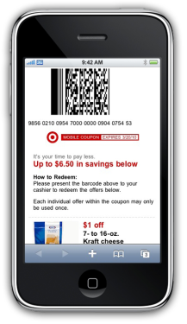
The Couponomy Re-invented Consumers as “Couponomists”
 | Q1 | Q2 | Q3 | Q4
2008 | -7% | -1% | -3% | +10%
2009 | +17% | +33% | +29% | +26%
2010 | +13%
% Change in Manufacturer Coupon Redemption Rates
Top 5 Redemption Growth Methods
Internet +263%
Direct Mail +69%
Magazine +51%
Instant Redeem +48%
Direct Mail Coop +45%
Notes:
We can see how the coupon craze took off as our economy worsened. Inmar reports coupon redemption up 27% in 2009; this reverses a significant downward trends over the past 10 years or more and growth continues into 2010. And, what will likely lead to continued growth is how new coupon methodologies are now available to simplify the process of coupon clipping. It is also interesting to see the internet is delivering the fastest growth, but even direct mail options are growing. Kroger is certainly a leader in the direct mail space, but so too are retailers like BJs and Costco.

Slide 37


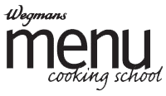







Want to Sell More Groceries & Cookware, Try Cooking Lessons
Source: Company websites
Notes:
Another way for grocers to drive more sales of groceries and cookware is to teach shoppers how to cook. Cooking schools won’t work in all banners or locations and retailers should also explore options for online cooking lessons.
Publix Apron's Cooking School in GA & FL: http://www.publix.com/aprons/schools/CookingSchools.do
The Cooking School at Jungle Jim’s in OH: http://www.junglejims.com/cookingschool/index.asp
Central Market Cooking School in TX: http://www.centralmarket.com/Cooking-School.aspx
Giant’s Cooking School in PA: http://www.giantfoodstores.com/shareddev/sharedcontent/OurStores/CCCS/cookschool.cfm
Schnucks Cooks in MO: http://www.schnuckscooks.com/
Shop Rite Culinary Workshop in CT, NJ, PA: http://www.shoprite.com/Cnt/CulinaryWorkShop.html
Wegmans Menu Cooking School in the State of NY: http://www.wegmans.com
Dierbergs School of Cooking in MO & IL: http://www.dierbergs.com/School/Take+A+Cooking+Class.aspx
Lunds & Byerly’s Everyday Expertise Classes in MN: http://www.lundsandbyerlys.com/events.aspx
37

Slide 38
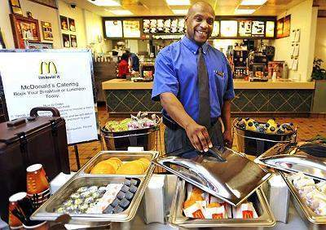

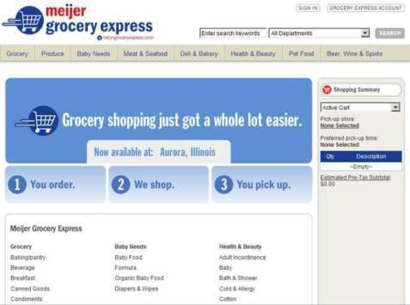

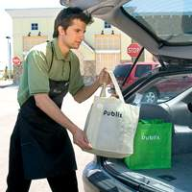
If Your Customers Aren't Coming to You, Go After Them or Make it Easier
Source: Keith Hine/Chicago Sun-Times; Meijer; Publix
Notes:
And if your customers aren’t coming to you as often as you would like, then look for opportunities to take your product to them or simplify the shopping experience! McDonalds has been a poster child for a retailer who is constantly looking for ways to re-invent themselves.
Meier and Publix are testing an online ordering and store pick-up service.
How about Sears rolling out Mygofer.com where Kmart will offer grocery delivery services? The test is currently in Manhattan and The Hamptons on Long Island and is apparently moving to Chicago later this Summer.
Downtown McDonald's delivers and caters
March 26, 2010 By CHERYL V. JACKSON Staff Reporter
McDonald's, now delivered to a conference room near you!
A downtown Chicago McDonald's has begun offering catering to its neighbors in its building at 233 N. Michigan and to adjoining office buildings at 111 E. Wacker and 205 and 225 N. Michigan.
This isn't just a Big Mac delivered to your cubicle. It's Big Macs, Egg McMuffins and a limited selection of other McDonald's breakfast and lunch items, delivered to your conference room, with white-tablecloth service, for a minimum of 10 people.
FULL TEXT: http://www.suntimes.com/business/2123985,CST-NWS-mcdonalds26.article
PHOTO: Darren Remmer is catering manager at McDonald's at 233 N. Michigan. It has begun delivery to nearby locations. (Keith Hale/Sun-Times)
38

Slide 39
Leadership Imperatives
Define: What You Want to be Famous For?
Know: Your Customer… It’s About Shopper Intimacy
Build: A Culture of Innovation…Decisions Driven By Insights
Performance with a Purpose… What Business are You In?
Be Distinct… Differentiation is Not Good Enough!
Win… With The Best Talent, Training and Deliver at Retail

